Slide 1
Drupal

Slide 2
Drupal-WebForm
The Drupal 8 Webform module is a contributed module and is one of the most powerful and flexible modules in Drupal 8.
It is an open source module used for building forms and managing submission.
Drupal Webform is a highly versatile module that is used to build forms and extract information from the users in Drupal websites. For example, we can use the Drupal webform module to create surveys, contact forms, feedback forms and much more.
After submission, this module will allow to send emails to the user and can send notifications to the administrator regarding the submission. There are options to view the submission, publish it as a node, page or block and export the results into a CSV file.
To work with Drupal 8, webforms enable Field API, System module, User module. Without enabling these three modules, the webform cannot be enabled.

Slide 3
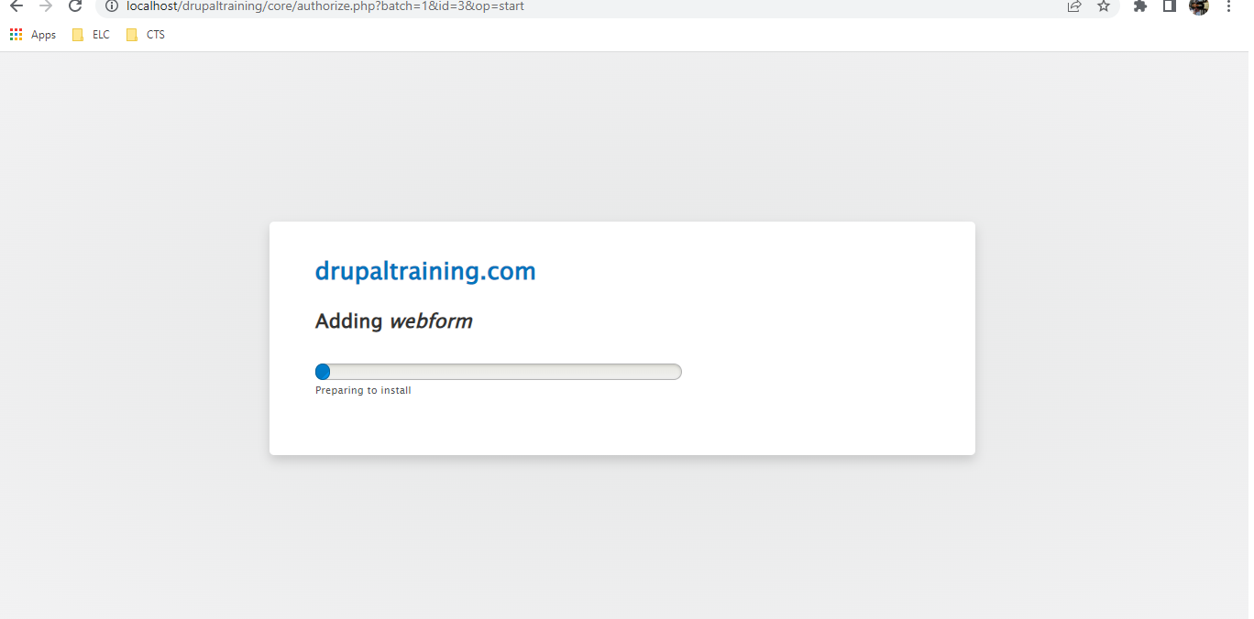
Drupal-WebForm
Install Drupal Webform
- https://www.drupal.org/project/webform

Slide 4
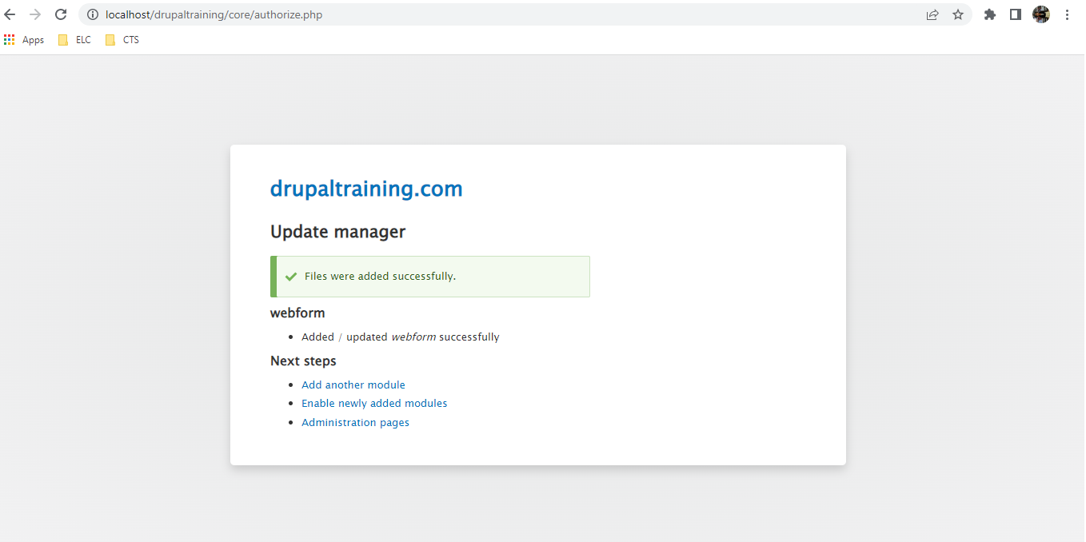
Drupal-WebForm
Install Drupal Webform
- https://www.drupal.org/project/webform

Slide 5
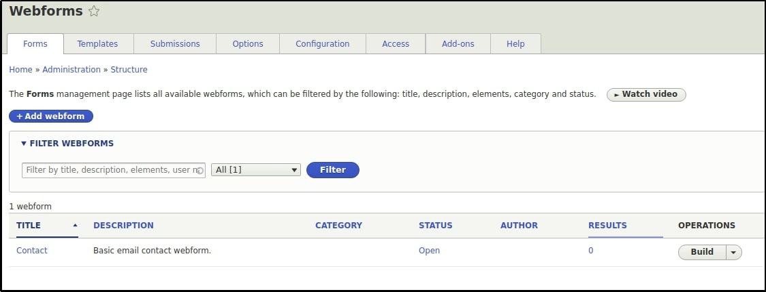
Drupal-WebForm
Create a new Drupal Webform
To create a new Drupal webform, enable Webform UI and Webform Access. Webform UI provides a good user interface for building / maintaining webforms and Webform Access controls the webform nodes. Enable the Webform Node before enabling the Webform Access. Then goto Structure > Webforms.

Slide 6
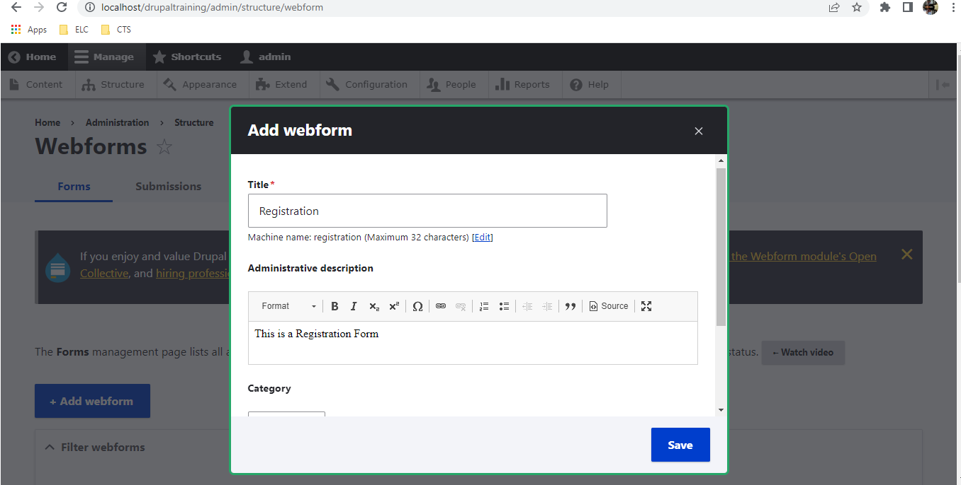
Drupal-WebForm
Create a new Drupal Webform

Slide 7
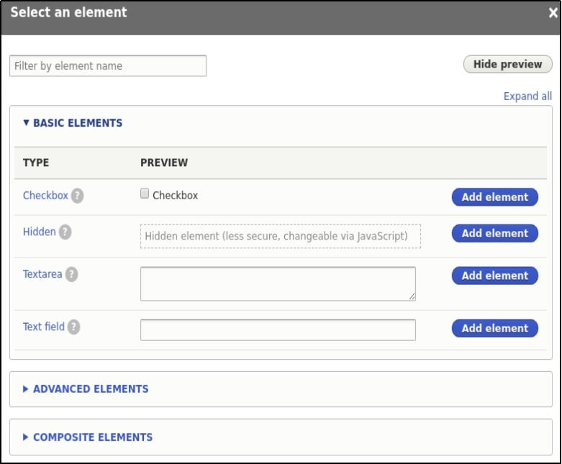
Drupal-WebForm
Create a new Drupal Webform

Slide 8
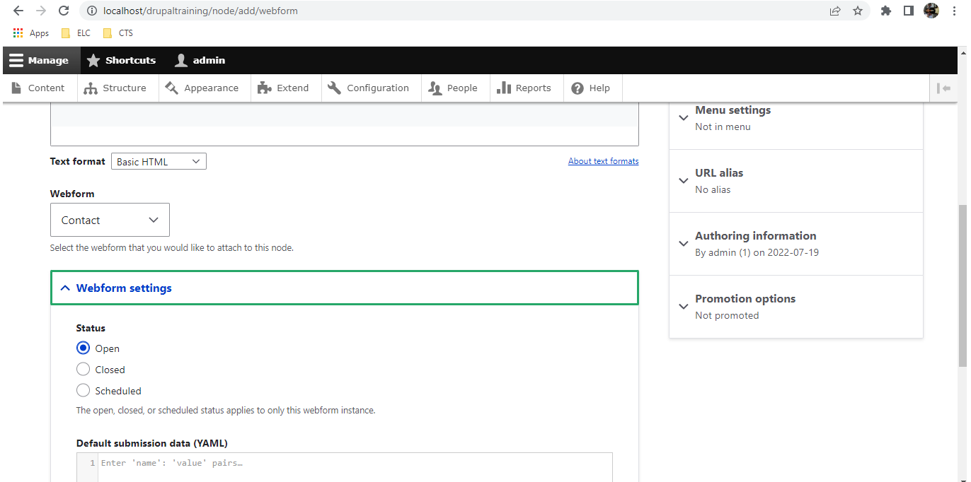
Drupal-WebForm
Create a new Drupal Webform

Slide 9
Drupal-WebForm
Advantages of the Drupal Webform Module
● Drupal Webform module is open source, which means it is free and you only need time to set up and configure the forms.
● You can also perform form validations through hooks, webform handlers or the Drupal Webform Validation module. The Drupal webform validation module adds an extra tab to the node where you an customize and create your own validation rules.
● These Webforms are flexible and allows for customization of fields used in the forms.
● It gives many options in a single installation like sending notifications and mails to the user and the administrator.
● Drupal Webforms makes it easy to export the results of the submission. Users can view the result of the submitted form in the admin interface and can also export the result in CSV format by clicking a single button.

Slide 10
Drupal-WebForm
Exercise::
● Create a Registration form with below fields
First Name
Last Name
Email
Password
Confirm Password
Mobile
Gender
Accept Terms & condition

Slide 11
Q&A

