Slide 1

St. Mary’s Centenary College of Management
Managed by Hyderabad Archdiocese Educational Society (HAES)
(Approved by AICTE and Affiliated to Osmania University) certified by ISO: 9001-2015
P.R.No.9-1-257/1, St. Francis Street, Secunderabad-500003, Telangana, India.
Title:stress management on V Axis Learnings Private Limited
Presented By : G sai Bhargavi
HT. No:1326-23-671-061

Slide 2

1. Introduction
Stress management is the practice of using techniques to control stress levels, ensuring it does not negatively affect health, productivity, or relationships. With rising challenges in personal and professional lives, learning to manage stress effectively has become essential for maintaining a balanced lifestyle.
Objectives of the Study
To identify the primary causes of stress in individuals.
To explore the effects of stress on physical, emotional, and behavioral health.
To evaluate the effectiveness of various stress management techniques.
To recommend strategies for better stress management in organizational or personal contexts.

Slide 3
A. Need and Importance of the Study
Stress has become a pervasive issue in today’s fast-paced world, significantly affecting individuals and organizations. This study explores the critical reasons stress management is essential and highlights its broader implications.
Stress is a leading contributor to chronic diseases like heart conditions and mental health issues.
Effective stress management improves productivity, health, and overall quality of life.
Organizations benefit from reduced absenteeism and higher employee satisfaction.

Slide 4
B. Scope of the Study
Focus on understanding stress management among individuals aged 20-50.
Analyze techniques used in workplaces and educational institutions.
Limited to urban settings for ease of data collection.
The scope defines the boundaries and extent of the research on stress management, outlining the population, settings, and specific areas of focus. It ensures clarity on what the study will and will not address.

Slide 5
C. Limitations of the Study
Every research study has its limitations, which define the constraints that might affect the generalizability or accuracy of the findings. For this study on stress management
This study on stress management is limited by its focus on urban populations aged 20-50, excluding rural, younger, and older demographics, as well as other critical environments like healthcare and domestic settings. Additionally, reliance on self-reported data and short-term analysis may introduce subjectivity and fail to capture cultural, regional, and long-term variations in stress perception and management.

Slide 6
Research Methodology
D. Research Methodology
Research Design: The research design deals with both type of study, nature of study (Descriptive and Exploratory) and type of study (Quantitative and Qualitative).
Data Collection:
Primary Data: Surveys and interviews.
Secondary Data: Journals, reports, and online sources.
c. Sample Technique : Stratified random sampling for professional sectors and collection of sample for designated size (100 respondents from urban settings)
d. Tools of data collection: Stratified random sampling and statistical analysis.

Slide 7
1.Theoretical framework
- Concepts, Theories, and Models: 1.Theoretical Models : a. General Adaptation Syndrome (Hans Selye): It emphasis on physiological response to stress through three stages, which include Alarm, Resistance, Exhaustion.
b. Transactional Model of Stress (Lazarus and Folkman): model emphasizes the interaction between an individual and their environment, focusing on cognitive appraisal and coping strategies. Interaction between individual and environment.
c. Job Demand-Resource Model: - Focuses on workplace stress by balancing job demands and available resources
2.Theoretical framework

Slide 8
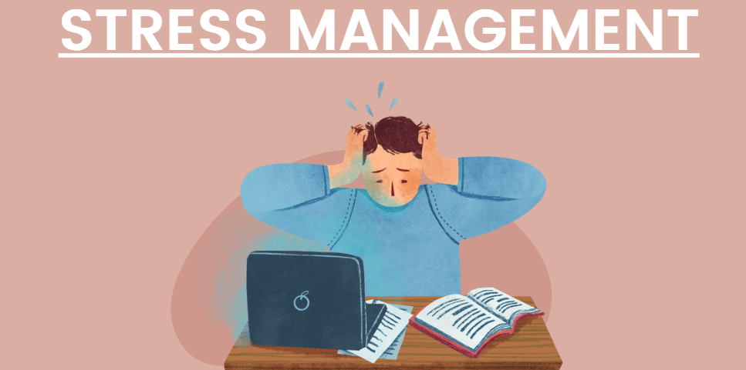
Research Articles:
Impact of Stress on Employee Productivity (National Journal).
Mindfulness in Stress Reduction (International Journal).
Yoga for Stress Relief among Students (National Journal).
Global Workplace Stress Trends (International Journal)
CBT Effectiveness in Stress Management (International Journal).

Slide 9

Company and Industry Profile:
Company Profile: Vaxis Learning is an education technology company founded in 2015, headquartered in Hyderabad . It offers innovative e-learning platforms, corporate training solutions, and K-12 tools with a focus on STEM education. The company uses AI-powered analytics and immersive technologies like VR and AR to deliver personalized learning experiences.
Company and Industry Profile

Slide 10
Data collection method:
Primary Sources: surveys and investor feedback( if applicable)
Secondary Sources: Extracted from HR reports, stress audits, and prior research studies.
Sample Questionnaire
What are the primary factors contributing to your stress in daily life?
How satisfied are you with the effectiveness of the stress management techniques you currently use?
Data Instruments

Slide 11
Descriptive Statistics: Used to summarize and describe the basic features of the dataset (mean, median, mode).
Correlation Analysis: Helps to explore relationships between variables such as stress levels and coping mechanisms.
Regression Analysis: Used to predict the impact of stress management techniques on employee well-being and productivity.
Chi-Square Test: Analyzes categorical data, such as differences in stress levels between various demographic groups.
Factor Analysis: Identifies key stressors or coping strategies based on responses to the survey.
List of Statistical Tools Used

Slide 12
Conclusion
Stress management is vital for individual well-being and organizational success.
Implementing effective techniques can reduce health risks and enhance productivity.
Future research can address broader demographics and cultural contexts.

