Slide 1



HackICAV’18
IoT BASED AUTOMATED EXTERNAL DEFIBRILLATOR AMBULANCE ROBOT USING AERIAL VEHICLE IN SMART CITIES
Submitted by
K. Anil Kumar Reddy 16F25A0203
T.Ramanjineyalu 16F25A0222
P.Sivakumar 16F25A0229
Department of Electrical and Electronics Engineering
GATES Institute of Technology
Gooty, Anantapur District
Andhra Pradesh – 515 401
India

Slide 2
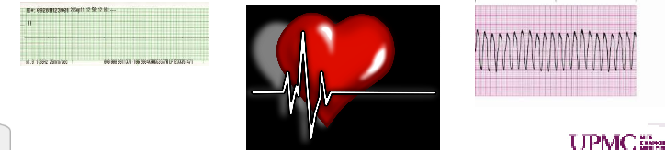
PROBLEM STATEMENT
CARDIAC ARREST
Cardiac arrest happens when your heart stops pumping blood around your body. If someone has suddenly collapsed, is not breathing normally and is unresponsive, they are in cardiac arrest.
Time is a critical issue when dealing with people who experience a sudden cardiac arrest that unfortunately could die due to inaccessibility of emergency treatment.

Slide 3
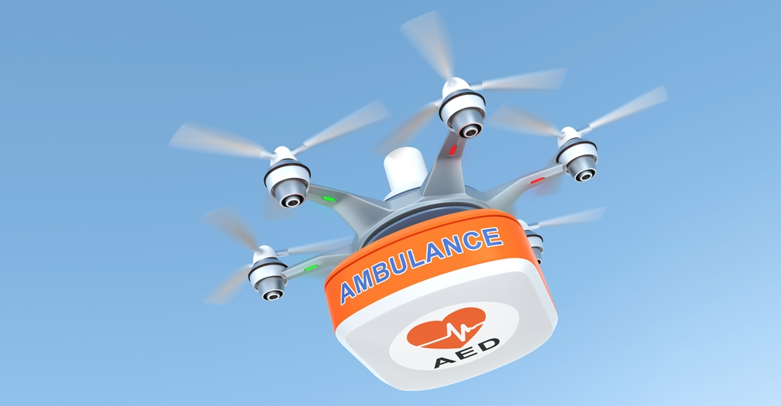
SOLUTION
Time is a critical issue when dealing with people who experience a sudden cardiac arrest that unfortunately could die due to inaccessibility of emergency treatment.
An immediate treatment using automated external defibrillator must be administered to the victim within few minutes.
We are proposing an ambulance robot which brings an automated external defibrillator in a sudden event of cardiac arrest & facilities of various modes operation to save someone’s lives.

Slide 4
AED FOR SMART CITY
Smart cities essentially require the state of art technologies that can provide smart service in various aspects, and Robotic systems are one of the key solutions for such requirements.
Time is a critical issue for cardiac arrest victim and an immediate treatment using automated external defibrillator must be administered to the victim within few minutes.
In India death rate due to cardio vascular diseases rose by around 34% from 116.7 to 209.1 death per one lakh population in the period 1990 to 2016.
Heart disease and stroke were estimated to account for around 15-20% and 6-9% of all deaths in India and US.
Hence we have proposed an ambulance robot which brings an AED in a sudden event of cardiac arrest & facilities of various modes operation to save someone’s lives in smart cities.

Slide 5
AMBULANCE RESPONSE TIME
In practice, the advent time of ambulance is far above the ten minutes. This is mainly due to many obstructions during the process of dispatching.
The delays subjected to various factors such as the long distance, traffic congestion, and difficulty to locate the address.
Any of these delays can lead to increase in response time.
In many cases like life-threatening emergencies the patient needs immediate first aid an medical attention to prevent serious anger.
The fate of patients cannot be influenced by waiting the ambulance but rather could be changed if some treatments could be given with in a few minutes of patient collapse.

Slide 6
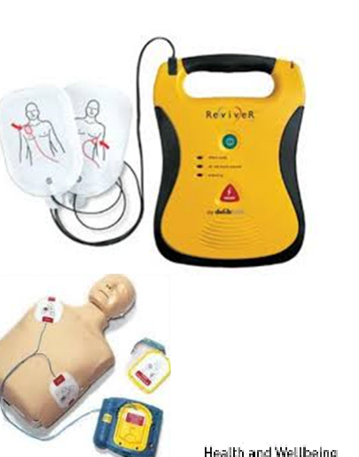
Automated External Defibrillator
Individuals suffering sudden cardiac arrest could be saved if the Automated External Defibrillator is applied within a few minutes.
At the same time, someone who helps the patient must be able to perform CPR (Cardiopulmonary Resuscitation)and attaches an AED to a person in cardiac arrest.
AED is small electronic portable defibrillator that is designed for minimally trained or untrained non-medical personnel.
This device can generate single phase & double phase waveforms.
Single phase waveforms generate a high energy output and double phase waveforms produce a low energy output.
This output shocks heart twice at the same time and decreases the complication caused by the defibrillator.
The helping person needs to call for ambulance immediately even before applying the AED.
AEDs can be located in many public areas and it may take a long time to get an AED at nearest scene of victims because AEDs are not available everywhere.

Slide 7
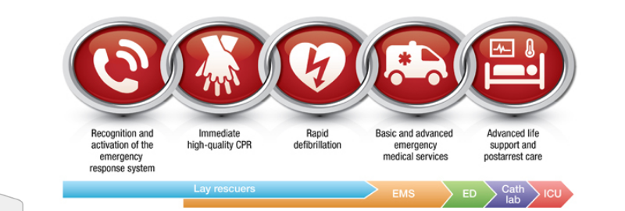
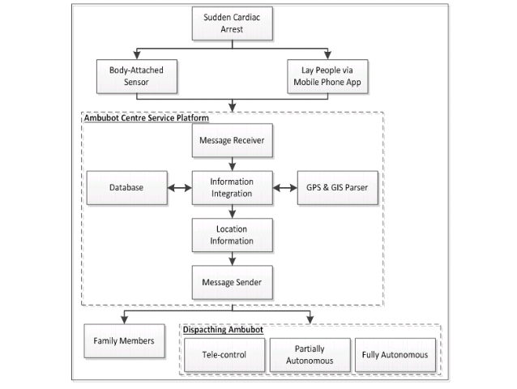
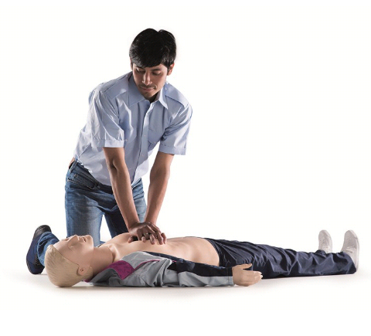

Slide 8
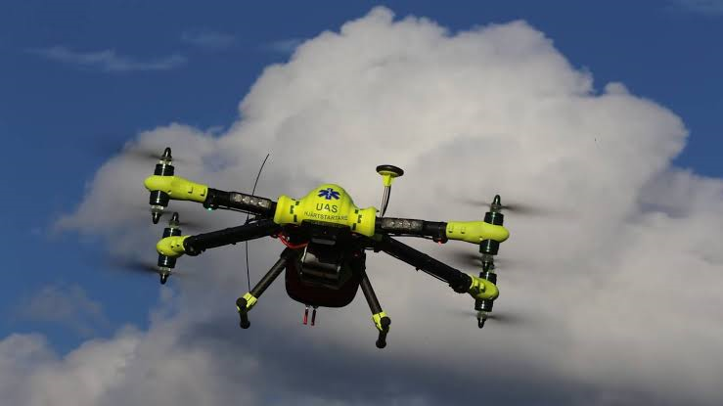
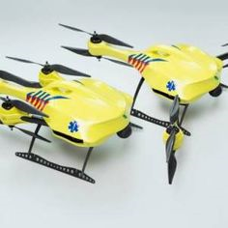
AMBULANCE ROBOT FOR SMART CITY
To keep patient staying alive before the advent of ambulance, we propose an idea of using Ambubot (Ambulance Robot) that could bring an AED.
There are two techniques that can be used to keep victim alive either by attaching a sensor or mobile application.
Whenever one of them is used, they immediately send out warning message and Global Positioning System (GPS) information to the Ambubot center.
The Ambubot center will convert the longitude and latitude co-ordinate into a street map using GPS and GIS parser.
The basic information such as personal contacts and characteristics, blood type, height, weight and photograph to generate the complete information needed for helping victims.
Ambubot center process the data packet, it will generate commands namely a command for dispatching Ambubot from the station to the scene before ambulance arrives and other command for delivering an emergency message to family members via Global System for Mobile Communication.

Slide 9
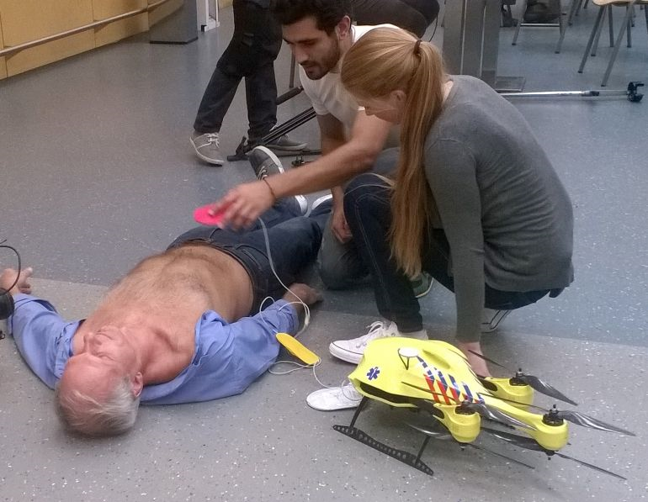
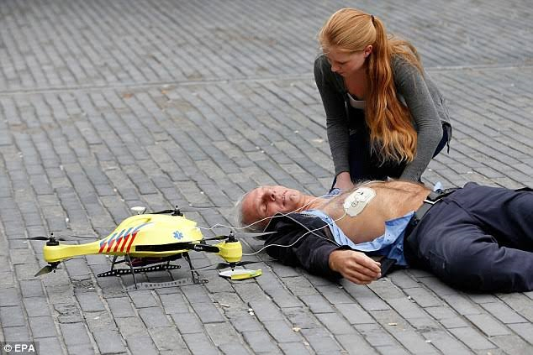
Ambubot center also consider informing ambulance from the nearest hospital after confirmation of the incident.
The hardware body attached sensor mainly consists of a GPS satellite location module, a gyro sensor, a micro processor, a GSM communication module.
The gyro sensor is integrated with Accelerometer x, y, z thus acceptable as fall sensor and it will be concatenated with tag that contains patient identification code.
A patient can be identified by identification code once registered and Ambubot center to help ensure the patients safety .
The microprocessor is in charge of computation and command execution as the main intelligent hardware module.
When gyro sensor sensed that the patients collapse, the microprocessor will transmit a short message to notify family members.

Slide 10
There are various ways of dispatching Ambubot to reach a destination, such as Telecontrol, partially autonomous and fully autonomous.
TELECONTROL OPERATION
Tele-control assists human operator to direct handling Ambubot using a visual display and a control pad.
Ambubot needs a people like driver who is in charge to control the robot with using a remote control device, which resembles a control panel and watch the real-time video stream from two surveillance cameras on Ambubot to navigate, locate, and approach the victim.
PARTIALLY AUTONOMOUS OPERATION
Ambubot utilizes both autonomous functions of the robot and direct handling by human operators.
Human operators should help in accommodating task procedures to the real environment.
Ambubot reports the current situation and displays the motion through streaming video by using cameras mounted, one in front of the body and the other one on the arm.
FULLY AUTONOMOUS OPERATION
Ambubot can move and perform desired tasks in frequently changing environments without continuous human guidance.
In this mode Ambubot executes AED by itself. In our future plan Ambubot will perform CPR as the first aid to save the victim life.
Ambubot grabber has been designed well to be light enough to apply the pads of AED on victims chest.

Slide 11
CONCLUSION
Sudden cardiac arrest occurs when the heart has stopped beating effectively due to an electrical malfunction of the heart.
It occurs instantly or shortly after symptoms appear. Early access to the AED can be a life saving measure in the event of a person suffering in cardiac arrest.
To have the absolute best chance of survival, immediate treatment must be carried out in the first few minutes after a person suffer a sudden cardiac arrest.
The Ambubot is intended to improve on manual search assistance of finding AED with the help of the information technology so that an immediate treatment can be delivered to help victims in cardiac arrest.
There are three dispatching methods of Ambubot to reach location of victim namely telecontrol, partially autonomous, and fully autonomous.
However, telecontrol robot is a major focus of our current research due to the difficulty of implementing other methods in real health care environment.

Slide 12
REFERENCES
[1] H. Ning et al., ‘‘From Internet to smart world,’’ IEEE Access, vol. 3, pp. 1994–1999, Oct. 2015.
[2] R. Jalali, K. El-khatib, and C. McGregor, ‘‘Smart city architecture for community level services through the Internet of Things,’’ in Proc. IEEE 18thInt.Conf.Intell.NextGenerat.Netw.(ICIN),Feb.2015,pp.108–113.
[3] M. Arif, H. Samani, C.-Y. Yang, and Y.-Y. Chen, ‘‘Adaptation of mobile robots to intelligent vehicles,’’ in Proc. 4th IEEE Int. Conf. Softw. Eng. Service Sci. (ICSESS), May 2013, pp. 550–553.
[4] Y.-C. Lin, S.-T. Wei, S.-A. Yang, and L.-C. Fu, ‘‘Planning on searching occluded target object with a mobile robot manipulator,’’ in Proc. IEEE Int. Conf. Robot. Autom. (ICRA), May 2015, pp. 3110–3115.
[5] C.-P. Lam, C.-T. Chou, K.-H. Chiang, and L.-C. Fu, ‘‘Human-centered robot navigation—Towards a harmoniously human–robot coexisting environment,’’ IEEE Trans. Robot., vol. 27, no. 1, pp. 99–112, Feb. 2011.
[6] T. Yonezawa, I. Matranga, J. A. Galache, H. Maeomichi, L. Gurgen, and T. Shibuya, ‘‘A citizen-centric approach towards global-scale smart city platform,’’ in Proc. Int. Conf. Recent Adv. Internet Things (RIoT), 2015, pp. 1–6.

Slide 13


