Slide 1

Open-Source Verilog & GTKWave Tool
Dr. Anil Kumar Gundu

Slide 2
Introduction
Open-Source RTL Verification Tool
  iVerilog is a widely-used, open-source tool for simulating and verifying RTL code.
Compiles and Executes Testbenches
  It is used to compile RTL designs and their testbenches, then run the simulation to check for functional correctness.
Waveform Viewing with GTKWave
  The resulting simulation waveforms can be visualized using the companion open-source tool, GTKWave.
Cross-Platform Support
  Both iVerilog and GTKWave can be installed and run on Windows, macOS, and Ubuntu.
Ubuntu: The Recommended Environment
  Installing and using these tools on Ubuntu is highly advantageous.
  It provides a smoother workflow and seamless integration with other essential synthesis and implementation tools.

Slide 3

Installing iverilog and Gtkwave
iverilog is the tool which is open source for logic verification of the RTL code
Verilog compiler and Verilog simulator
sudo apt install iverilog
For waveform viewing Gtkwave :
sudo apt install gtkwave

Slide 4
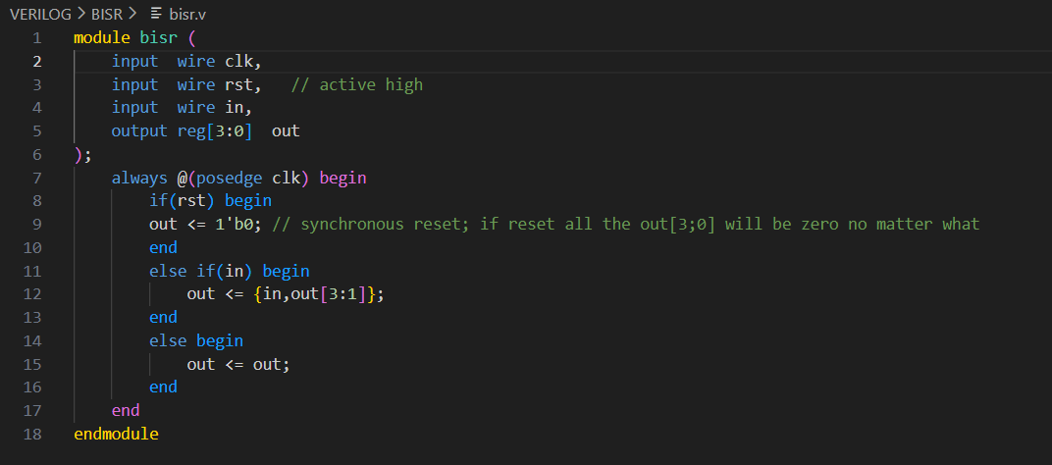
File name extensions and simulation process
Verilog code is written and saved with a file extension .v
I am using visual studio code editor with Verilog extension attached to VS Code
Steps to follow :
  Compile
  Simulate
  Waveform view (use gtkwave)

Slide 5

Commands
Compile the Verilog file and testbench Verilog file:
  iverilog -o sim.vvp dff_sync_reset.v tb_dff_sync_reset.v
After running this command, a file with bytecode format will be formed with name sim.vvp
iverilog does NOT produce an executable directly. Instead, it creates a simulation bytecode file with extension .vvp. This file contains the compiled Verilog design in a format that the vvp runtime can execute.
Run the byte code file: The bytecode file .vvp which is formed to be simulated
  vvp sim.vvp
Waveform viewer with gtkwave
  After the previous step, a file with extension .vcd is formed this can be visualized with gtkwave
After above 2 steps
Command : gtkwave file_name_formed.vcd

Slide 6
Verilog – Important points
Wire :
Represents a physical connection; cannot store values.
Can be assigned continuously using assign or driven by module outputs.
Always reflects the current value of what drives it.
Reg :
Can store a value inside always or initial blocks.
May represent combinational or sequential logic depending on the always block.
  always @(*) → combinational
  always @(posedge clk) → flip-flop (sequential)
Cannot be driven by assign; only assigned procedurally.

Slide 7
Appendix

Slide 8
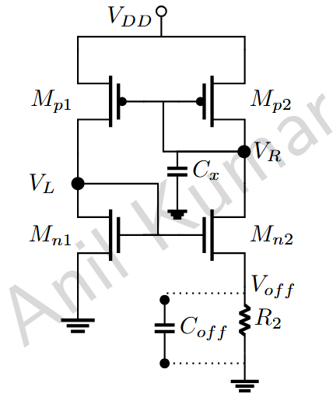
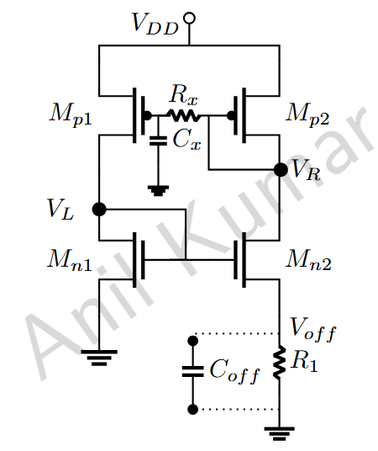
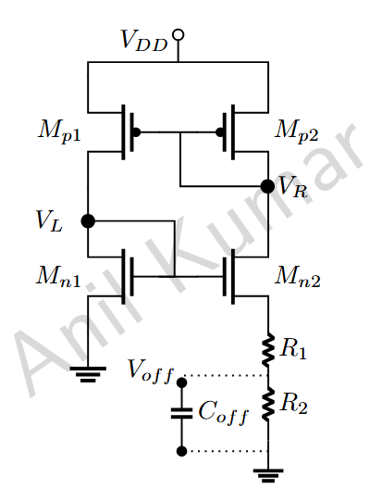
NMOS Transconductance Characterization (V_{DS} is 1.8V and V_{GS} is varied from 0V to 1.8V)
We often approximate the I_{DS}−V_{GS} relationship with a square law, but in reality, the current scales with V_{GS} to an exponent typically ranging from 1 to 2. This non-ideal behavior means that relying on the simple square law equation will result in significant deviation in the calculated transconductance g_{m}.

Slide 9



















Memory Architecture

Slide 10

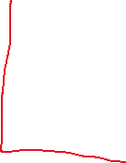













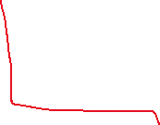




Memory Architecture : 512 words*74bits with mux8

