Slide 1

The Beta-Multiplier: A Step-by-Step Guide to Understanding
Dr. Anil Kumar Gundu

Slide 2
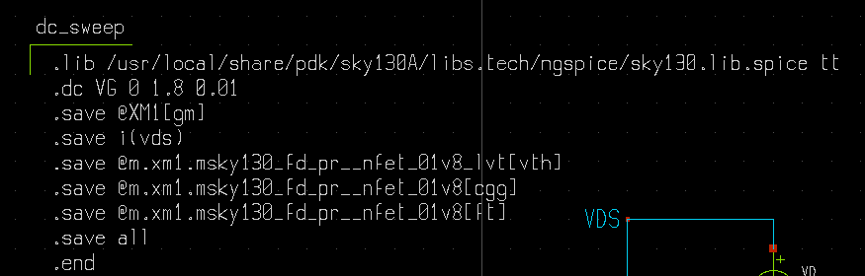
Important Points / Notes for the technology file incorporation SKY130A
Pick the symbols either of the paths :
/usr/local/share/pdk/sky130A/libs.tech/xschem/sky130_fd_pr/
or
/usr/local/share/pdk/sky130B/libs.tech/xschem/sky130_fd_pr/
But make sure that library you are directing for the symbols you chose from above paths should be
.lib /usr/local/share/pdk/sky130A/libs.tech/ngspice/sky130.lib.spice tt
tt means typical-typical corner (use appropriately the desired corner)
Anil Kumar Gundu

Slide 3
A Systematic and Simplified View of Beta-Multiplier
One way to bias the devices M_{n1} and M_{n2} is to push the same current to both devices
How can this be done? Use a matched current mirror (pmos in this case) as it will make sure that M_{n1} and M_{n2} carries same current
We have two options to push same current to the devices M_{n1} and M_{n2} (shown below left and right):
Which option works without any problem
Option-1
Option-2

Slide 4
A Systematic and Simplified View of Beta-Multiplier – Option 1
It’s a positive feedback loop. The loop gain is larger than 1.
The loop gain and related analysis is shown below.
The open loop gain in this case is strictly greater than 1 for any K > 1

Slide 5
A Systematic and Simplified View of Beta-Multiplier – Option 2
It’s a positive feedback loop. But the loop gain is smaller than 1.
The loop gain and related analysis is shown below.
The open loop gain in this case is strictly less than 1 for any K > 1
This loop effectively helps in keeping loop gain less than 1

Slide 6
Beta-Multiplier at a Glance

Slide 7
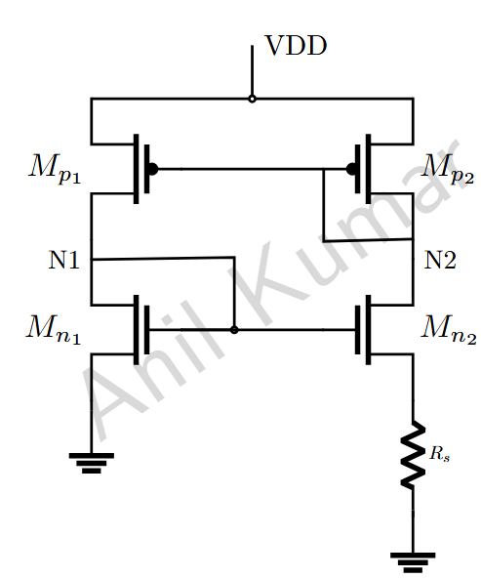
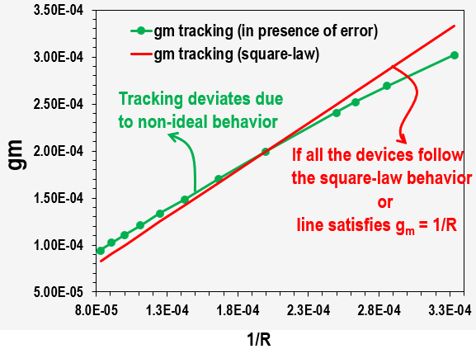
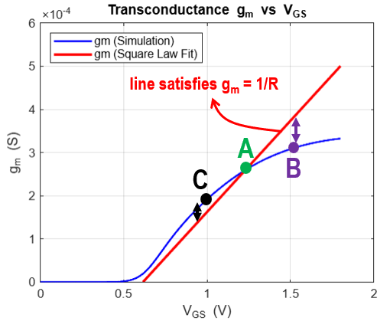
Gm Tracking: Off-Chip Resistor Impact
Let us say, for a given sizing of the devices, transconductance (gm) perfectly tracks the inverse of the off-chip resistor (R), meaning g_{m}=1/R and sets the operating point at ‘A’.
Here's how variations in the resistor R affect the operating point and transconductance:
If the resistor R increases to 2R:
Ideally, the current in device M_{n2} should halve and this current will be mirrored to M_{p1}
However, the operating point of M_{n1} shifts along the blue contour to 'C’.
This indicates that the actual gm is higher than its expected value (which should be 1/(2R)).
Similarly, If the resistor R decreases to R/2. The operating point moves towards 'B’.
In this scenario, gm decreases, or. the devices may even move out of saturation
W/L
4(W/L)
Anil Kumar Gundu
L is chosen such that the CLM is minimum
Anil Kumar Gundu
Characterized using opensource skywater 130nm PDK

Slide 8
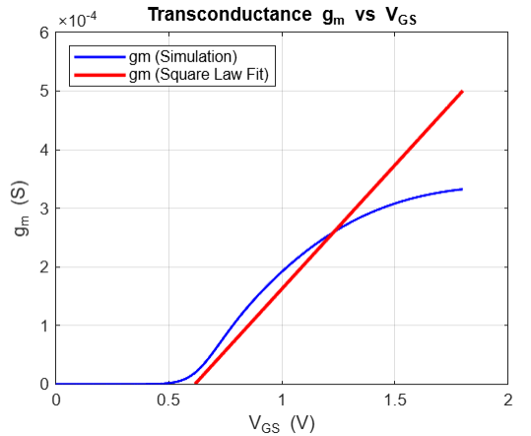
Gm Tracking: Off-Chip Resistor Impact
If the off-chip resistor is increased or decreased, will this gm still be tracked accurately, if not how the error is going to behave.
Let us say, for a given sizing of the devices, the gm is perfectly tracked and the gm = 1/R for the off-chip resistor of R. Now let’s
line satisfies g_{m} = 1/R
Tracking deviates due to non-ideal behavior
If all the devices follow the square-law behavior
A
Anil Kumar Gundu
B
C
or
line satisfies g_{m} = 1/R

Slide 9
Simulations (SKYWATER 130nm PDK)
R = 1/g_{m}
R = 2.7 kohms
g_{m} < 1/ R
M_{n2} moving out of saturation, if R < 2.7 kohm
R = 5 kohms
Anil Kumar Gundu
Anil Kumar Gundu
g_{m} > 1/R
R = 15 kohms
R = 10 kohms
g_{m} > 1/R

Slide 10
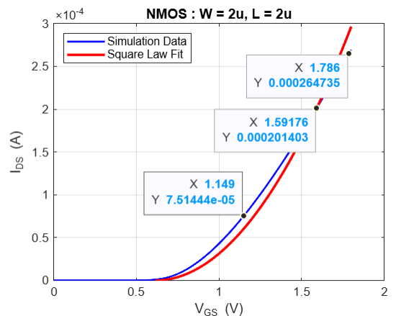
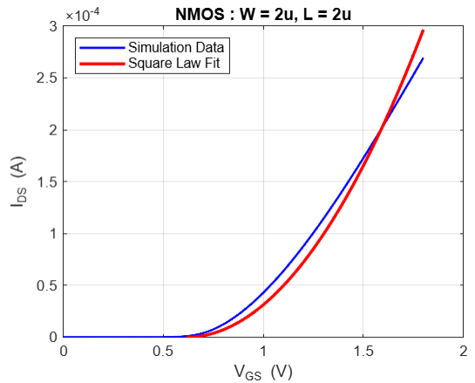
NMOS: W/L is (2um/1um) and VDS is 1.8V and VGS is varied from 0V to 1.8V
Anil Kumar Gundu
Anil Kumar Gundu
Drain-to-source current higher than the modelled square law
Drain-to-source current lower than modelled square law
Threshold Voltage (Vt) = 603.456 mV

Slide 11
NMOS: W/L is (2um/1um): Transconductance plot and square law fit
Region - 2
Threshold Voltage (Vt) = 603.456 mV
Little deviation from square law model
Larger deviation from square law model
Anil Kumar Gundu
Region - 1
In this region, the transconductance matches the square-law behavior, indicating the device operates within the ideal square-law regime of the I–V characteristics.

Slide 12
NMOS Transconductance Characterization (V_{DS} is 1.8V and V_{GS} is varied from 0V to 1.8V)
When varying the current in a MOS device of a given size (from maximum to minimum or vice versa), the transconductance aligns with the ideal square law at a particular current value. The further the current moves from this point, the greater the error or deviation
Threshold Voltage (Vt) = 603.456 mV
We often approximate the I_{DS}−V_{GS} relationship with a square law, but in reality, the current scales with V_{GS} to an exponent typically ranging from 1 to 2. This non-ideal behavior means that relying on the simple square law equation will result in significant deviation in the calculated transconductance g_{m}.

Slide 13
NMOS Transconductance Characterization (V_{DS} is 1.8V and V_{GS} is varied from 0V to 1.8V)
When varying the current in a MOS device of a given size (from maximum to minimum or vice versa), the transconductance aligns with the ideal square law at a particular current value. The further the current moves from this point, the greater the error or deviation
Threshold Voltage (Vt) = 603.456 mV
We often approximate the I_{DS}−V_{GS} relationship with a square law, but in reality, the current scales with V_{GS} to an exponent typically ranging from 1 to 2. This non-ideal behavior means that relying on the simple square law equation will result in significant deviation in the calculated transconductance g_{m}.

Slide 14
Appendix

Slide 15
PMOS Critical Data : Threshold Voltage
Threshold voltage of the nmos (130nm google SKY130A) devices are extracted at a nominal temperature of 27ºC for the following devices (TT corner):
Width = 1um and L = 0.15um
Device | Device | VDD (max) | Type | Threshold Voltage (mV)
pfet_01v8 | PMOS | 1.8 | Nominal | 510.3
pfet_01v8_hvt | PMOS | 1.8 | High V_{t} | 660.9
pfet_01v8_lvt | PMOS | 1.8 | Low V_{t} | 282.5
pfet_01v8_nf | PMOS | 1.8 | Nominal V_{t} (with fingers) | 510.3
pfet_01v8_hvt_nf | PMOS | 1.8 | High V_{t} (L =0.35u with fingers) | 775.6
pfet_01v8_lvt_nf | PMOS | 1.8 | Low V_{t} (with fingers) | 282.5
More details on the device voltages and their characteristics, refer
https://skywater-pdk.readthedocs.io/en/main/rules/device-details.html

Slide 16
NMOS Critical Data: Threshold Voltage
Threshold voltage of the nmos (130nm google SKY130A pdk) devices are extracted at a nominal temperature of 27ºC for the following devices (TT corner):
Width = 1um and L = 0.15um
Device | Device | VDD (max) | Type | Threshold Voltage (mV)
nfet_01v8 | NMOS | 1.8 | Nominal | 769.2
nfet_03v3_nvt | NMOS | 1.8 | Native V_{t} | 0
nfet_01v8_lvt | NMOS | 1.8 | Low V_{t} | 570.48
nfet_01v8_nf | NMOS | 1.8 | Nominal V_{t} (with fingers) | 769.2
nfet_01v8_esd_nvt_nf | NMOS | 1.8 | Native V_{t} (with fingers) | 686.5
nfet_01v8_lvt_nf | NMOS | 1.8 | Low V_{t} (with fingers) | 570.48
Nfet_20v0_nf | NMOS | 20 | Zero V_{t} | 0
More details on the device voltages and their characteristics, refer
https://skywater-pdk.readthedocs.io/en/main/rules/device-details.html

Slide 17
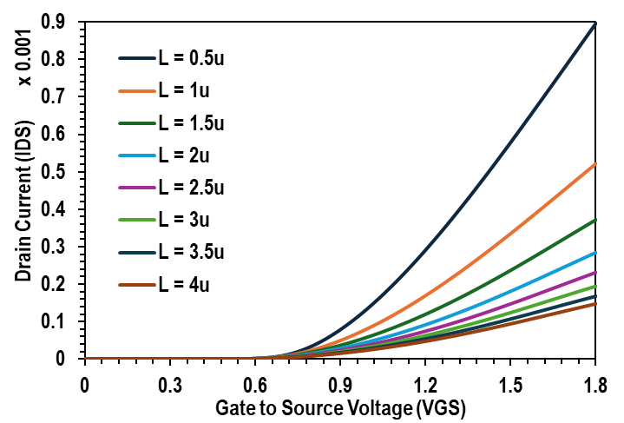
NMOS: Square Law Fitting (Ids vs Vgs)
Channel length of the NMOS is varied for an NMOS with width of 4um and then the square law equation is fitted.
Approximately the Vth is chosen (approximately chosen) and checked the R² value.
Device is forming mostly square law
Length (µm) | K | R²
0.5 | 0.000537 | 0.9967
1 | 0.000307 | 0.9975
1.5 | 0.000217 | 0.9983
2 | 0.000165 | 0.9985
2.5 | 0.000134 | 0.9986
3 | 0.000113 | 0.9986
3.5 | 9.71e-05 | 0.9986
4 | 8.53e-05 | 0.9987

Slide 18
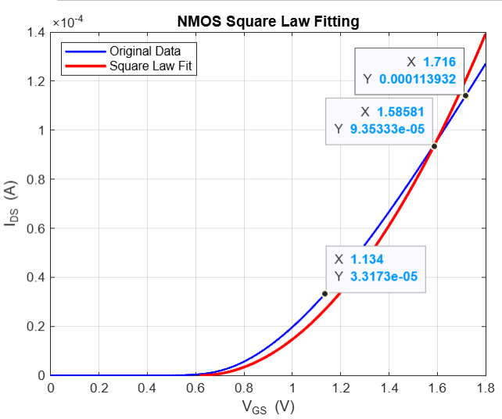
NMOS: W/L is (1um/1um) and VDS is 1.8V and VGS is varied from 0V to 1.8V
Define an Operating Point: First, establish a specific operating point for the MOSFET by determining values for gate-to-source voltage (V_{GS}​), drain current (I_{DS}​ ), and drain-to-source voltage (V_{DS}​).
Differentiate I_{DS}​ with respect to V_{GS}​ : The transconductance (gm​) is fundamentally the rate of change of the drain current (I_{DS​}) concerning the gate-to-source voltage (V_{GS}) around the chosen operating point. Mathematically, it's expressed as g m​ = ∂V_{GS}/∂I_{DS}​ .
Utilize Square-Law Approximation for Analysis: To gain insight into gm​ , you can fit the measured or simulated I_{DS}​ vs. V_{GS}​ data to a square-law equation. This comparison helps to assess whether the actual I_{DS}​ is changing more slowly or quickly than predicted by the ideal square-law model, indicating if g m​ is underestimated or overestimated.

Slide 19
NMOS: Square Law Fitting (Ids vs Vgs)
Channel length of the NMOS is varied for an NMOS with width of 4um and then the square law equation is fitted.
Approximately the Vth is chosen (approximately chosen) and checked the R² value.
R² = 0.9967
R² = 0.9967
R² = 0.9967
R² = 0.9967
R² = 0.9967
R² = 0.9967
R² = 0.9967
R² = 0.9987

Slide 20
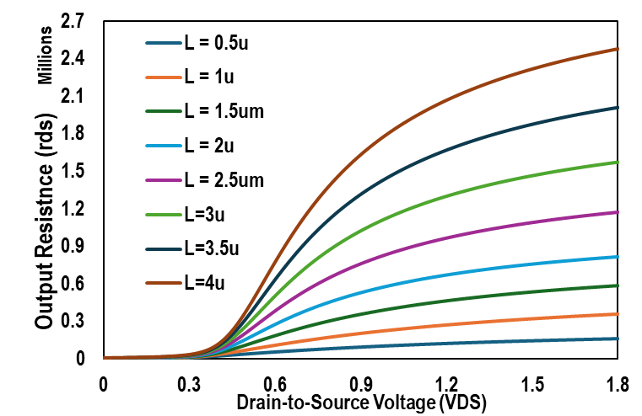
NMOS: Drain-to-Source Resistance
Channel length of the NMOS is varied for an NMOS with width of 4um.
Rds is plotted for various channel lengths.

Slide 21
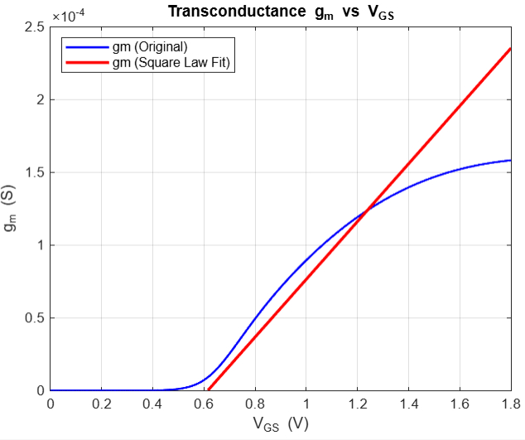

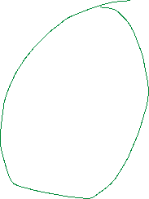




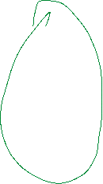
NMOS: W/L is (1um/1um) and VDS is 1.8V and VGS is varied from 0V to 1.8V
We often approximate the I_{DS}−V_{GS} relationship with a square law, but in reality, the current scales with V_{GS} to an exponent typically ranging from 1 to 2. This non-ideal behavior means that relying on the simple square law equation will result in significant deviation in the calculated transconductance g_{m}.

Slide 22

Gm tracking with off-chip resistor and error understanding
This circuit ensures that the transconductance (gm) of transistor Mn1 closely tracks the inverse of the off-chip resistor value (i.e., gmₘₙ₁ ≈ 1/R), provided that the width-to-length (W/L) ratio of Mn2 is scaled to be four times that of Mn1 (i.e., (W/L)ₘₙ₂ = 4 × (W/L)ₘₙ₁).
Assuming the off-chip resistance varies within a range from R_{min} to R_{max}, with a value R (where square-law equation holds), we analyze the impact on tracking accuracy. As the resistance R increases, the expected transconductance (1/R) decreases.
However, due to nonidealities such as channel-length modulation, mismatch, and limited loop gain, the tracked gmₘₙ₁ tends to overshoot, resulting in gmₘₙ₁ > 1/R.
Conversely, when the off-chip resistance R decreases, the circuit attempts to track a higher target transconductance. In this case, the limitations in biasing and device operation may cause gmₘₙ₁ to undershoot the ideal value, resulting in gmₘₙ₁ < 1/R.
This deviation from ideal tracking becomes more significant toward the extremes of the resistor range and should be carefully considered in the design and calibration of gm-based analog blocks.

Slide 23
Gm tracking with off-chip resistor and error understanding
While the beta-multiplier is designed to precisely control the transconductance (g_{m}​ ) of a MOSFET (or one of the application) using an off-chip resistor, it is important to understand how precisely the transconductance of the device can be tracked with off-chip resistor.
It's important to recognize that typical design analyses often assume the validity of the square-law equation for MOSFETs. However, this assumption does not hold true, even for devices with long channel length, due to various non-ideal effects.
Hence it is very important to characterize and, at a minimum, qualitatively determine whether variations in the off-chip resistor lead to an underestimation or overestimation of the MOSFET's transconductance.

Slide 24
Gm tracking with off-chip resistor and error understanding
Let us say, for a given sizing of the devices, transconductance (gm) perfectly tracks the inverse of the off-chip resistor (R), meaning g_{m}=1/R and sets the operating point at ‘A’.
Here's how variations in the resistor R affect the operating point and transconductance:
If the resistor R increases to 2R:
Ideally, the current in device M_{n2} should halve and this current will be mirrored to M_{p1}
However, the operating point of M_{n1} shifts along the blue contour to 'C’.
This indicates that the actual gm is higher than its expected value (which should be 1/(2R)).
Similarly, If the resistor R decreases to R/2. The operating point moves towards 'B’.
In this scenario, gm decreases, or. the devices may even move out of saturation
W/L
4(W/L)
L is chosen such that the CLM is minimum
Characterized using opensource skywater 130nm PDK

Slide 25
Ideas to develop
Finding the intersection point of both gm’s after fitting the nearest square-law equation.
If the device is biased to this current, it will hold all the square-law equations.
Next step …. Next step …. (think)
In this way, we can design the beta multiplier that exactly matches to off-chip resistor value
Threshold Voltage (Vt) = 603.456 mV
We often approximate the I_{DS}−V_{GS} relationship with a square law, but in reality, the current scales with V_{GS} to an exponent typically ranging from 1 to 2. This non-ideal behavior means that relying on the simple square law equation will result in significant deviation in the calculated transconductance g_{m}.

Slide 26
Sizing of the Beta - Multiplier
V_{DD} = 1.8V. Choosing the appropriate PMOS and NMOS devices to allow better overdrive. In the SKY130A pdk, very little options of NMOS and PMOS devices are available.
The lowest Vt of NMOS device apart from native and zero Vt is LVT device which is as high
PMOS has nominal transistor flavor with ~510mV and LVT flavor with as low as ~280mV
Let’s choose NMOS with LVT and PMOS with LVT flavors for the beta multiplier design
Device | Device | VDD (max) | Type | Threshold Voltage (mV) | V_{SG} (V) | V_{SD} (V)
nfet_01v8_lvt_nf | NMOS | 1.8 | Low V_{t} (with fingers) | 570.48 | 1 | 1.8
pfet_01v8_lvt_nf | PMOS | 1.8 | Low V_{t} | 282.5 | 1 | 1.8

