Slide 1
MPU6050 (Gyroscope + Accelerometer + Temperature) Sensor Module
MPU6050 Module
MPU6050 sensor module is complete 6-axis Motion Tracking Device. It combines 3-axis Gyroscope, 3-axis Accelerometer and Digital Motion Processor all in small package. Also, it has additional feature of on-chip Temperature sensor. It has I2C bus interface to communicate with the microcontrollers.
It has Auxiliary I2C bus to communicate with other sensor devices like 3-axis Magnetometer, Pressure sensor etc.
If 3-axis Magnetometer is connected to auxiliary I2C bus, then MPU6050 can provide complete 9-axis Motion Fusion output.
Let’s see MPU6050 inside sensors.
3-Axis Gyroscope
The MPU6050 consist of 3-axis Gyroscope with Micro Electro Mechanical System(MEMS) technology. It is used to detect rotational velocity along the X, Y, Z axes as shown in below figure.
- When the gyros are rotated about any of the sense axes, the Coriolis Effect causes a vibration that is detected by a MEM inside MPU6050.
- The resulting signal is amplified, demodulated, and filtered to produce a voltage that is proportional to the angular rate.
- This voltage is digitized using 16-bit ADC to sample each axis.
- The full-scale range of output are +/- 250, +/- 500, +/- 1000, +/- 2000.
- It measures the angular velocity along each axis in degree per second unit.
3-Axis Accelerometer
The MPU6050 consist 3-axis Accelerometer with Micro Electro Mechanical (MEMs) technology. It used to detect angle of tilt or inclination along the X, Y and Z axes as shown in below figure.
- Acceleration along the axes deflects the movable mass.
- This displacement of moving plate (mass) unbalances the differential capacitor which results in sensor output. Output amplitude is proportional to acceleration.
- 16-bit ADC is used to get digitized output.
- The full-scale range of acceleration are +/- 2g, +/- 4g, +/- 8g, +/- 16g.
- It measured in g (gravity force) unit.
- When device placed on flat surface it will measure 0g on X and Y axis and +1g on Z axis.

Slide 2
PID controller
A proportional–integral–derivative controller (PID controller or three-term controller) is a control loop feedback mechanism widely used in industrial control systems and a variety of other applications requiring continuously modulated control. A PID controller continuously calculates an error value as the difference between a desired setpoint (SP) and a measured process variable (PV) and applies a correction based on proportional, integral, and derivative terms (denoted P, I, and D respectively), hence the name.
In practical terms it automatically applies accurate and responsive correction to a control function. An everyday example is the cruise control on a car, where ascending a hill would lower speed if only constant engine power is applied. The controller's PID algorithm restores the measured speed to the desired speed with minimal delay and overshoot, by increasing the power output of the engine.
The first theoretical analysis and practical application was in the field of automatic steering systems for ships, developed from the early 1920s onwards. It was then used for automatic process control in manufacturing industry, where it was widely implemented in pneumatic, and then electronic, controllers. Today there is universal use of the PID concept in applications requiring accurate and optimised automatic control.

Slide 3

BLYNK
Blynk is a hardware-agnostic IoT platform with customizable mobile apps, private cloud, rules engine, and device management analytics dashboard.

Slide 4
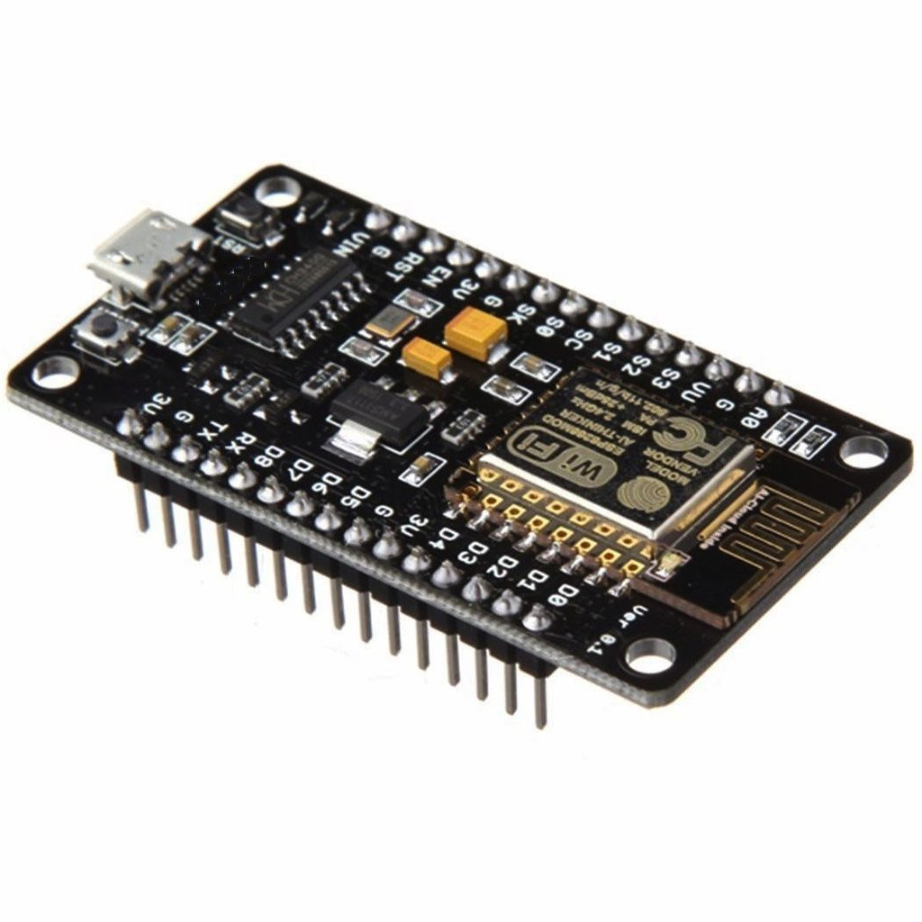

Slide 5
NODEMCU
NodeMCU is an open source IoTplatform.^{[4][5]} It includes firmwarewhich runs on the ESP8266 Wi-Fi SoCfrom Espressif Systems, and hardware which is based on the ESP-12 module.^{[6][7]} The term "NodeMCU" by default refers to the firmware rather than the development kits. The firmware uses the Lua scripting language. It is based on the eLua project, and built on the Espressif Non-OS SDK for ESP8266. It uses many open source projects, such as lua-cjson^{[8]} and SPIFFS.^{[9]}
DeveloperESP8266
Opensource CommunityTypeSingle-board microcontrollerOperating systemXTOS
CPU : ESP8266^{[1]}(LX106^{[2]})
Memory : 128kBytes
Storage : 4MBytes[
PowerUSB

Slide 6
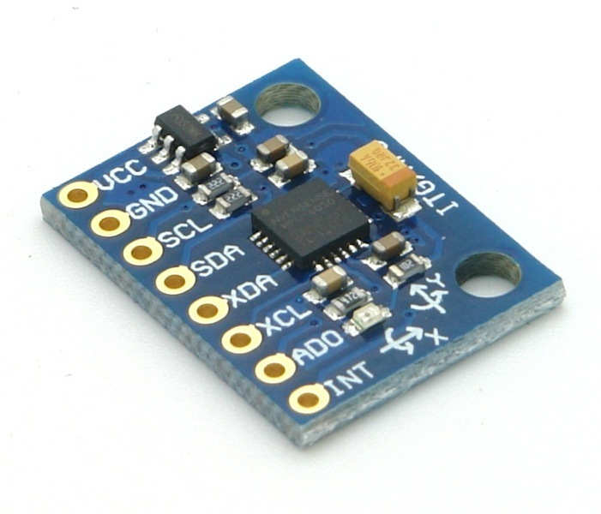

Slide 7
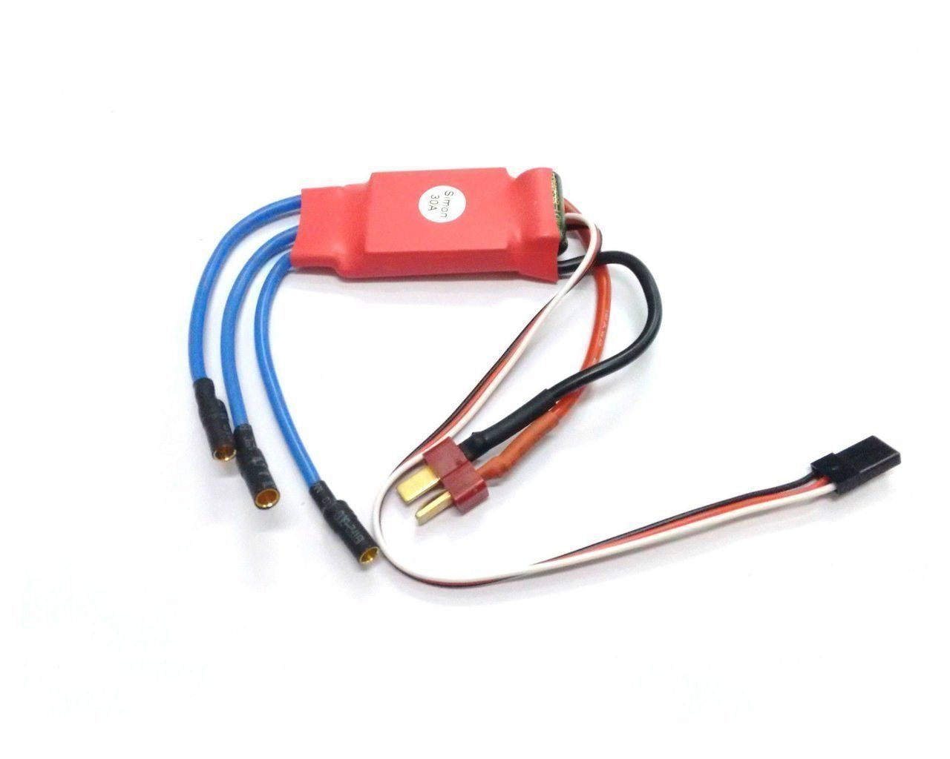

Slide 8
E S C (ELECTRONIC SPEED CONTROLLER)
An electronic speed control follows a speed reference signal (derived from a throttle lever, joystick, or other manual input) and varies the switching rate of a network of field effect transistors (FETs) .^{[1]} By adjusting the duty cycle or switching frequency of the transistors, the speed of the motor is changed. The rapid switching of the transistors is what causes the motor itself to emit its characteristic high-pitched whine, especially noticeable at lower speeds.
Different types of speed controls are required for brushed DC motors and brushless DC motors. A brushed motor can have its speed controlled by varying the voltage on its armature. (Industrially, motors with electromagnet field windings instead of permanent magnets can also have their speed controlled by adjusting the strength of the motor field current.) A brushless motor requires a different operating principle. The speed of the motor is varied by adjusting the timing of pulses of current delivered to the several windings of the motor.
A generic ESC module rated at 35 amperes with an integrated BEC
Brushless ESC systems basically create three-phase AC power, as in a variable frequency drive , to run brushless motors. Brushless motors are popular with radio controlled airplane hobbyists because of their efficiency, power, longevity and light weight in comparison to traditional brushed motors. Brushless AC motor controllers are much more complicated than brushed motor controllers.^{[2]}
The correct phase varies with the motor rotation, which is to be taken into account by the ESC: Usually, back EMF from the motor is used to detect this rotation, but variations exist that use magnetic (Hall effect) or optical detectors. Computer-programmable speed controls generally have user-specified options which allow setting low voltage cut-off limits, timing, acceleration, braking and direction of rotation. Reversing the motor's direction may also be accomplished by switching any two of the three leads from the ESC to the motor.

