Slide 1
MPU-6050 Module
The MPU-6050 module has 8 pins,
INT: Interrupt digital output pin.
AD0: I2C Slave Address LSB pin. This is 0th bit in 7-bit slave address of device. If connected to VCC then it is read as logic one and slave address changes.
XCL: Auxiliary Serial Clock pin. This pin is used to connect other I2C interface enabled sensors SCL pin to MPU-6050.
XDA: Auxiliary Serial Data pin. This pin is used to connect other I2C interface enabled sensors SDA pin to MPU-6050.
SCL: Serial Clock pin. Connect this pin to microcontrollers SCL pin.
SDA: Serial Data pin. Connect this pin to microcontrollers SDA pin.
GND: Ground pin. Connect this pin to ground connection.
VCC: Power supply pin. Connect this pin to +5V DC supply.
MPU-6050 module has Slave address (When AD0 = 0, i.e. it is not connected to Vcc) as,
Slave Write address(SLA+W): 0xD0
Slave Read address(SLA+R): 0xD1
MPU-6050 has various registers to control and configure its mode of operation. So, kindly go through MPU-6050 datasheet and MPU-6050 Register Map.
Calculations
Note that gyroscope and accelerometer sensor data of MPU6050 module consists of 16-bit raw data in 2’s complement form.
Temperature sensor data of MPU6050 module consists of 16-bit data (not in 2’s complement form).
Now suppose we have selected,
- Accelerometer full scale range of +/- 2g with Sensitivity Scale Factor of 16,384 LSB(Count)/g.
- Gyroscope full scale range of +/- 250 °/s with Sensitivity Scale Factor of 131 LSB (Count)/°/s.
then,
To get sensor raw data, we need to first perform 2’s complement on sensor data of Accelerometer and gyroscope.
After getting sensor raw data we can calculate acceleration and angular velocity by dividing sensor raw data with their sensitivity scale factor as follows,
Accelerometer values in g (g force)
Acceleration along the X axis = (Accelerometer X axis raw data/16384) g.
Acceleration along the Y axis = (Accelerometer Y axis raw data/16384) g.
Acceleration along the Z axis = (Accelerometer Z axis raw data/16384) g.
Gyroscope values in °/s (degree per second)
Angular velocity along the X axis = (Gyroscope X axis raw data/131) °/s.
Angular velocity along the Y axis = (Gyroscope Y axis raw data/131) °/s.
Angular velocity along the Z axis = (Gyroscope Z axis raw data/131) °/s.
Temperature value in °/c (degree per Celsius)
Temperature in degrees C = ((temperature sensor data)/340 + 36.53) °/c.

Slide 2
MPU6050 (Gyroscope + Accelerometer + Temperature) Sensor Module
MPU6050 Module
MPU6050 sensor module is complete 6-axis Motion Tracking Device. It combines 3-axis Gyroscope, 3-axis Accelerometer and Digital Motion Processor all in small package. Also, it has additional feature of on-chip Temperature sensor. It has I2C bus interface to communicate with the microcontrollers.
It has Auxiliary I2C bus to communicate with other sensor devices like 3-axis Magnetometer, Pressure sensor etc.
If 3-axis Magnetometer is connected to auxiliary I2C bus, then MPU6050 can provide complete 9-axis Motion Fusion output.
Let’s see MPU6050 inside sensors.
3-Axis Gyroscope
The MPU6050 consist of 3-axis Gyroscope with Micro Electro Mechanical System(MEMS) technology. It is used to detect rotational velocity along the X, Y, Z axes as shown in below figure.
- When the gyros are rotated about any of the sense axes, the Coriolis Effect causes a vibration that is detected by a MEM inside MPU6050.
- The resulting signal is amplified, demodulated, and filtered to produce a voltage that is proportional to the angular rate.
- This voltage is digitized using 16-bit ADC to sample each axis.
- The full-scale range of output are +/- 250, +/- 500, +/- 1000, +/- 2000.
- It measures the angular velocity along each axis in degree per second unit.
3-Axis Accelerometer
The MPU6050 consist 3-axis Accelerometer with Micro Electro Mechanical (MEMs) technology. It used to detect angle of tilt or inclination along the X, Y and Z axes as shown in below figure.
- Acceleration along the axes deflects the movable mass.
- This displacement of moving plate (mass) unbalances the differential capacitor which results in sensor output. Output amplitude is proportional to acceleration.
- 16-bit ADC is used to get digitized output.
- The full-scale range of acceleration are +/- 2g, +/- 4g, +/- 8g, +/- 16g.
- It measured in g (gravity force) unit.
- When device placed on flat surface it will measure 0g on X and Y axis and +1g on Z axis.

Slide 3
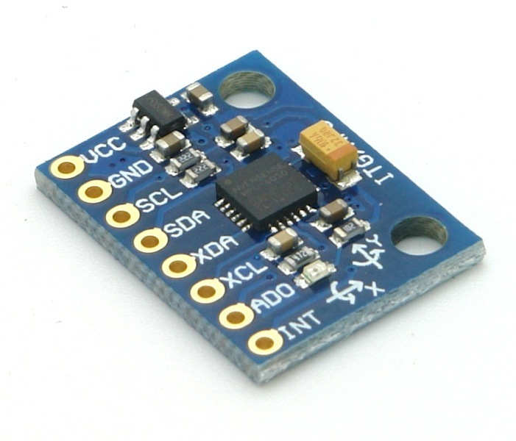

Slide 4
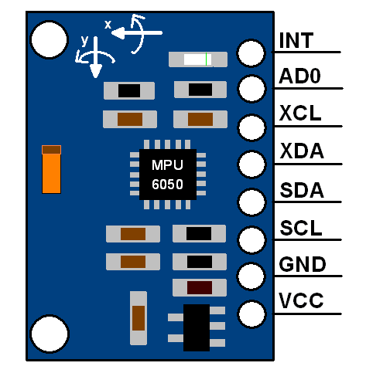

Slide 5
