Slide 1
GenAI for Data Engineers
Day 1 — LLM Landscape & Foundations
Sigma Intelligence Bootcamp · 18 May 2026
15 Days · 70% Hands-On · Production-Ready AI Engineering

Slide 2
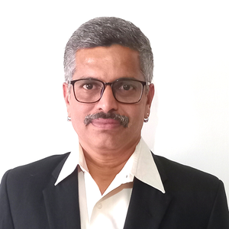

PROFILE
EXPERIENCE
25+ YEARS OF EXPERIENCE IN GLOBAL MNC IN Solutioning, Designing, Architecting, Implementing and Maintaining IT Systems on Multi Cloud, Data & AI.
5000+ HOURS OF TRAINING EXPERIENCE
TRAINING & TEACHING
ANIL KUMAR S
Mentor & Instructor @ GREAT LEARNING - PG Program in Cloud Computing & DevOps
Designed & Delivering Cloud and DevOps with Gen AI Training Program Certified by IITM P
Professor of Practice - VIT Vellore, Veltech Chennai & GRT Institute of Engineering & Technology
Evaluator and Jury Member - Smart India Hackathon
Corporate Trainer in Cloud, Data & Gen AI
Ex-Associate Director, Kyndryl/IBM | Solutions Architect –FinOps, Multi Cloud, Data & Gen AI | TEDx Speaker
EDUCATION & CERTIFICATIONS
linkedin.com/in/askanilkumar/
MBA & EXEC ALUMNI IIM –C
Certified in AWS, Azure, Google Public cloud
PMP Certified (Project Management Professional
Finops Certified Practitioner & Certified in FinOps for AI
2

Slide 3
2 Scenarios

Slide 4
"You are a data engineer at Sigma DataTech. This is five rows from the transaction table you built last month. Look at it for 30 seconds. Tell me what you see."
1
txn_id | amount | time | status | merchant
1001 | ₹24,999 | 02:17:33 | completed | M4521
1002 | ₹24,999 | 02:18:01 | completed | M4521
1003 | ₹24,999 | 02:18:29 | completed | M4521
1004 | ₹1.00 | 02:19:00 | completed | M4521
1005 | ₹1,87,000 | 02:19:45 | completed | M7823

Slide 5
The Pipeline That Fixed Itself
Your pipeline broke at 3 AM. It fixed itself. You never woke up.
2
Monday. 3:17 AM. Sigma DataTech's payment reconciliation pipeline fails silently. Upstream bank changed their CSV format without notice. ₹4 crore of transactions are stuck unprocessed. The CFO's Monday 9 AM dashboard is at risk.
Nobody's phone rings. No one is woken up….
Do not worry !! Your Agent is Watching !!

Slide 6
Agentic AI in Action
Time | Action
3:17 AM | Detects pipeline failure. Reads the error log.
3:18 AM | Pulls the new CSV from S3. Compares schema to expected. Finds 2 new columns, 1 renamed field.
3:19 AM | Rewrites the Databricks notebook to handle both old and new format.
3:20 AM | Runs the notebook on 500 sample rows. All pass.
3:21 AM | Deploys fix. Reruns failed job. Bronze → Silver → Gold. All ₹4 crore lands in Snowflake.
3:22 AM | Detects the new column contains merchant category codes. Auto-updates the Snowflake schema, refreshes the dbt model, triggers Power BI dataset refresh.
3:23 AM | Writes RCA. Raises GitHub PR. Pings Slack: "Fixed. CFO dashboard is live."
2
3:24 AM — Agent goes back to watching mode.

Slide 7
From Data Platform to AI Platform
• You spent 25 days building Sigma DataTech's data platform on AWS /Azure—
› Cloud DE· Databricks · Airflow · Snowflake · Power BI
• The business has a new ask:
› 'Our pipelines run. Now make them Intelligent.'
• Sigma DataTech is spinning off Sigma Intelligence —
› an AI-first data product team serving 50+ MNC enterprise clients.
You are the founding AI Data Engineering team.
• Your 15-day onboarding starts today. The clock is running.

Slide 8
Your 15-Day Roadmap
Week 1 · Foundations
Week 2 · DE Productivity
Week 3 · Agentic DE
• GenAI & LLM Landscape
• Prompt Engineering for DE
• AI Coding Assistants
• RAG & Vector Databases
• MCP & Tool Calling
• AI-Assisted SQL & dbt
• Pipeline Code Generation
• Code Review & Debugging
• AI for DataOps & CI/CD
• Vibe Coding & Prototyping
• Agentic AI Foundations
• Intelligent Data Ingestion
• AI Governance & Lineage
• Self-Healing Pipelines
• Project Presentation
FOUNDATION
APPLICATION
AUTOMATION
Every day: 30% concept → live demo → 70% hands-on → team debrief → quiz

Slide 9

Opening Poll — Where Does Your Team Stand?
Q1 — AI tools you have personally used:
› Claude / ChatGPT / Gemini / Copilot / None
Q2 — What worries you most about AI in DE work?
› It will replace my job / It gives wrong code
› Hard to debug / I don't know where to start
Q3 — Which best describes you today?
› 'I'm excited and ready' / 'Curious but unsure'
› 'Show me it's actually useful' / 'I'm skeptical, convince me'
Q4 — What's the most impressive AI thing you've seen?
› 3–4 volunteers share. 1 minute each.
• We revisit these answers on Day 15. Your baseline starts now.

Slide 10
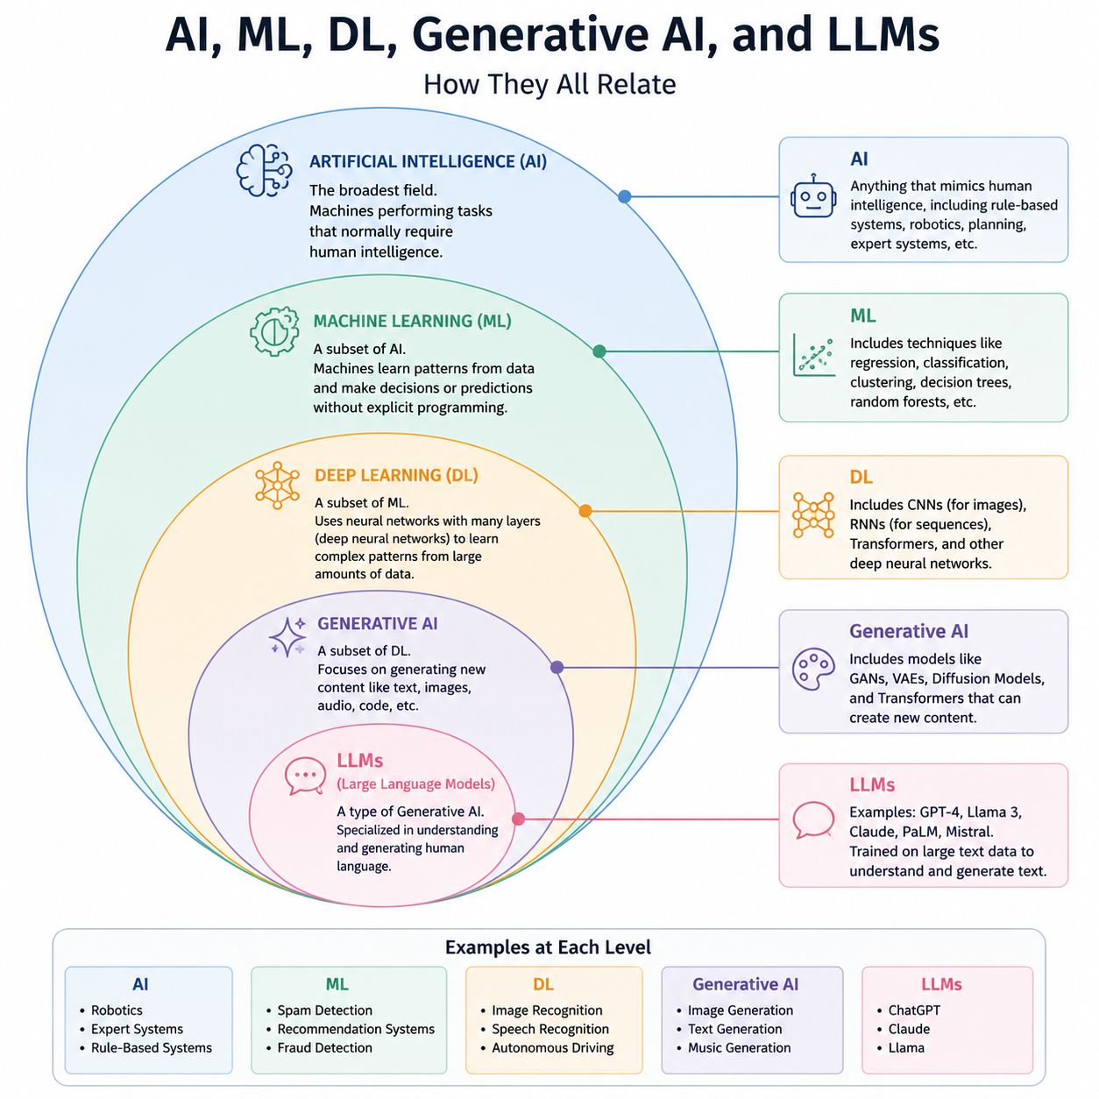
What is AI

Slide 11
Gen AI
INPUT | OUTPUT
1 | 1
2 | 4
3 | 9
4 | 16
5 | ?
6 | ?

Slide 12
Gen AI
AREA | BEDROOMS | PRICE
2000 | 2 | 601K
2500 | 3 | 751K
3200 | 3 | 961K
1900 | 2 | 571K
2100 | 3 | ?
670K

Slide 13
Gen AI
AMOUNT | LOCATION | LOGIN DEVICE
500 | Chennai | Mobile
45,000 | Russia | Unknown Laptop
1,200 | Bengaluru | Mobile
75,000 | Nigeria | New Device
2,000 | Chennai | Mobile
FRAUD
NO
YES
NO
YES
NO
ML Used for Final fraud risk prediction &
Gen AI used for explanation, investigation summary, conversational analysis

Slide 14
Gen AI for DE
The “Best” Use Cases – Quick Summary Table
Use Case | Primary Value | Typical Tools/Integrations
Code & Pipeline Generation | 10x developer velocity, less boilerplate | GitHub Copilot, dbt, Airflow, Databricks
Text-to-SQL | Self‑service analytics, reduced ad‑hoc load | OpenAI/Anthropic API + data catalog
Auto‑Documentation | Live, accurate data catalog & lineage | DataHub, Atlan, Alation, dbt docs
Intelligent Data Quality | Proactive anomaly detection & root‑cause hints | Monte Carlo, Soda, custom LLM agents
Synthetic Data | Safe, fast testing & development | Mostly AI, Gretel, Tonic.ai
Schema Design & Migration | Faster, standardised modelling | Internal copilots, ER/Studio plugins
Test Generation | Reliable pipelines, fewer data incidents | dbt, Great Expectations, Soda
Conversational Debugging | Faster MTTR, better on‑call experience | Data observability platforms + LLMs

Slide 15
Quiz

Slide 16
Gen AI
Smart Prompting
Transformer Deepdive
Interactive HTML

Slide 17
Gen AI
https://tinyurl.com/sigmoid18may26

Slide 18
Live Demo 1 — OpenAI Tokenizer (platform.openai.com/tokenizer)
Trainer pastes each item live. Observe token count and cost implications.
Text to Paste | Tokens | Takeaway
'Hello World' | 2 | As expected
'detect_schema_drift()' | 5 | Underscores inflate count
A full Airflow DAG file | Count live | Typical file = 500–2,000 tokens
A 500-row CSV header | Count live | Context window planning needed
10 pipeline files for AI review | Count live | $100–$500/day at scale

Slide 19
Live Demo 2 — HuggingFace Model Hub (huggingface.co/models)
Step 1 — Filter by task:
› Text Generation · Sentence Similarity · Feature Extraction (embeddings)
Step 2 — Open meta-llama/Llama-3.2-8B
› Model card: parameters, licence, training data, intended use.
› Note: CC-BY-NC licence — NOT for commercial products without Meta permission.
Step 3 — Open sentence-transformers/all-MiniLM-L6-v2
› Embedding model · 384 dimensions · 80MB · runs on CPU in under 1 second.
› This is what we will use in the RAG lab on Day 4.
Step 4 — Search nomic-embed-text
› Available on Ollama · local embeddings · 768 dimensions.
• Takeaway: HuggingFace is the App Store for AI models.
• Before building anything custom, check here first.

Slide 20
Live Demo 3 — Same Prompt, Claude vs ChatGPT, Live
Trainer runs this prompt on both models simultaneously:
› 'I have a Pandas DataFrame with 10 million rows and a created_at timestamp.
› Write Python to add a week_number column (ISO week).
› Optimise for performance — this runs daily on a production pipeline.'
Watch for on each model:
› Does it use .dt.isocalendar().week (correct) or .dt.week (deprecated)?
› Does it use vectorisation — or slow .apply()?
› Does it warn about the 10M row performance implication?
› Does it handle NaT / null timestamps?
› Does it explain WHY it made each choice?
Discussion:
› Which response would you merge to production without changes?
› Which would you reject, and why?
• This is exactly the rubric you use in your lab today.

Slide 21
Quiz — Q1 and Q2
Q1. Which of the following best describes a 'token' in the context of LLMs?
A) A single word from the training data
B) A unit of text, approximately 0.75 words on average
C) A unique session ID assigned to each user
D) A single character processed one at a time
Q2. The Transformer architecture improved on RNNs primarily because it:
A) Used more training data than any previous model
B) Reads sequences word-by-word but twice as fast
C) Processes the entire sequence simultaneously, enabling parallelism
D) Uses smaller parameter counts for faster inference

Slide 22
Quiz — Q3 and Q4
Q3. Sigma Intelligence must process a file with raw customer PII. Which is correct?
A) Use GPT-4o API — it is the most accurate model
B) Use Claude via API — Anthropic has strong safety policies
C) Use Ollama with Llama 3.2 locally — data never leaves the machine
D) Any model is fine as long as the data is encrypted in transit
Q4. Claude says Snowflake has a function called SPLIT_PART_ADVANCED() — it does not. This is:
A) Model drift
B) Bias
C) Hallucination
D) Context window overflow

Slide 23
Quiz — Q5 and Q6
Q5. Which of the following BEST describes an embedding?
A) A compressed version of the training dataset
B) A vector of numbers representing the semantic meaning of text
C) A fine-tuning technique for domain adaptation
D) The positional index of a token in the input sequence
Q6. A churn model trained in 2023 fails in 2025 because customer behaviour changed. This is:
A) Hallucination
B) Concept drift
C) Context window overflow
D) Attention head failure

Slide 24
Quiz — Q7 and Q8
Q7. You want to send 500 table schema definitions (~180,000 words) to an LLM in one call. Which model fits?
A) GPT-4o (128K token context)
B) Llama 3.2 (128K token context)
C) Claude Sonnet 4 (200K token context)
D) None — all models fail at this scale
Q8. What does Multi-Head Attention do inside a Transformer?
A) Processes multiple user requests simultaneously
B) Runs attention multiple times in parallel, each head learning different relationships
C) Splits long input into chunks to handle large documents
D) Prevents hallucinations by cross-checking attention scores

Slide 25
Quiz — Q9 and Q10
Q9. Claude's Redshift SQL uses 'customer_id' but the real table uses 'customer_uuid'. It fails. Why?
A) Hallucination — the model invented a wrong column name
B) Model drift — training data is outdated
C) Incomplete prompt — the actual schema was not provided
D) Context overflow — the query was too long to process
Q10. Which is NOT a recommended responsible AI practice for a DE team?
A) Sending anonymised schema descriptions to external LLM APIs
B) Human review of all AI-generated DELETE/DROP statements
C) Using Ollama locally for workloads involving raw customer PII
D) Deploying AI-generated pipeline code to production without testing

Slide 26
Quiz Answers + Leaderboard Update
Q | Answer | Why
1 | B | Token ≈ 0.75 words, not a full word
2 | C | Parallelism is the key Transformer breakthrough
3 | C | PII must stay local — Ollama, not cloud API
4 | C | Fluent + confident + wrong = hallucination
5 | B | Embedding = semantic vector in high-dimensional space
6 | B | World changed → input-output relationship changed = concept drift
7 | C | Claude Sonnet 4 has 200K context — only model that fits
8 | B | Multiple heads, each learning different relationship types
9 | C | Model had no schema — engineer's responsibility to provide it
10 | D | AI-generated code to prod without testing = unacceptable risk

Slide 27
Day 1 Complete — What We Covered
Concepts:
› GenAI history 2017–2025 · Transformer architecture · Attention & Tokens
› Key models compared · Embeddings · Hallucinations · Bias · Model Drift
› Responsible AI · GenAI × DE opportunity map
Hands-on today:
› Installed Ollama · pulled Llama 3.2 · ran first local LLM query
› Benchmarked Claude / GPT-4o / Llama 3.2 on a real DE task
› Tested generated code against known expected output
› Presented findings as a team with a structured recommendation
Tomorrow — Day 2:
› Prompt Engineering for Data Engineers
› NL→SQL · Chain-of-thought · Role prompting · Structured output
› Building your reusable DE Prompt Library
• Sigma Intelligence status: Mission 1 COMPLETE.

