Slide 1
”DIKSHA” Sundaram Fin.Tech 2025
Anil Rasa
Date : 19-APR-2025

Slide 2

Topics Covered !

Slide 3
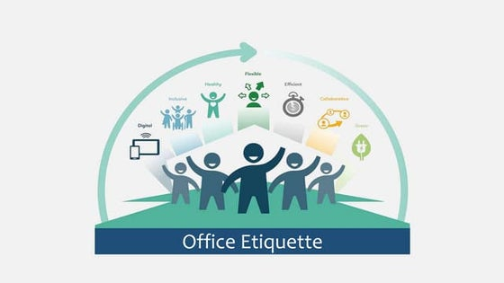
Learning 1 | My takeaways
→Etiquettes
→Dialects
→Diction(Choice of words)

Slide 4
Etiquettes:
→Etiquettes are the rules for polite behavior. They are the good manners we follow when we are around other people, like how to talk, eat, dress, or act in different places (home, school, work, etc.).
→They are (Be on time, Greet Everyone, Say the Magic words,Dining Etiquette,Dress Frofessionally)
Dialects:
→A dialect is a form of a language spoken by a smaller group,often characterized by distinct vocabulary,grammer and pronucation(the way in which a word pronounced)
Ex:-American english and British english are distinct dialects of the english language.
Diction:
→choice of words especially with regard to correctness ,clearness or effectiveness.
→Diction refer to the choice and use of words in speech or writing ,impacting tone,style and the overall meaning of peace
Q

Slide 5
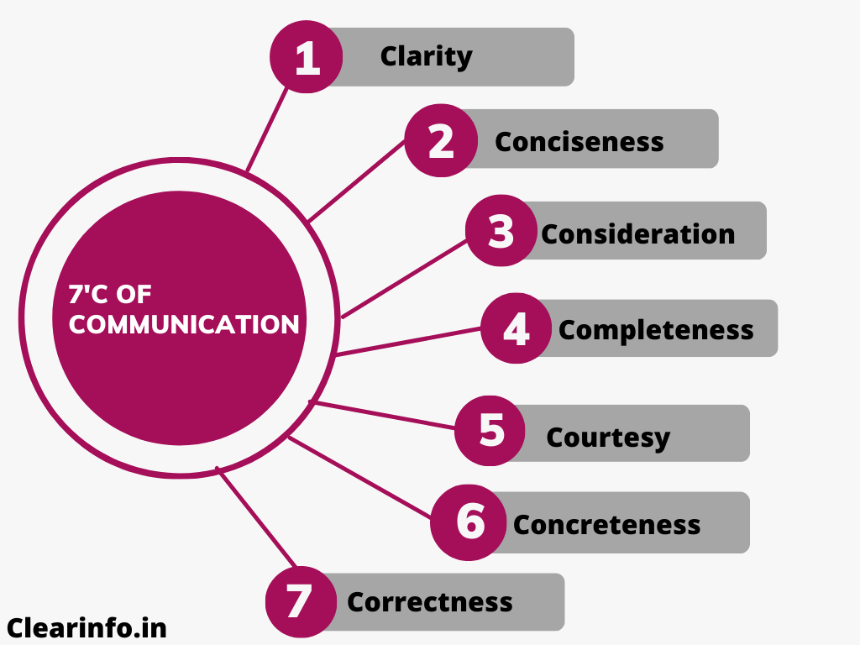
Learning 2| My Takeaways
→ Verbal and Non-verbal Communication
→Barriers of Communication
→ 7c’s of Communication
→Mind Mapping Techniques:

Slide 6
1. Verbal Communication (Using Words)
→This is when we use spoken or written words to share information.
Ex:-Talking to someone, Speaking on the phone, Writing a letter or email
2. Non-verbal Communication (Without Words):
→This is when we communicate without using words—just with body language, expressions, tone, etc.
Ex:-Smiling or frowning, Nodding your head,Using hand gestures,Eye contact
Barriers of Communication:
→ These are things that block or confuse communication between people.
Types of Barriers:1) Language Barrier 2) Noise Barrier 3) Emotional Barrier 4) Cultural Barrier 5) Physical Barrier
7c’s of Communication:
These are 7 key rules to make communication clear and effective:
→Clear, Concise, Concrete, Correct, Coherent, Complete, Courteous
Mind Mapping Techniques:
Mind mapping is a way to visually organize ideas. It helps you think better, plan, and remember things easily.
Start with a Main Idea
Add Branches for Sub-Topics
3) Add More Details
4) Use Colors & Pictures
5) Keep It Clear

Slide 7
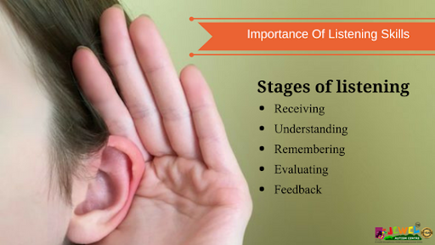
Learning 3| My takeaways
→Listening Skills
→Empathy
→ Telephone/Mobile Etiquette
→Probing

Slide 8
Listening Skills:
→Listening skills mean how well you pay attention and understand when someone is talking.
→It's not just about hearing—it's about focusing, understanding, and responding properly.
Good Listening Looks Like:
*Looking at the speaker
*Not interrupting
*Nodding or smiling
*Asking question
Bad Listening Looks Like
*Looking at your phone
*Thinking about something else
*Interrupting or talking too much
Empathy:
Empathy means understanding how someone else feels — and caring about their feelings.
ex:-Your friend is sad, so you say, “I understand, I’d feel the same way.”
Telephone/Mobile Etiquette:
→These are the good manners and polite ways to talk on a phone — at home, school, or work.
Good etiquettes:- Answer politely, Speak clearly, Be respectful, Listen carefully
Avoid these:-Talking loudly in public, Using rude language
Probing:
Probing means asking questions to get more details or to understand better.

Slide 9

Learning 4 | takeaways
→Email
→Messages-virtual chat
→Note Taking

Slide 10
Email writing:
Writing an email is like writing a letter, but online. It should be clear, polite, and to the point.
Parts of email writing:
1)Subject Line
2)Greeting (Salutation)
3)Opening Line(ex:I hope you are doing well.)
4)Main Message (Body)
5)Closing Line
6)Sign-Off
→Use simple language
→Avoid spelling mistakes
→Be polite and professional
→Don’t use ALL CAPS (it feels like shouting)
Messages-virtual chat:
Virtual Chat means talking with someone using a computer, phone, or app (like WhatsApp, Messenger, Teams, etc.) instead of face-to-face.
→Be clear, Be polite,reply on time,use proper greetings.

Slide 11
Thank You

