Slide 1

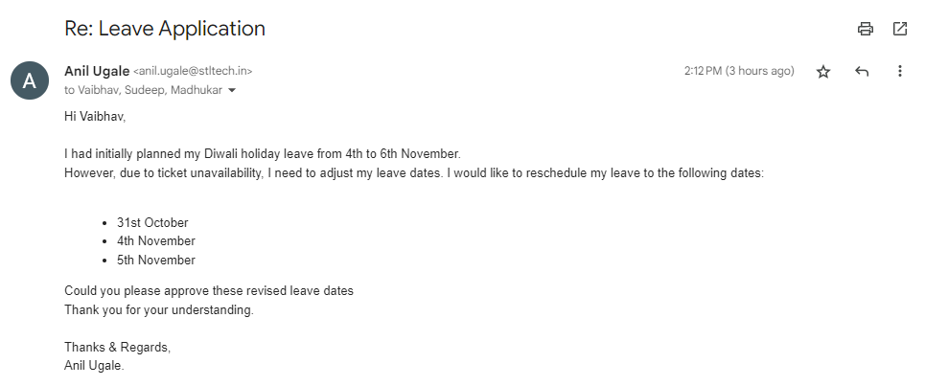
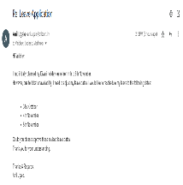
Employee_Name
Weather
Weather
Weather_quote
Famous People You Share Your Birthday With:
mx/mn°C
Famouspeople_list

