Slide 1
12 bit Asynchronous Counter
EEE -468 : VLSI Laboratory
Section: G2
July 2023
Section C1
Project Presentation
Project Group 2
Khondaker Nafis Ahmed
1906147
Manjur Muntasir
1906150
Fahim Shahriar Anim
1906178
Shahriyer Hasan
1906128
Abid Abdullah
1906108

Slide 2
Outline
Introduction
Implementation
Output Analysis
Result Discussion
Conclusion

Slide 3
Introduction
A 12-bit asynchronous counter, also known as a ripple counter, is a type of digital counter used in electronics to count pulses or events
This allows the counter to count from 0 to 2¹² −1, or 0 to 4095 in decimal.
All control signals (Load, Up_down, Reset, Enable) are asynchronous here.

Slide 4
Implementation Plan
Design Code
Verification using Directed and Layered Testbench
RTL Synthesis
PnR Analysis
Optimization

Slide 5
Implementation Plan
Cadence CAD Tools
NCSim for simulation
Sim vision for visualization
Genus for RTL synthesis
Innovus for PnR

Slide 6

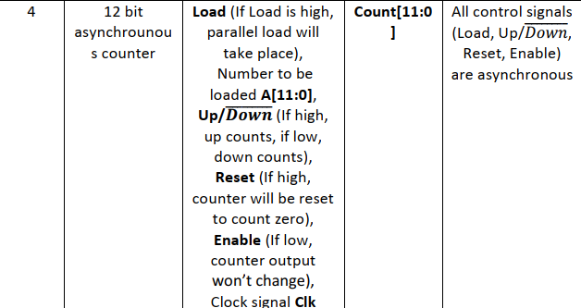
Implementation
Design Problem

Slide 7
Implementation
Final Design Verilog
always@(negedge load)
begin
if(!enable) count<=count;
else if(reset) count<=0;
else if(up_down) count<=count+1;
else if(!up_down) count<=count-1;
end
always@(posedge clk)
begin
if(!enable) count<=count;
else if(!reset & !load)
begin
if(up_down==1) count<=count+1;
else if(up_down==0) count<=count-1;
end
end
always@(posedge up_down)
begin
if(!enable) count<=count;
else if(reset) count<=0;
else if(load) count<=data;
else count<=count+1;
end
always@(negedge up_down)
begin
if(!enable) count<=count;
else if(reset) count<=0;
else if(load) count<=data;
else count<=count-1;
end
module counter(clk, reset, up_down, load, data, count, enable);
//define input and output ports
input clk, reset, load, up_down, enable;
input [11:0] data;
output reg [11:0] count;
//always block will be executed at each and every positive edge of the clock
always@(posedge reset)
begin
if(!enable) count<=count;
else count<=0;
end
always@(negedge reset)
begin
if(!enable) count<=count;
else if(load) count<=data;
else if(up_down) count<=count+1;
else if(!up_down) count<=count-1;
end
always@(posedge load)
begin
if(!enable) count<=count;
else if(!reset) count<=data;
end

Slide 8
Implementation
Final Design Verilog
always@(posedge enable)
begin
if(reset) count<=0;
else if(load) count<=data;
else if(up_down) count<=count+1;
else if(!up_down) count<=count-1;
end
always@(data)
if(load & !reset) count<=data;
endmodule

Slide 9
Implementation
Design Difficulties
1. Multiple inputs transition at the same time
module counter(clk, reset, up_down, load, data, count, enable);
//define input and output ports
input clk, reset, load, up_down, enable;
input [3:0] data;
output reg [3:0] count;
always@(posedge reset)
if(enable)
begin
count<=0;
end
always@(posedge load)
if(enable)
begin
count<=data;
end
always@(posedge up_down or negedge up_down)
if(enable)
begin
if(up_down) count<=count+1;
else count<=count-1;
end
//always block will be executed at each and every positive edge of the clock
always@(posedge clk)
if(enable)
begin
//if(reset) count <= 0; //Set Counter to Zero
//else if(load) count <= data; //load the counter with data value
if(up_down) count <= count + 1; //count up
else count <= count - 1; //count down
end
endmodule

Slide 10
Implementation
Design Difficulties
2. Reset, Load or Up-Down ON for a long time
module counter(clk, reset, up_down, load, data, count, enable);
//define input and output ports
input clk, reset, load, up_down, enable;
input [11:0] data;
output reg [11:0] count;
logic r=0;
logic l=0;
logic ud=up_down;
//always block will be executed at each and every positive edge of the clock
always@(posedge clk or posedge reset or posedge load or posedge up_down or negedge up_down)
begin
if(enable)
begin
if(reset==1 & r==0)
begin
count<=0;
r=1;
end
else if(load==1 & l==0)
begin
count<=data;
l=1;
end
else if(up_down==1 & ud==0)
begin
count<=count+1;
ud=1;
end
else if(up_down==0 & ud==1)
begin
count<=count-1;
ud=0;
end
else if(up_down==1)
begin
count<=count+1;
ud=1;
end
else if(up_down==0)
begin
count<=count-1;
ud=0;
end
if(reset==0) r=0;
else r=1;
if(load==0) l=0;
else l=1;
end
else count<=count;
end
endmodule

Slide 11
Implementation
always@(negedge load)
begin
if(!enable) count<=count;
else if(reset) count<=0;
else if(up_down) count<=count+1;
else if(!up_down) count<=count-1;
end
always@(posedge clk)
begin
if(!enable) count<=count;
else if(!reset & !load)
begin
if(up_down==1) count<=count+1;
else if(up_down==0) count<=count-1;
end
end
always@(posedge up_down)
begin
if(!enable) count<=count;
else if(reset) count<=0;
else if(load) count<=data;
else count<=count+1;
end
always@(negedge up_down)
begin
if(!enable) count<=count;
else if(reset) count<=0;
else if(load) count<=data;
else count<=count-1;
end
always@(posedge enable)
begin
if(reset) count<=0;
else if(load) count<=data;
else if(up_down) count<=count+1;
else if(!up_down) count<=count-1;
end
always@(data)
if(load & !reset) count<=data;
endmodule
Design Difficulties
3. More than one posedge or negedge inputs not allowed in always
module counter(clk, reset, up_down, load, data, count, enable);
//define input and output ports
input clk, reset, load, up_down, enable;
input [11:0] data;
output reg [11:0] count;
//always block will be executed at each and every positive edge of the clock
always@(posedge reset)
begin
if(!enable) count<=count;
else count<=0;
end
always@(negedge reset)
begin
if(!enable) count<=count;
else if(load) count<=data;
else if(up_down) count<=count+1;
else if(!up_down) count<=count-1;
end
always@(posedge load)
begin
if(!enable) count<=count;
else if(!reset) count<=data;
end

Slide 12
Implementation
initial
begin
load=1'b1; #18
load=1'b0; #22
load=1'b1; #8
load=1'b0; #12
load=1'b1; #10
load=1'b0;
end
initial
begin
up_down=1'b1; #40
up_down=1'b0; #20
up_down=1'b1; #8
up_down=1'b0; #10
up_down=1'b1; #8
up_down=1'b0;
end
initial
begin
data=12'b100011001000; #14
data=12'b110100111100; #2
data=12'b111100001111; #20
data=12'b101001011010; #8
data=12'b110000111100;
end
//monitor all the input and output ports at times when any inputs changes its state
initial
begin
$monitor("time=%0d, reset=%b, load=%b, up_down=%b, data=%d, count=%d", $time, reset, load, up_down, data, count);
end
initial
begin
$dumpfile("dump.vcd");
$dumpvars();
#100
$finish;
end
endmodule
Directed Testbench
module counter_tb;
reg clk,reset,load,up_down, enable;
reg [11:0] data;
wire [11:0] count;
// instance counter design
counter ct_1(.clk(clk), .reset(reset), .load(load), .up_down(up_down), .enable(enable), .data(data), .count(count));
//clock generator
initial
begin
clk = 1'b0;
repeat(30) #3
clk= ~clk;
end
//insert all the input signal
initial
begin
reset=1'b1; #7
reset=1'b0; #33
reset=1'b1; #2
reset=1'b0;
end
initial
begin
enable=1'b1; #12
enable=1'b0; #22
enable=1'b1;
end

Slide 13
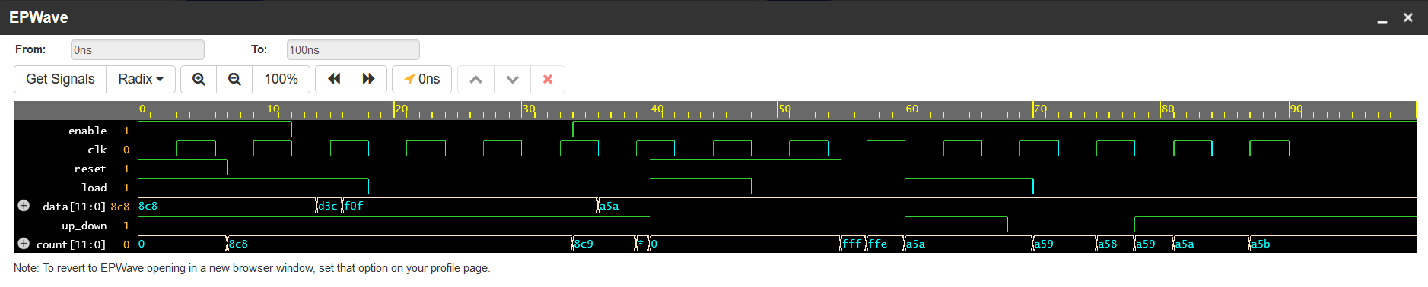
Implementation
Directed Testbench

Slide 14
Implementation
Layered Testbench – Testbench.sv
Layered Testbench – Interface.sv
`include "testcase01.sv"
//`include "test.sv"
`include "interface.sv"
module testbench;
bit clk;
initial begin
forever #5 clk =~clk;
end
int tnum=30;
counter_if countif(clk);
test test01(tnum,countif);
initial begin
$dumpfile("dump.vcd");
$dumpvars;
#200;
$finish;
end
counter DUT (
.reset(countif.reset),
.up_down(countif.up_down),
.load(countif.load),
.enable(countif.enable),
.data(countif.data),
.count(countif.count),
.clk(clk)
);
endmodule
interface counter_if(input clk);
logic reset,load, up_down, enable;
logic [11:0] data;
logic [11:0] count;
clocking driver_cb @(negedge clk);
default input #0 output #0;
output reset,load, up_down, enable, data;
endclocking
clocking mon_cb @(clk, reset, enable, load, up_down, data);
default input #0 output #0;
input reset,load, up_down, enable, data;
input count;
endclocking
modport DRIVER (clocking driver_cb, input clk);
modport MONITOR (clocking mon_cb, input clk);
endinterface

Slide 15
Implementation
Layered Testbench – Scoreboard.sv
class scoreboard;
mailbox driv2sb;
mailbox mon2sb;
transaction d_trans;
transaction m_trans;
event driven;
function new(mailbox driv2sb, mon2sb);
this.driv2sb=driv2sb;
this.mon2sb=mon2sb;
endfunction
task main(input int tnum);
$display("------------------Scoreboard Test Starts--------------------");
repeat(tnum) begin
m_trans=new();
mon2sb.get(m_trans);
report();
if(m_trans.count != d_trans.count)
$display("time:%d, Failed : reset=%d up_down=%d load=%d enable=%d data=%d Expected out=%d Resulted out=%d",$time, d_trans.reset,d_trans.up_down, d_trans.load, d_trans.enable, d_trans.data, d_trans.count,
m_trans.count);
else
$display("time:%d, Passed : reset=%d up_down=%d load=%d enable=%d data=%d Expected out=%d Resulted out=%d",$time, d_trans.reset,d_trans.up_down, d_trans.load, d_trans.enable, d_trans.data, d_trans.count, m_trans.count);
end
$display("------------------Scoreboard Test Ends--------------------");
endtask:main
task report();
d_trans=new();
driv2sb.get(d_trans);
if (d_trans.enable==1)
begin
if(d_trans.reset==1) d_trans.count=0;
else if(d_trans.load==1) d_trans.count=d_trans.data;
else if(d_trans.up_down==1) d_trans.count=d_trans.count+1;
else if(d_trans.up_down==0) d_trans.count=d_trans.count-1;
end
else d_trans.count=d_trans.count;
endtask:report
endclass:scoreboard

Slide 16
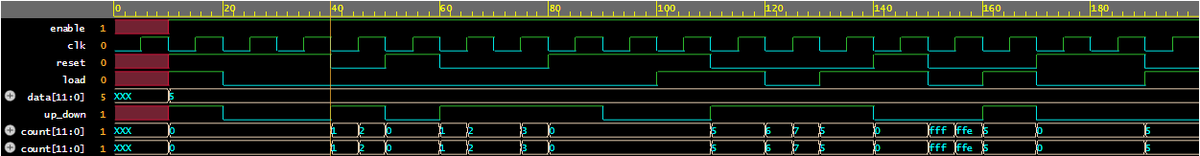
Implementation
Layered Testbench – Transaction.sv
class transaction;
bit [11:0] data = 5;
rand bit reset;
rand bit up_down;
bit enable = 1;
rand bit load;
bit [11:0] count;
endclass:transaction
Layered Testbench – Waveform

Slide 17
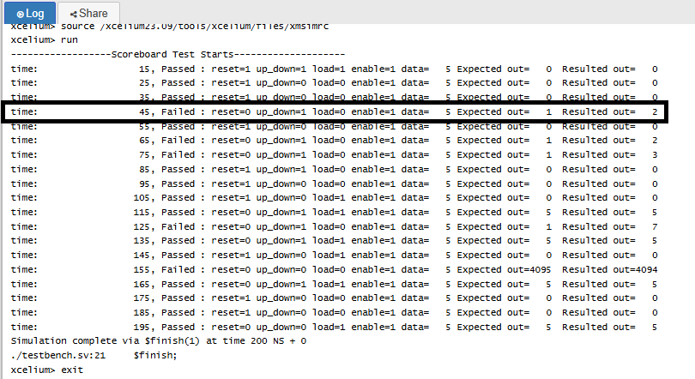
Implementation
Layered Testbench

Slide 18
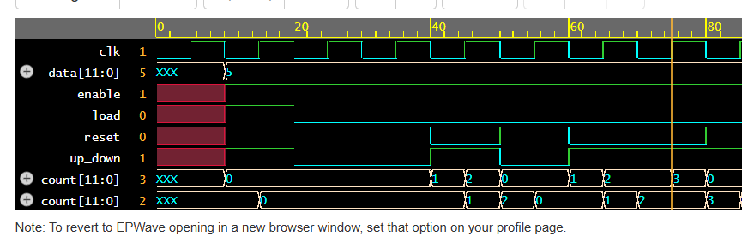
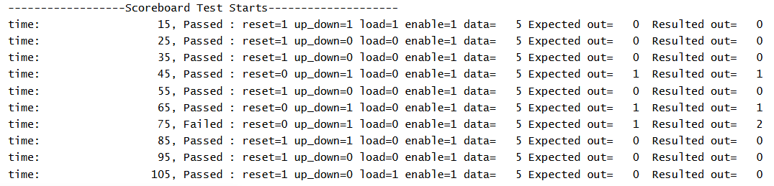
Implementation
Layered Testbench

Slide 19
SYNTHESIS

Slide 20
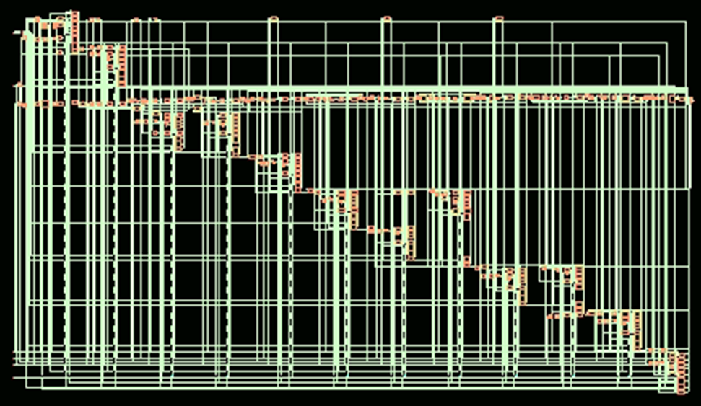
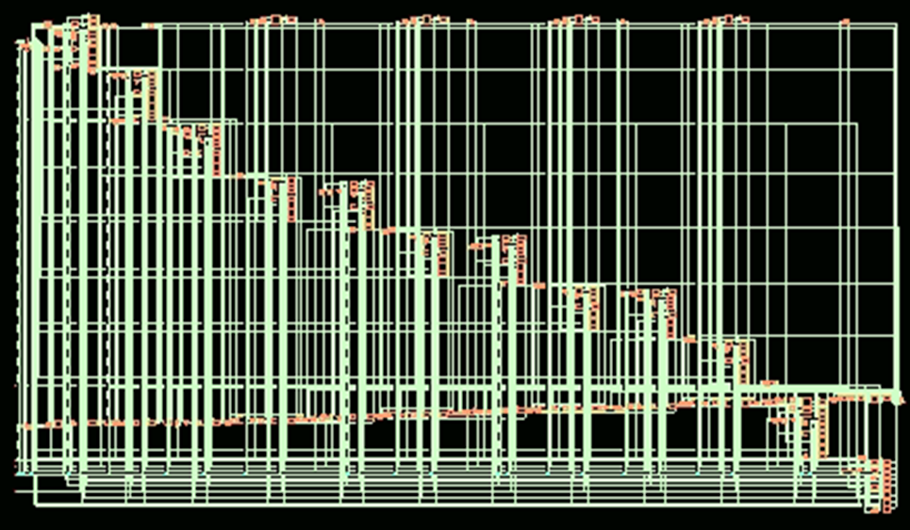
Synthesis
Synthesis:
Synthesis after using syn_map:

Slide 21
Synthesis
set_dont_use [get_lib_cells CLK*]
set_dont_use [get_lib_cells SDFF*]
set_dont_use [get_lib_cells DLY*]
set_dont_use [get_lib_cells HOLD*]
# If you dont want to use LVT uncomment this line
#set_dont_use [get_lib_cells *LVT*]
####################################################################
### Load Design
#####################################################################
###source verilog_files.tcl
read_hdl "\
${DESIGN}.v"
elaborate $DESIGN
puts "Runtime & Memory after 'read_hdl'"
time_info Elaboration
check_design -unresolved
####################################################################
### Constraints Setup
#####################################################################
read_sdc counter2.sdc
report timing -encounter >> reports/${DESIGN}_pretim.rpt
####################################################################################################
### Synthesizing to generic
####################################################################################################
syn_generic
puts "Runtime & Memory after 'syn_generic'"
time_info GENERIC
report datapath > reports/${DESIGN}_datapath_generic.rpt
generate_reports -outdir reports -tag generic
write_db -to_file ${DESIGN}_generic.db
report timing -encounter >> reports/${DESIGN}_generic.rpt
##This synthesizes your code
syn_map
## This writes all your files
write -mapped > counter2_synth.v
## THESE FILES ARE NOT REQUIRED, THE SDC FILE IS A TIMING FILE
write_script > script
TCL code:
#run Genus in Legacy UI if Genus is invoked with Common UI
::legacy::set_attribute common_ui false / ;
if {[file exists /proc/cpuinfo]} {
sh grep "model name" /proc/cpuinfo
sh grep "cpu MHz" /proc/cpuinfo
}
puts "Hostname : [info hostname]"
##############################################################################
### Preset global variables and attributes
##############################################################################
set DESIGN counter2
set SYN_EFF medium
set MAP_EFF medium
set OPT_EFF medium
# Directory of PDK
#set pdk_dir /home/wsadiq/buet_flow/GPDK045
set pdk_dir /home/cad/VLSI2Lab/Digital/library/
#set_attribute init_lib_search_path $pdk_dir/gsclib045/timing
#set_attribute init_hdl_search_path /home/wsadiq/buet_flow/rtl
set_attribute init_lib_search_path $pdk_dir
#set_attribute init_hdl_search_path ../../rtl
##Set synthesizing effort for each synthesis stage
set_attribute syn_generic_effort $SYN_EFF
set_attribute syn_map_effort $MAP_EFF
set_attribute syn_opt_effort $OPT_EFF
#set_attribute library "\
slow_vdd1v0_basicCells_hvt.lib \
slow_vdd1v0_basicCells.lib \
slow_vdd1v0_basicCells_lvt.lib"
set_attribute library "\
slow_vdd1v0_basicCells.lib"

Slide 22
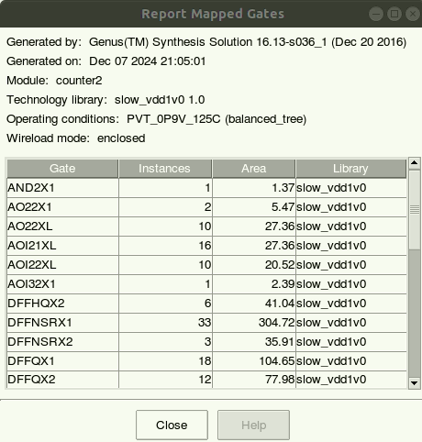
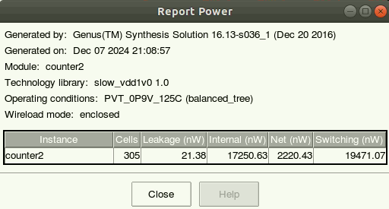
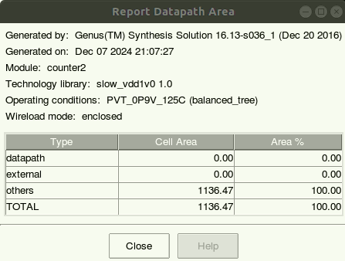
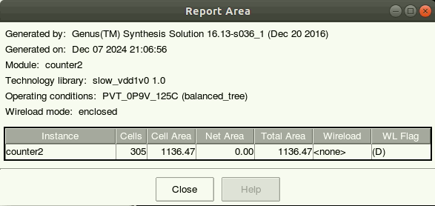
Reports

Slide 23
Variable: CLOCK PERIOD

Slide 24
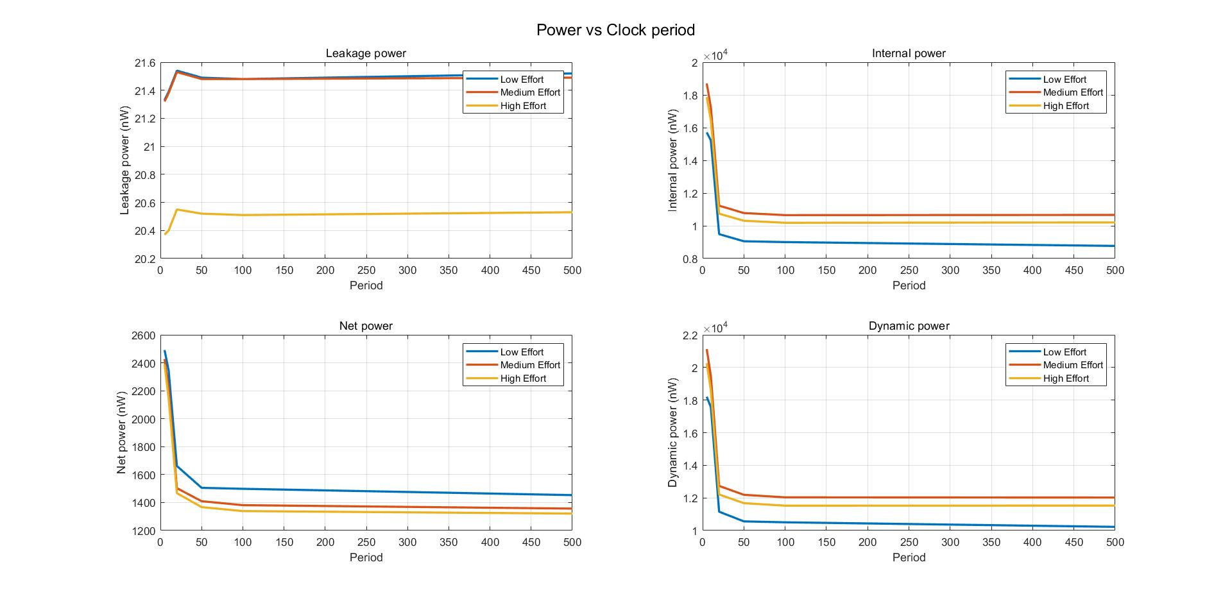

Slide 25
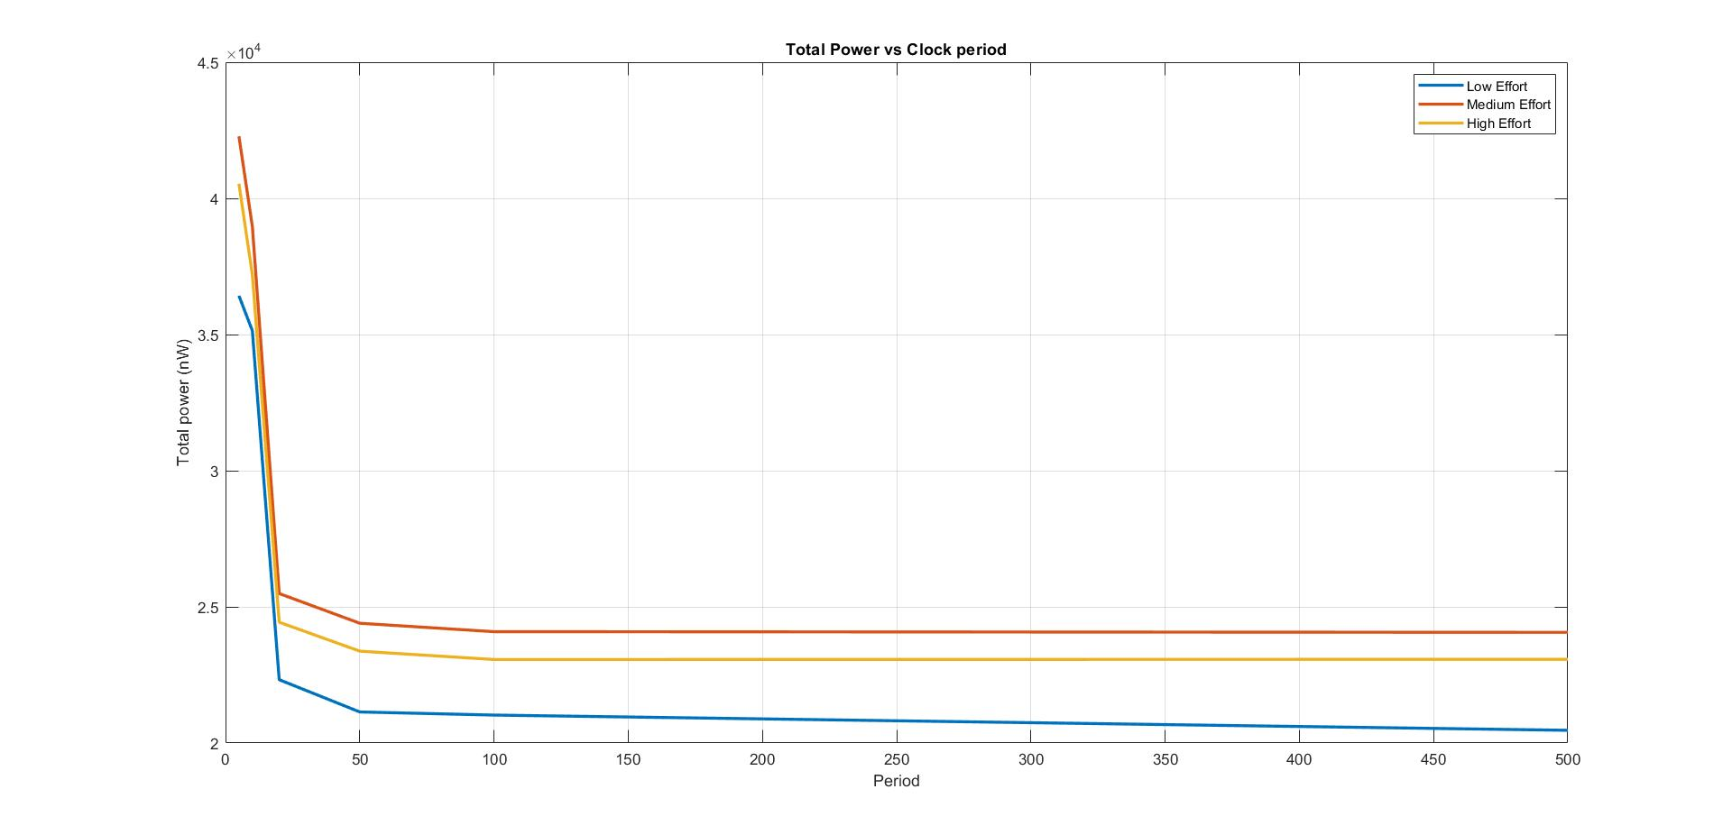
Period increases and power decreases but speed also decreases

Slide 26
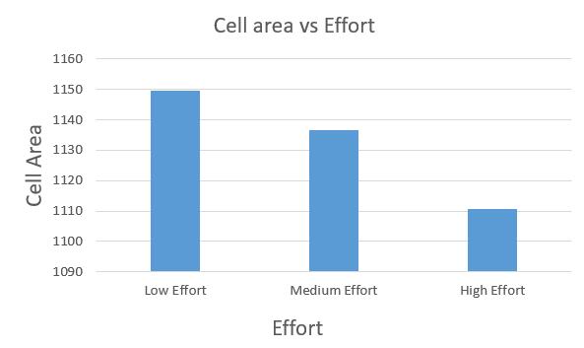
Variation of power in LOW and HIGH effort is 0.02 mW, but cell area is very high in Low effort

Slide 27
Variable: SETUP TIME/ HOLD TIME/ INPUT DELAY/ OUTPUT DELAY

Slide 28
Variable: SETUP TIME/ HOLD TIME/ INPUT DELAY/ OUTPUT DELAY
Clock Period: 10ns

Slide 29
Power and Area do not change with respect to a change in the mentioned parameters. However, different effort gives different values of Power and area

Slide 30
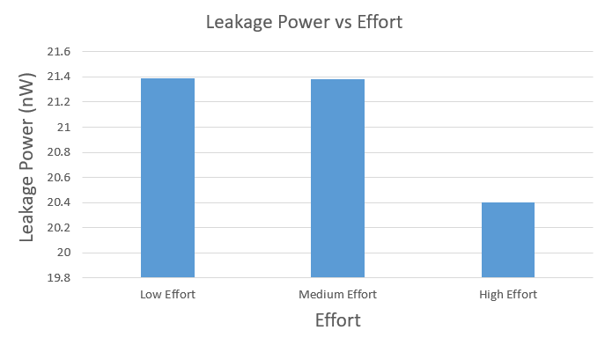
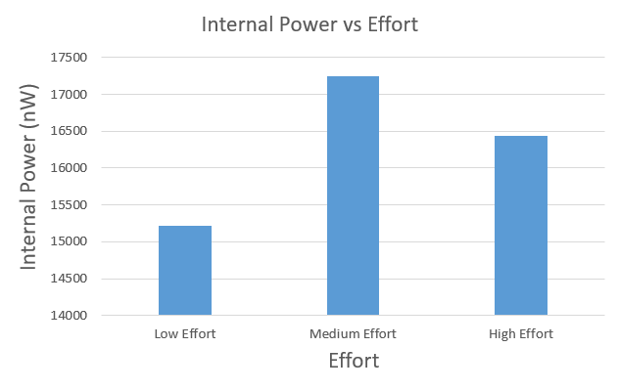
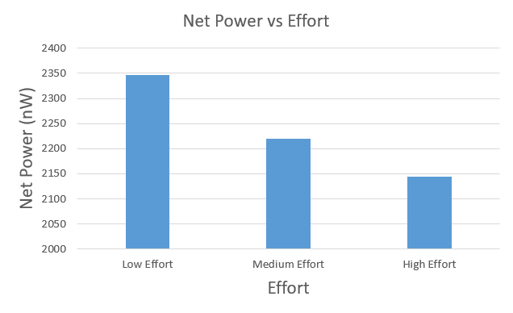
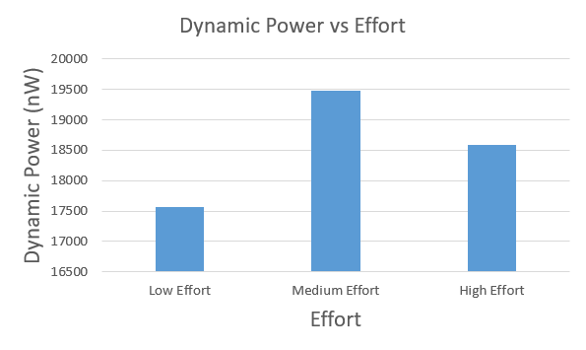

Slide 31
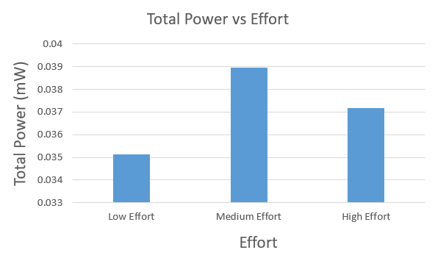

Slide 32
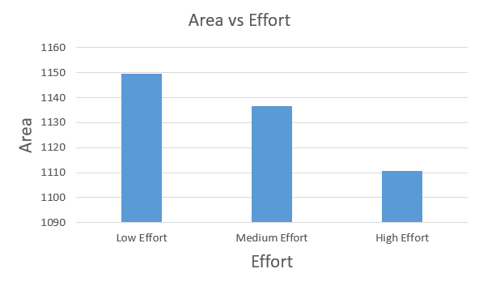

Slide 33
Variable: SETUP TIME/ HOLD TIME/ INPUT DELAY/ OUTPUT DELAY
Clock Period: 50ns

Slide 34
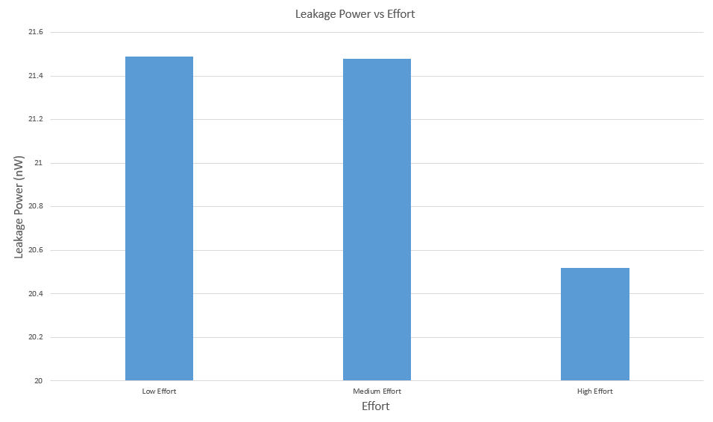
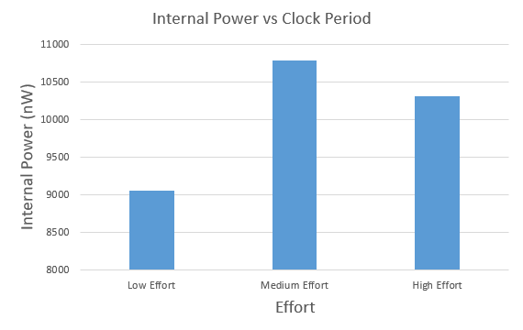
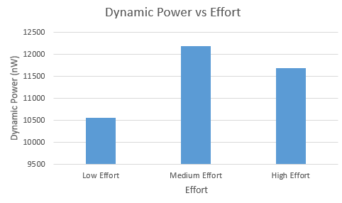
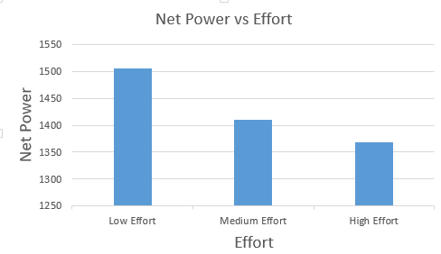

Slide 35
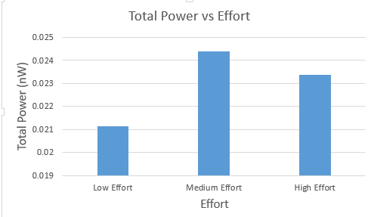

Slide 36
Remarks:
1. Low effort has lower power consumption
2. However low effort requires highest cell area
3. We can select medium or high effort since power consumption is not much higher (0.004 to 0.002 mW range), which allows us to reduce cell area
4. Power consumption shows exponentially decaying behavior with time period. We can choose clock period = 10ns (Power consumption curve almost saturates from this point).

Slide 37
Optimized Design
Parameters | Designed Value
Clock Period | 10ns
Setup Time | 3ns
Hold Time | 2ns
Input Delay | 0.4ns
Output Delay | 0.6ns

Slide 38
PHYSICAL DESIGN

Slide 39
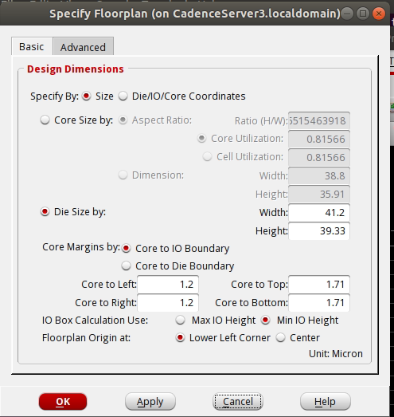
Default Layout: Area – 41.2 x 39.33, Spacing – 0.84, Set-to-set distance - 2

Slide 40
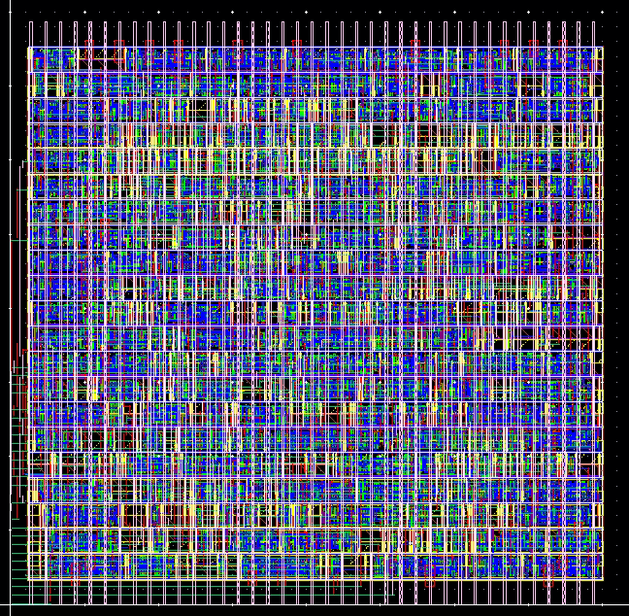
Default Layout: Area – 41.37 x 39.33, Spacing – 0.84, Set-to-set distance - 2

Slide 41
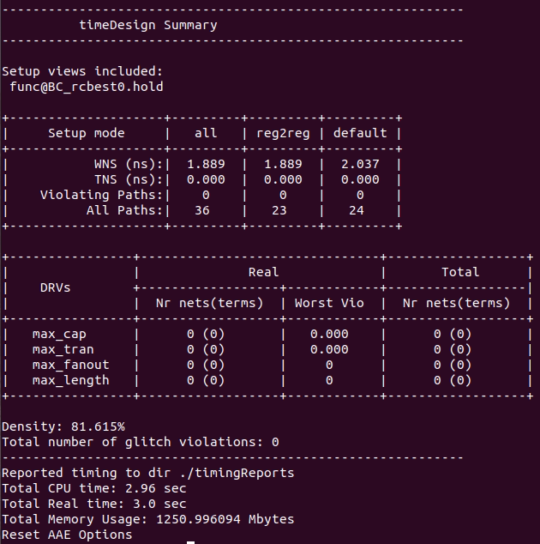
Default Layout: Area – 41.37 x 39.33, Spacing – 0.84, Set-to-set distance - 2

Slide 42
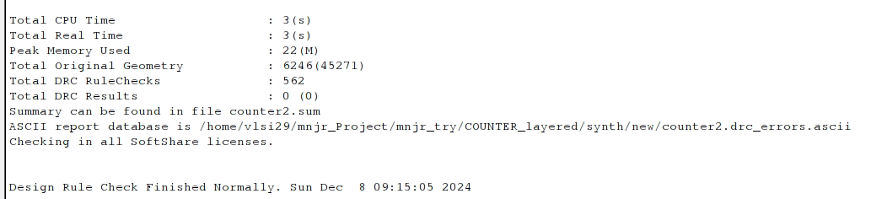
Default Layout: Area – 41.37 x 39.33, Spacing – 0.84, Set-to-set distance - 2

Slide 43
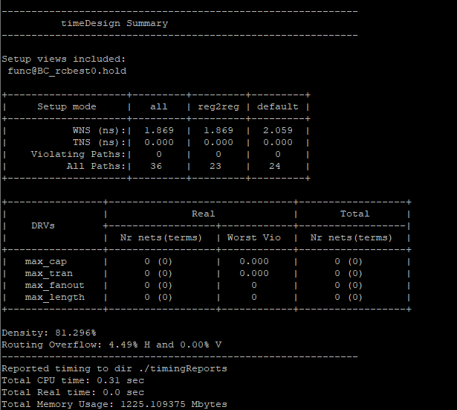
Default Layout: Area – 41.37 x 39.33, Spacing – 0.15, Set-to-set distance - 2

Slide 44
Default Layout: Area – 41.37 x 39.33, Spacing – 0.6, Set-to-set distance - 2

Slide 45
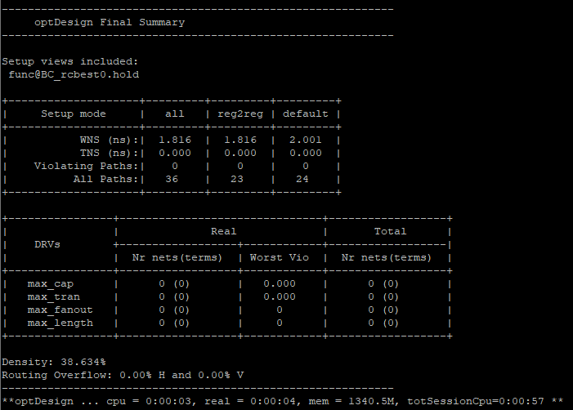
Final Optimized Layout: Area – 60 x 50, Set-to-set distance – 2, Spacing – 0.84

Slide 46
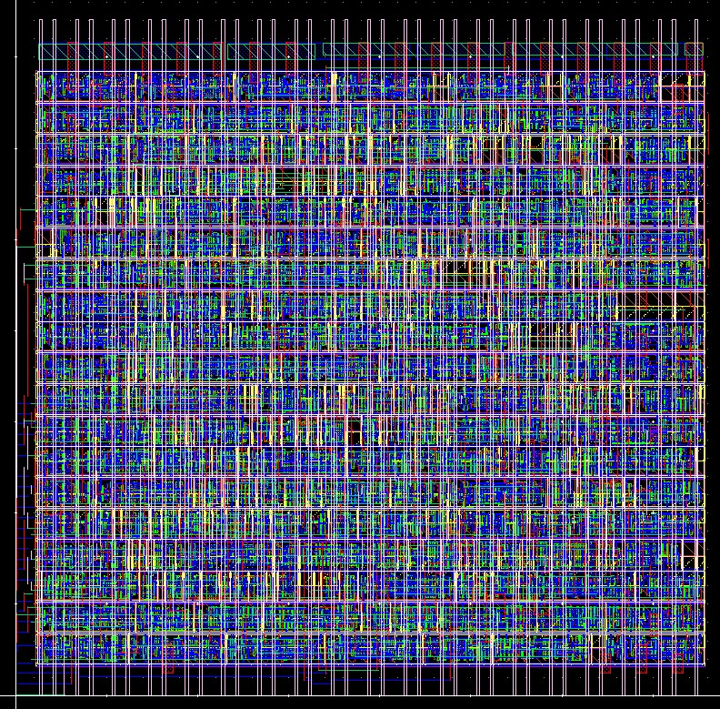
Final Optimized Layout: Area – 39 x 37, Set-to-set distance – 2, Spacing – 0.6

Slide 47
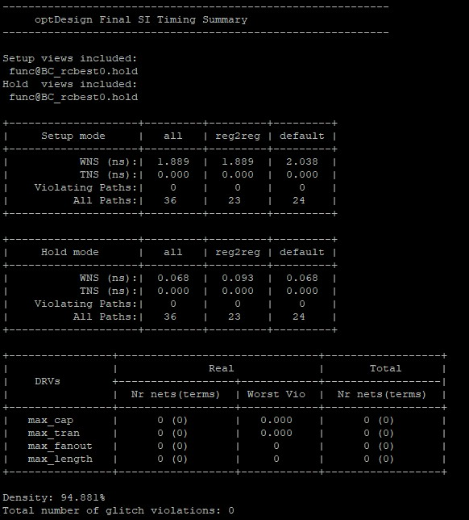
Final Optimized Layout: Area – 39 x 37, Set-to-set distance – 2, Spacing – 0.6

Slide 48
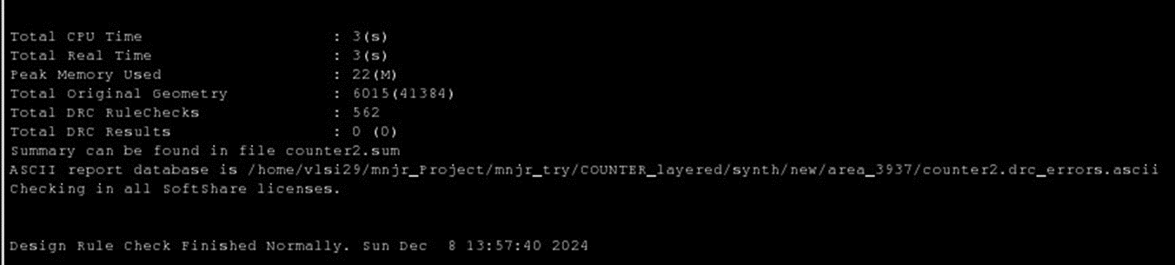
Final Optimized Layout: Area – 39 x 37, Set-to-set distance – 2, Spacing – 0.6

Slide 49
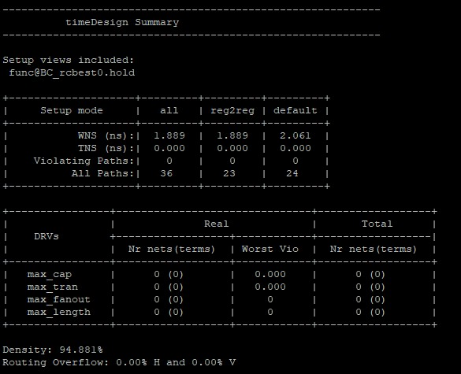
Final Optimized Layout: Area – 39 x 37, Set-to-set distance – 1, Spacing – 0.6
Final Optimized Layout: Area – 39 x 37, Set-to-set distance – 3, Spacing – 0.6

Slide 50
Optimized Design
Parameters | Designed Value
Width | 39
Height | 37
Set-to-set distance | 2
Spacing | 0.6
Density | 94.881%

Slide 51
THANK YOU

