Slide 1
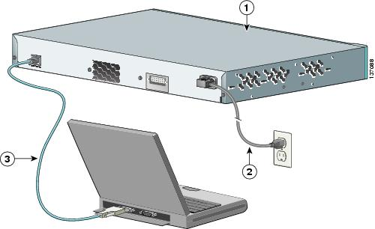
The Lights Out Problem
Admin access to the consoles of routers, servers, media converters.
Often critical during for emergencies
needed for setup and initial configuration
Desirable during firmware updates and other high risk activities

Slide 2
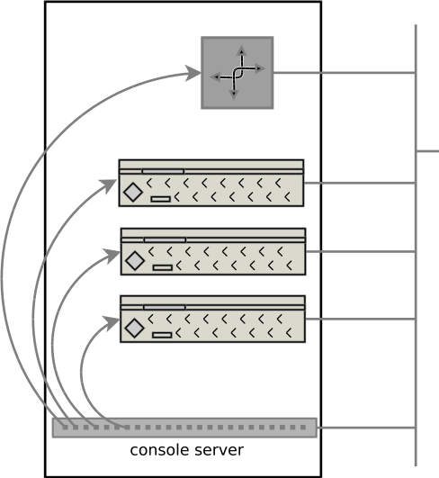
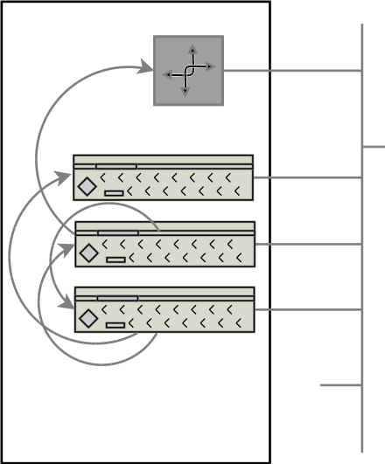
Existing Solutions 1
Terminal servers.
  Perfect for big cabinets
Use multi-serial card
  Uses PCI multi-port cards
  Leverages junk hardware
What’s
PCI?

Slide 3
Existing Solutions 2
HP: Guardian Service Processor and iLO, Dell: iDrac, IBM: Remove Service Adapter
  Works for servers
  Primarily IP-KVM, rather than serial console
    (but, in theory, IPMI provides serial ports)
  High bandwidth requirements, poor copy and paste, and very poor logging options.
    How to you copy&paste kernel crash message into google?
SNMP and other mgmt options for switches/routers tends to be vendor specific, and network focused

Slide 4
Challenges with existing solutions
Built-in server methods are vendor specific, interact poorly with non-Windows environments, and can be bandwidth expensive.
  Bandwidth (more so, latency) is usually a problem during a crisis!
Terminal server options do not scale to smaller data centers. (8-port devices can cost $1000+)
  Terminal servers with remote power control are available, but rare and expensive.
  Unknown security, few security updates, hard to customize.
PC-based systems are hard to scale beyond 4-ports, require available PCI slots (rate in 1U and 2U servers). Expansion cards are harder and harder to obtain.
  USB based serial ports often do not enumerate consistently
  Easily customized, sometimes too custom to be easily replicated or maintained.
  Harder and harder with move to virtualized servers, as ESXi does make serial port access easy.
All solutions result in significant risk of in-band exposure to control interfaces, or worse, lack of access to interfaces.
“dialup” and “DSL” options are fading fast, and what if you are the DSL provider in the area?

Slide 5
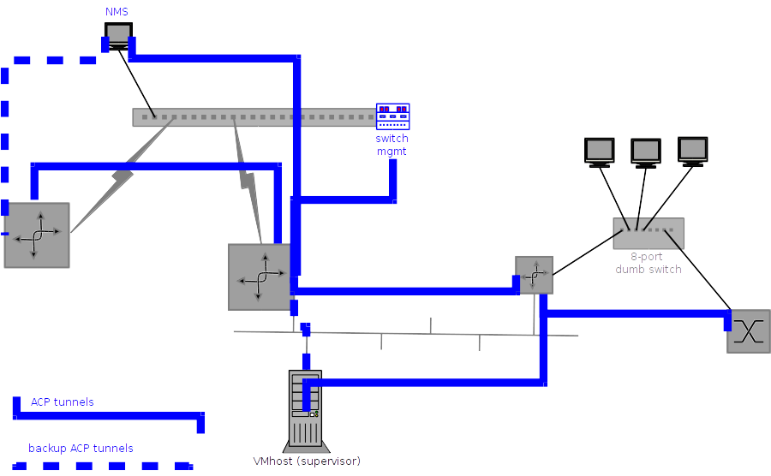
ANIMA based solutions
Within 2 product life cycles (~5 years) expect ANIMA and Autonomic Control Plane (ACP) solutions to be everywhere.
The ACP is the IPv6 out-of-band VPN that lives on top of the in-band network, is automatically created.

Slide 6
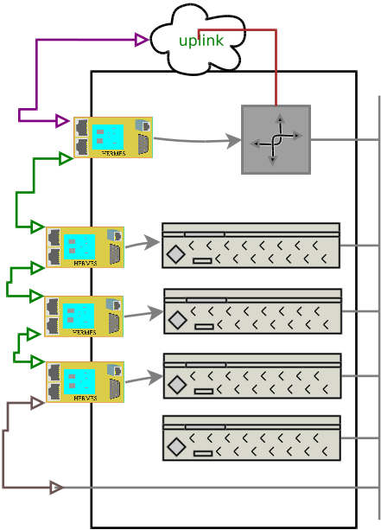
HERMES
Have the ACP now for legacy (console/craft) devices using an inexpensive small box.
Daisy chain units
Expand incrementally
Optionally Control power
Connect to private VLAN for mgmt access (e.g. ESXi/vSphere, switch VLAN 1)
Uplink via any DHCPv4/v6, create a tunnel home.
Cross link between cages via optional ad-hoc wifi.

Slide 7
Technical details/Standards
New units auto enroll using ANIMA bootstrap mechanism.
Connect cables in any desired way, use as many hubs, switches or WAN links as desired.
Access to serial port is via rfc2217 using ssltelnet, can be be kerberized. (or via ssh)
ANIMA ACP uses auto configured IPsec/IKEv2 for traffic.
ACP uses RPL (RFC6550) L3 routing protocol for (redundant) connectivity.
RPL finds shortest path and keeps redundant paths available.

