Slide 1
Hermes Connect
creates opportunities for colocation!

Slide 2
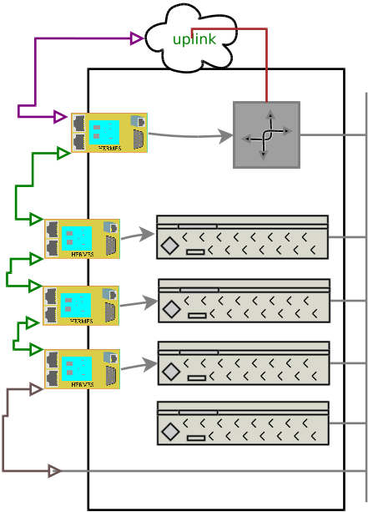
HERMES Connect… that uplink
This link is
the one
that hurts
As long as customer does not need to service the border router/switch, things can be fine.
But, if they screw up their switch/firewall/etc. then they cut themselves off…
Unless!!!!

Slide 3
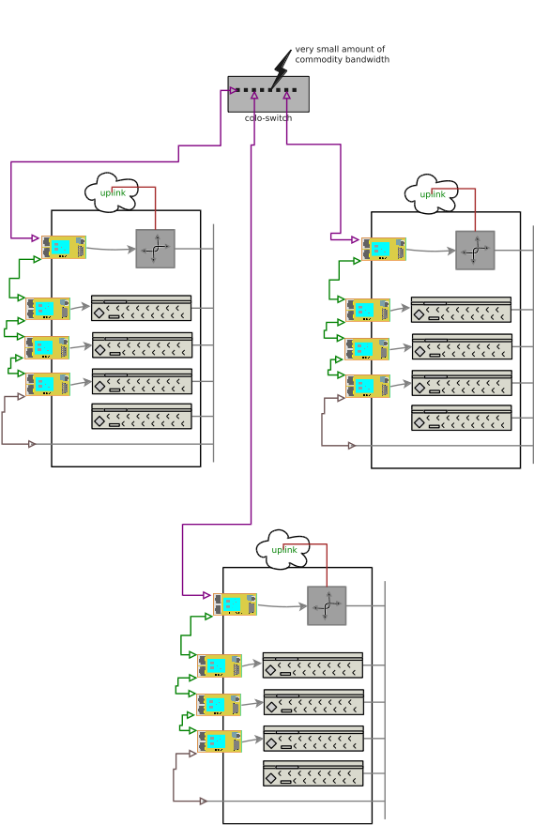
HERMES Connect… that uplink
Have the colo provide a small amount of connectivity

