Slide 1
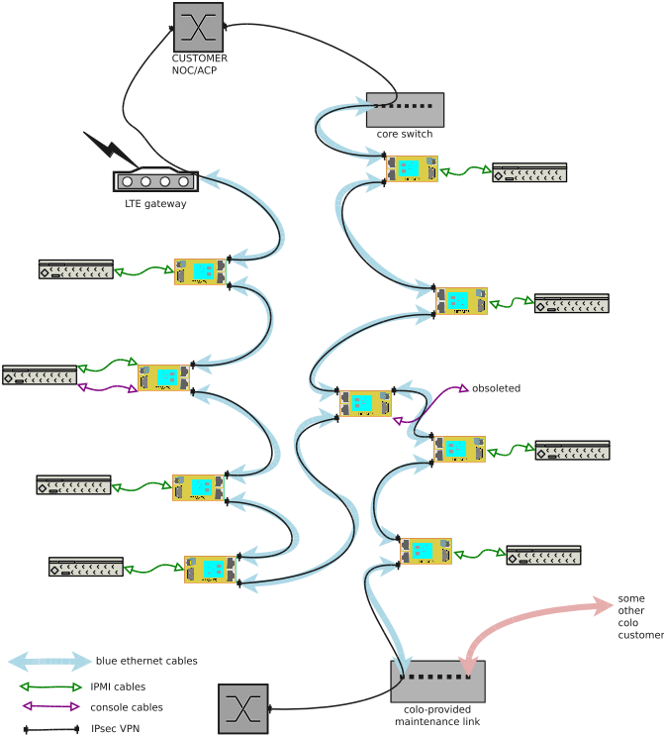
Operational State
This illustrates a possible setup of eight Hermes Connect units, along with an extra. There are three uplinks shown. One is inband with the traffic in the cabinet (“core switch”), a second one utilities a commodity LTE gateway that provides NAT44 (maybe even CGN) access.
Also shown is a third uplink (“colo”) which provides services to many cabinets.
All traffic between Connect units is encrypted, even with the cabinet.
The green cables could be unencrypted IPMI cables, and the purple cables are RS232 serial console cables.

Slide 2
Technical details/Standards
New units auto enroll using ANIMA bootstrap mechanism.
Connect cables in any desired way, use as many hubs, switches or WAN links as desired.
Access to serial port is via rfc2217 using ssltelnet, can be be kerberized. (or via ssh)
ANIMA ACP uses auto configured IPsec/IKEv2 for traffic.
ACP uses RPL (RFC6550) L3 routing protocol for (redundant) connectivity.
RPL finds shortest path and keeps redundant paths available.

