Slide 1
RFC8994 – Autonomic Control Plane
Implementation Report
IETF120 – Vancouver – July 2024
Michael Richardson
<mcr+ietf@sandelman.ca>
https://github.com/ANIMAgus-minerva/
https://minerva.sandelman.ca/

Slide 2
Cast List
RFC8995 components
  Minerva Highway (MASA)
  Minerva Fountain (Registrar)
  Minerva Reach (test pledge)
  Minerva RustyBeach (pledge written in Rust)
    no_std goal
    bootstrap
RFC8994 components
  Minerva Connect
  Minerva Rooster
  Unstrung (RPL daemon)
  Bluerose Openswan (IPsec IKEv2 daemon)

Slide 3
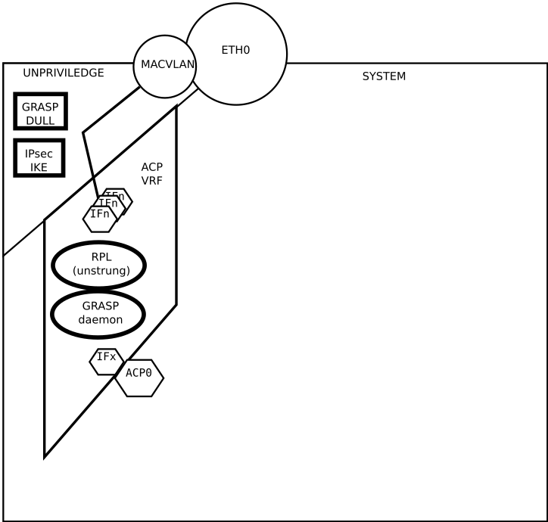
Architectural Diagram - 1
abutment
Uses Linux network namespaces
  Not a fully isolated container.
Parent process deals with network interfaces coming/going, and creates virtual interfaces that it pushes into the unpriviledged “dull” space.
  Calling it the “abutment” space since early 2024.
  IKE daemon runs in the abutment space
  GRASP DULL daemon runs in the abutment space
A second space is the “ACP” space
  The RPL daemon runs in the ACP space.
  Full GRASP daemon will run in the acp space
System sees a single interface, “acp0”, which has an IPv6 address assigned by the Registrar, and a /48 route for the rest of the ACP
system
ACP

Slide 4
Architecture Diagram - 2
System – Connect Main PID
tokio-runtime
macvlan
Send into namespace
Abutment
Unshare(2)
tokio-runtime
IPC
(CBOR-SERDE)
Scan
interfaces
xfrmtun
Send into namespace
ACP
Unshare(2)
tokio-runtime
IPC
(CBOR-SERDE)

Slide 5
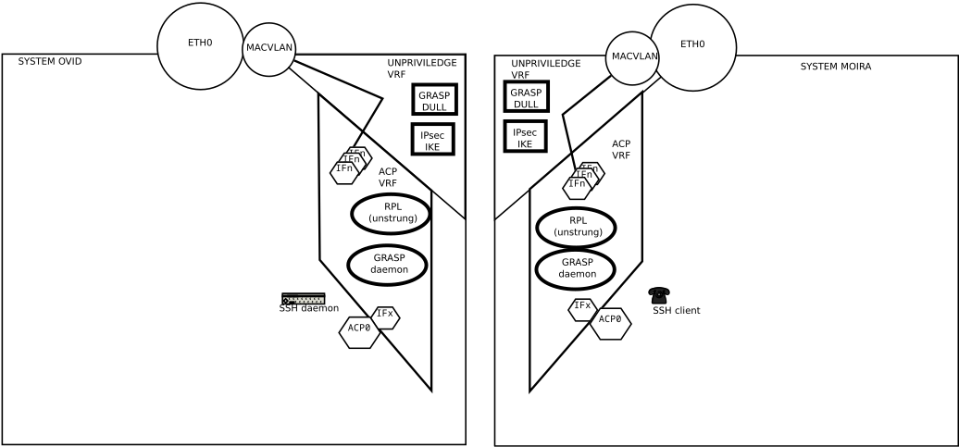
Architecture Diagram - 3
ESP
M_FLOOD
IKE_INIT
ACP_x
Interface
(xfrmtun)
RPL, new
interface
RPL
DIO
DAO

Slide 6
Challenges
Connect written in rust
  5500 lines with some unit tests
  Started in fall 2020
BlueroseSwan written in C
  History going back to 1997
    (my history starts in 2001)
Unstrung (RPL) written in C++
  11K lines, including tests
  Started in 2009, gap from 2016 to 2021
I’m uniquely steeped in these three technologies. Hah.
Each daemon deals with lists of network interfaces
  Using Netlink socket
  Connect in three different namespaces
Connect creates interfaces and moves them around network namespaces that it manages
Bugs in systemd-login that makes it kill ssh if a namespace gets abandonned
  Don’t use systemd for now.
Linux IPsec turns out not to allow IPv6 scope-id to be set for the IPsec ESP SA
  Discovered in fall 2022 after ruling out other annoying issues involving IPsec eating ICMP ND messages
  Was obvious in hindsight

Slide 7
Solutions
Teach ESP about scope-id for IPv6-LL
  Worth doing, but lots of target systems won’t get new kernels tomorrow
Number things with ULA and try that
  Okay, but too much coordination required?
Each systems numbers its abutment interfaces using a local ULA/48.
  fdab:1234:3456:ifindex::IID/128

Slide 8
Hacking around with ULAs
Was v6-LL
Now can be ULA
M_FLOOD
let ike_locator = grasp::GraspLocator::O_IPv6_LOCATOR { v6addr: myv6,
transport_proto: IPPROTO_UDP,
port_number: 500 };
let acp_objective =grasp::GraspObjective { objective_name: "AN_ACP".to_string(),
objective_flags: grasp::F_SYNC,
loop_count: 1, /* do not leave link */
objective_value: Some("IKEv2".to_string()),
locator: Some(ike_locator) };
let flood = grasp::GraspMessage { mtype: GraspMessageType::M_FLOOD,
session_id: sesid,
initiator: myllv6,
ttl: 10000,
objectives: vec![acp_objective] };
Remains
IPv6-LL

Slide 9
Hacking around with ULAs - 2
./dull ip -6 route ls
fdcc:aeab:2346:e:50ab:93ff:fee8:8dd4(/128) via fe80::50ab:93ff:fee8:8dd4 dev dull014 proto static metric 1024 pref medium
fdcc:aeae:1234:24:9041:4eff:fe17:3e6b via fe80::9041:4eff:fe17:3e6b dev dull014 proto static metric 1024 pref medium

Slide 10
More Challenges
Macvlan does not mix with bridges (same internal hooks)
  So connect creates ethernet pairs, and adds them to the bridge, if it finds a bridge.
hermes-[~] mcr 10016 %brctl show
bridge name bridge id STP enabled interfaces
trusted 8000.52540051dafb no eth0
pull014
hermes-[~] mcr 10017 %./dull ifconfig
dull014: flags=4163<UP,BROADCAST,RUNNING,MULTICAST> mtu 1500
inet6 fe80::44c7:b2ff:fea2:6bbc prefixlen 64
inet6 fdc2:ae5d:4f12:23:44c7:b2ff:fea2:6bbc
ether 46:c7:b2:a2:6b:bc txqueuelen 1000 (Ethernet)
Ethernet pairs have randomly assigned layer-2 addresses
So have random IIDs for Ipv6-LL.
ULA is reusing the IID too!
Every run has new values, which makes debugging annoying.
moira-[~] mcr 10038 %./dull ping6 fe80::44c7:b2ff:fea2:6bbc%dull013
PING fe80::44c7:b2ff:fea2:6bbc%dull013(fe80::44c7:b2ff:fea2:6bbc%dull013) 56 data bytes
64 bytes from fe80::44c7:b2ff:fea2:6bbc%dull013: icmp_seq=1 ttl=64 time=5.36 ms
64 bytes from fe80::44c7:b2ff:fea2:6bbc%dull013: icmp_seq=2 ttl=64 time=5.64 ms
64 bytes from fe80::44c7:b2ff:fea2:6bbc%dull013: icmp_seq=3 ttl=64 time=5.61 ms

Slide 11
Inside ESP debugging
moira-[~] mcr 10002 %./acp ifconfig
acp_6bbc_3e6b: flags=193<UP,RUNNING,NOARP> mtu 1500
inet6 fe80::eafa:d18d:5087:c609 prefixlen 64
acp_8dd4_3e6b: flags=193<UP,RUNNING,NOARP> mtu 1500
inet6 fe80::bc1e:dd58:c3a3:70f6 prefixlen 64
To test ACP interface to ACP interface, can use ping6 LL with interface.
Wound up naming ACP interfaces for two ends of v6-LL outside (abutment) interface
hermes-[~] mcr 10018 %./acp ifconfig
acp_6bbc_3e6b: flags=193<UP,RUNNING,NOARP> mtu 1500
inet6 fe80::d3b6:906f:4ec5:e6b9 prefixlen 64
acp_8dd4_6bbc: flags=193<UP,RUNNING,NOARP> mtu 1500
inet6 fe80::2cc5:805a:658a:58f6 prefixlen 64
hermes-[~] mcr 10018 %./acp ifconfig
acp_6bbc_3e6b: flags=193<UP,RUNNING,NOARP> mtu 1500
inet6 fe80::d3b6:906f:4ec5:e6b9 prefixlen 64
acp_8dd4_6bbc: flags=193<UP,RUNNING,NOARP> mtu 1500
inet6 fe80::2cc5:805a:658a:58f6 prefixlen 64
ovid-[~] mcr 10026 %./acp ifconfig
[sudo] password for mcr:
acp_8dd4_3e6b: flags=193<UP,RUNNING,NOARP> mtu 1500
inet6 fe80::c996:b05c:33e2:5d0 prefixlen 64
acp_8dd4_6bbc: flags=193<UP,RUNNING,NOARP> mtu 1500
inet6 fe80::676d:d807:bdf4:3a42 prefixlen 64
23:48:51.211012 IP6 fdcc:aeae:1234:24:9041:4eff:fe17:3e6b >
fdcc:aeab:2346:e:50ab:93ff:fee8:8dd4: ESP(spi=0x40f1ad64,seq=0x65)
23:49:22.571054 IP6 fdc2:ae5d:4f12:23:44c7:b2ff:fea2:6bbc >
fdcc:aeae:1234:24:9041:4eff:fe17:3e6b: ESP(spi=0xef984590,seq=0x73e)

Slide 12
moira-[~] mcr 10006 %./acp ping6 fe80::ca88:90a3:49ff:7fd5%acp_fca9_c740
PING fe80::ca88:90a3:49ff:7fd5%acp_fca9_c740(fe80::ca88:90a3:49ff:7fd5%acp_fca9_c740) 56 data bytes
From fe80::7170:bf9d:fdd8:6b04%acp_fca9_c740 icmp_seq=1 Destination unreachable: Address unreachable

Slide 13
RPL layer
ovid
ovid
moira
moira
Root
(hermes)
Root
(hermes)

Slide 14
Conclusions 1
ULA numbering is a 2nd version of IPsec.
  Fundamentally non-interoperable with IPv6-LL version
  GRASP announcement can announce both, mind you.
  If we introduce this hack it probably won’t go away
Debugging is really difficult/tidious, we need to include some additional sanity checks
  Need to get telemetry back (over ACP!)
    So really, this all needs YANG modules that can describe topology: ACP, RPL,
  Some other ways/conventions to allow this to be more easily understood
    Or just make it so reliable it doesn’t matter

Slide 15
Conclusions/Concerns
On a LAN with an ACP-ignorant switch
  Such as a Top-of-Rack Switch full of 1U servers containing a BMC
Every system sees every other system
  RPL prunes things, after IPsec tunnel is created
With 20 to 40 1U servers per cabinet...
  1560 IPsec tunnels
    Worse if multiple cabinets are L2 connected
Need to prune tunnels at GRASP level
  GRASP DULL needs to offer priority so ACP daemons can pick 2-3 links, and avoid all piling on top of a single DODAG parent
  RFC9032, (and draft-ietf-roll-enrollment-priority) do this for 6tisch/802.15.4, we need to repeat this in GRASP DULL M_FLOOD announcements
Such a nice problem to have!

