Slide 1
Black-box variational inference on Bayesian neural network
ML from scratch 12/15/2021
Johannes Bill and Alex Zhang

Slide 2

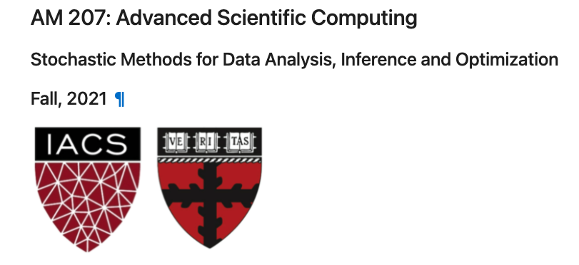
Acknowledgment
Weiwei Pan
POSTDOCTORAL FELLOW LECTURER IN COMPUTATIONAL SCIENCE

Slide 3
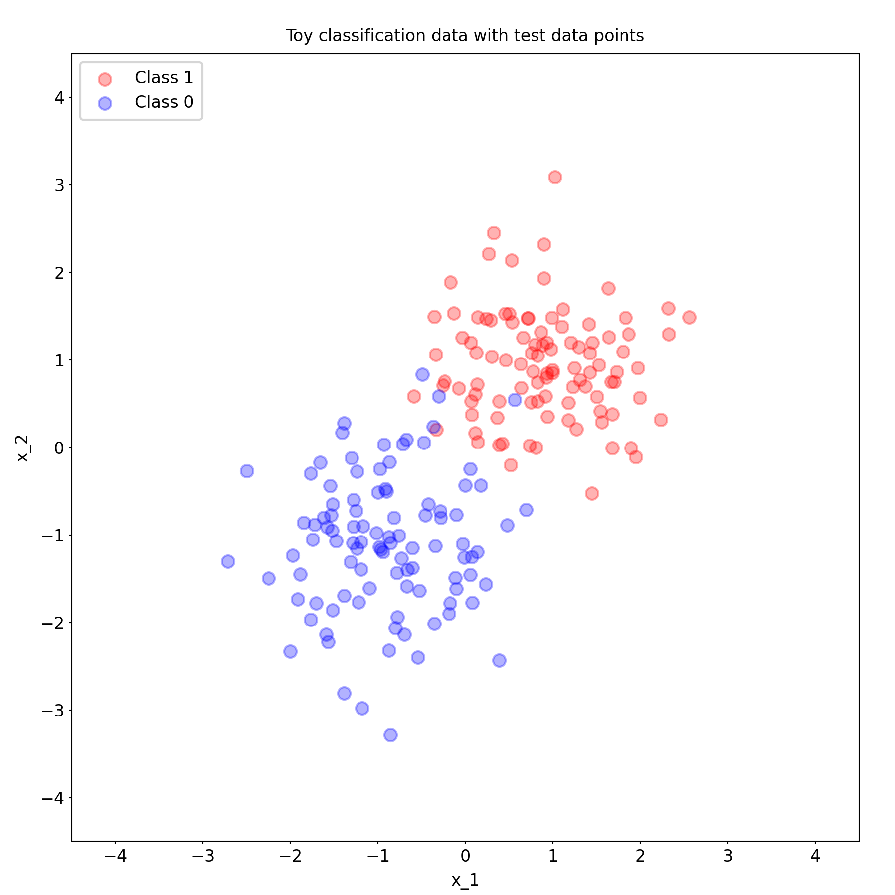
Why should we care about predictive uncertainty?

Slide 4
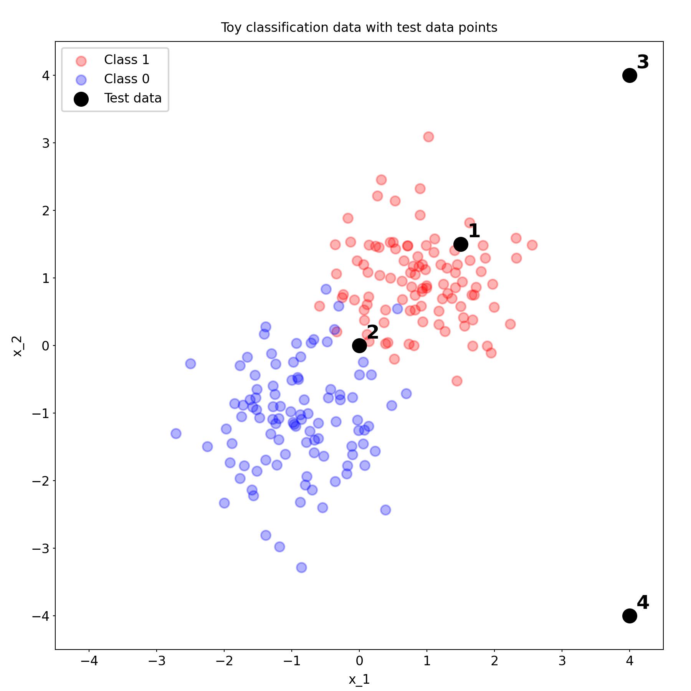
Why should we care about predictive uncertainty?
Out-of-distribution data
(OOD data)

Slide 5
Bayesian treatment of function approximators -> predictive uncertainty

Slide 6
Let’s collect some human data on this classification task!!

Slide 7
BBVI with the reparameterization trick (on models for binary classification)
How do we get posterior distribution p(W | Data)?
What is variational inference?
How do we do black-box variational inference?
Reparameterization trick
Experiment outline
Bayesian logistic regression
Bayesian logistic regression with polynomial features
Bayesian neural network
Deepnote link for tomorrow to follow…

