Slide 1
Open Source Brain
http://www.opensourcebrain.org
The Open Source Brain initiative (OSB) makes computational models of neurons and networks available in open source, standardized formats such as NeuroML and PyNN, encouraging collaborative development. Models and model components can be viewed, analysed and their functional behaviour explored through online simulations in standard web browsers.
Neuroinformatics tutorial
1.5 Model sharing
Notes:
1

Slide 2
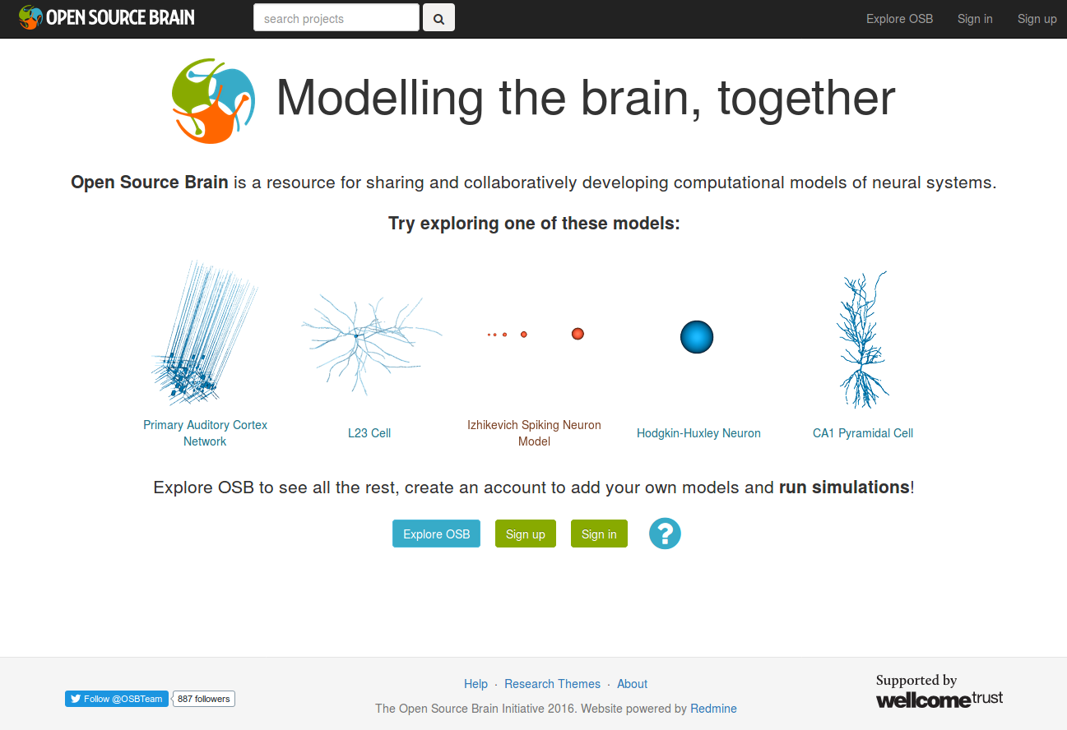
Notes:
1

Slide 3

Models available on OSB
Olfactory Bulb
Migliore et al (2014)
Olf. Bulb network model
Neocortex
Mainen et al. (1995)
L5 Pyramidal cell
Rothman et al. (2010)
L5 Pyramidal cell
Hay et al (2011)
L5 Pyramidal cell
Traub et al. (2005)
L2/3 Pyr (FRB/RS), L4SS,
L5 Pyr (IB/RS), L6 Pyr,
Deep & superficial basket,
axo-axonic & LTS
interneurons,
Cortical column network
model
Cerebellum
Maex and Schutter (1998)
Granule cell layer
Steuber and Saviane, based
on Berends et al. (2005)
Granule cell
Vervaeke et al. (2010)
Golgi cell network
Solinas et al. (2007a,b)
Granule cell, Golgi cell
De Schutter and Bower (1994)
Purkinje cell
Steuber et al. (2011)
Cerebellar nucleus
neuron
Abstract neuron models
Izhikevich (2003)
Morris & Lecar (1981)
FitzHugh & Nagumo (1969)
Hippocampus
Migliore et al. (2005)
CA1 Pyramidal cell
Bezaire et al (2017)
Full scale CA1
Thalamus
Traub et al. (2005)
Thalamocortical relay cell,
Nucleus reticularis thalami cell
C elegans
OpenWorm project
302 cell connectome
Notes:
1

Slide 4
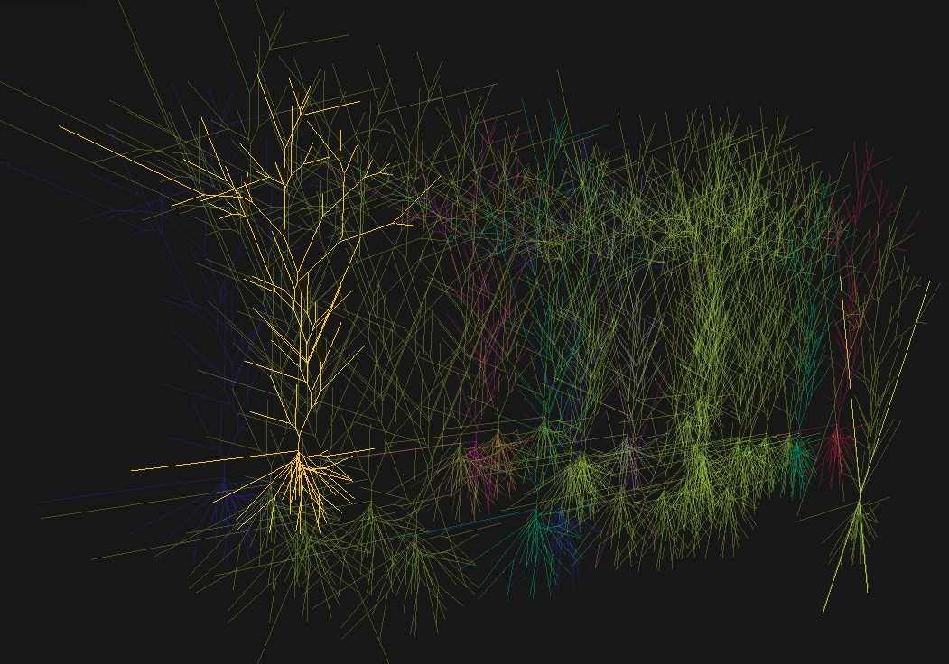
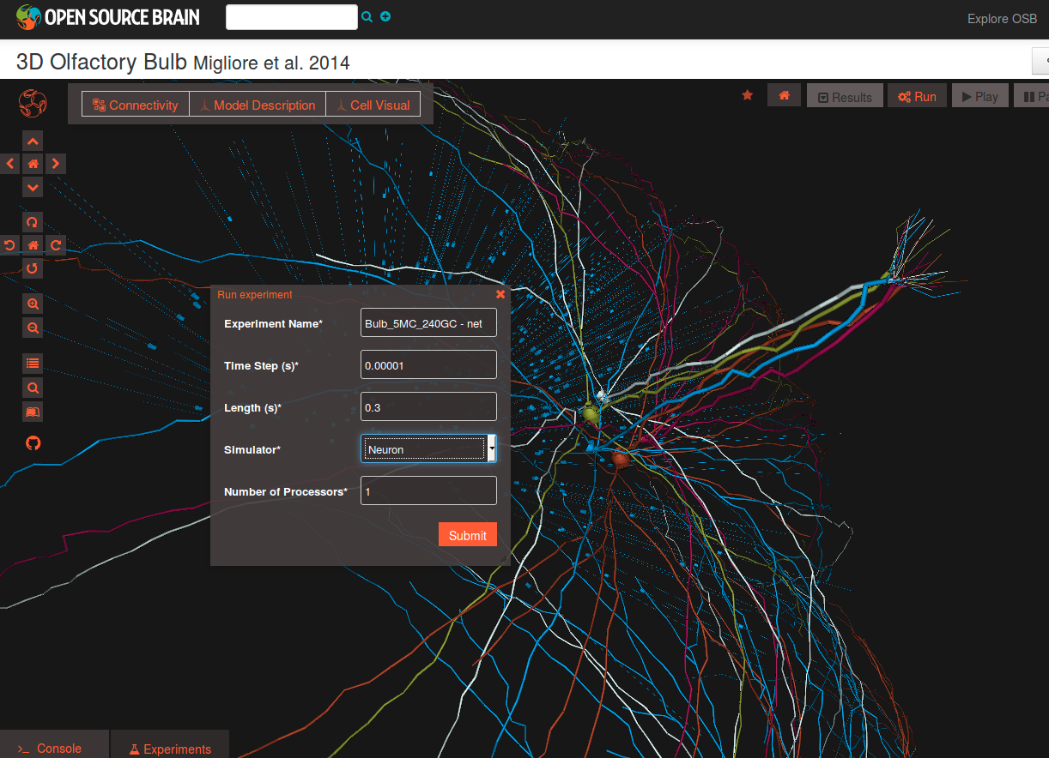
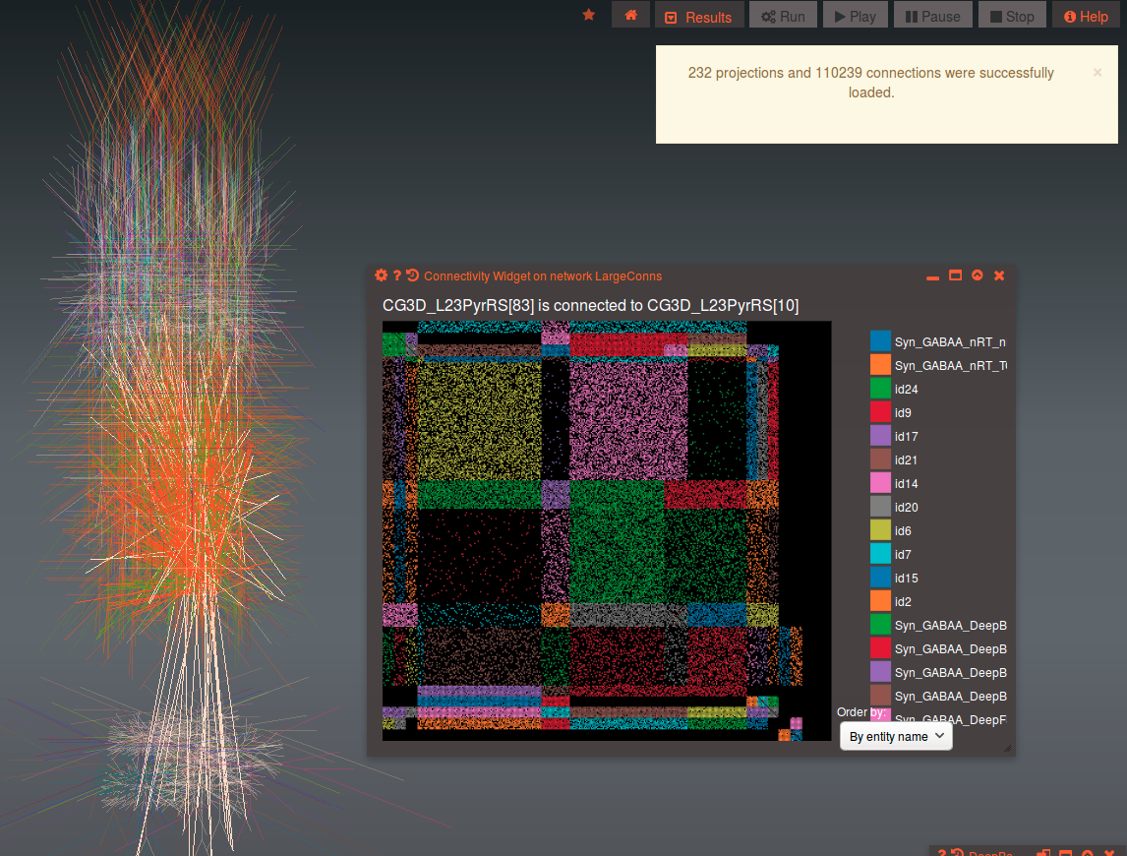
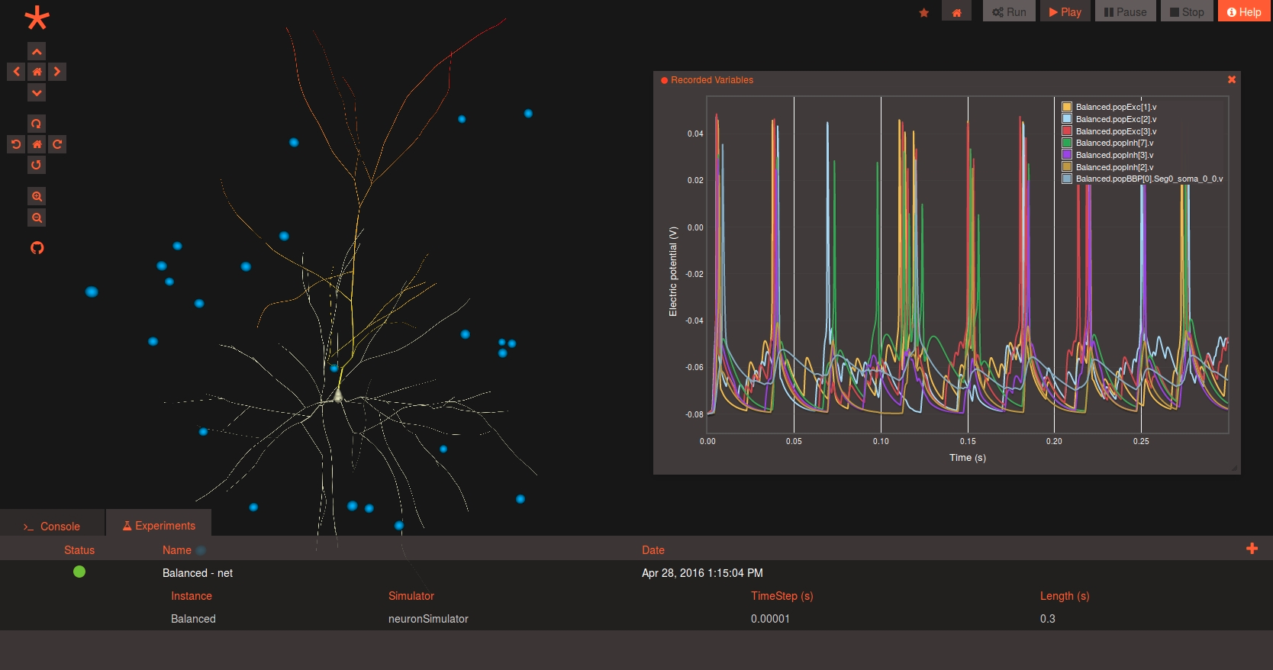
Notes:
1

