Slide 1
IonChannelGenealogy
https://icg.neurotheory.ox.ac.uk
The ICG database provides a comprehensive and quantitative assay of ion channel models currently available in the neuroscientific modeling community, all browsable in interactive visualizations.
Neuroinformatics tutorial
1.2 Structured data from literature
Notes:
1

Slide 2
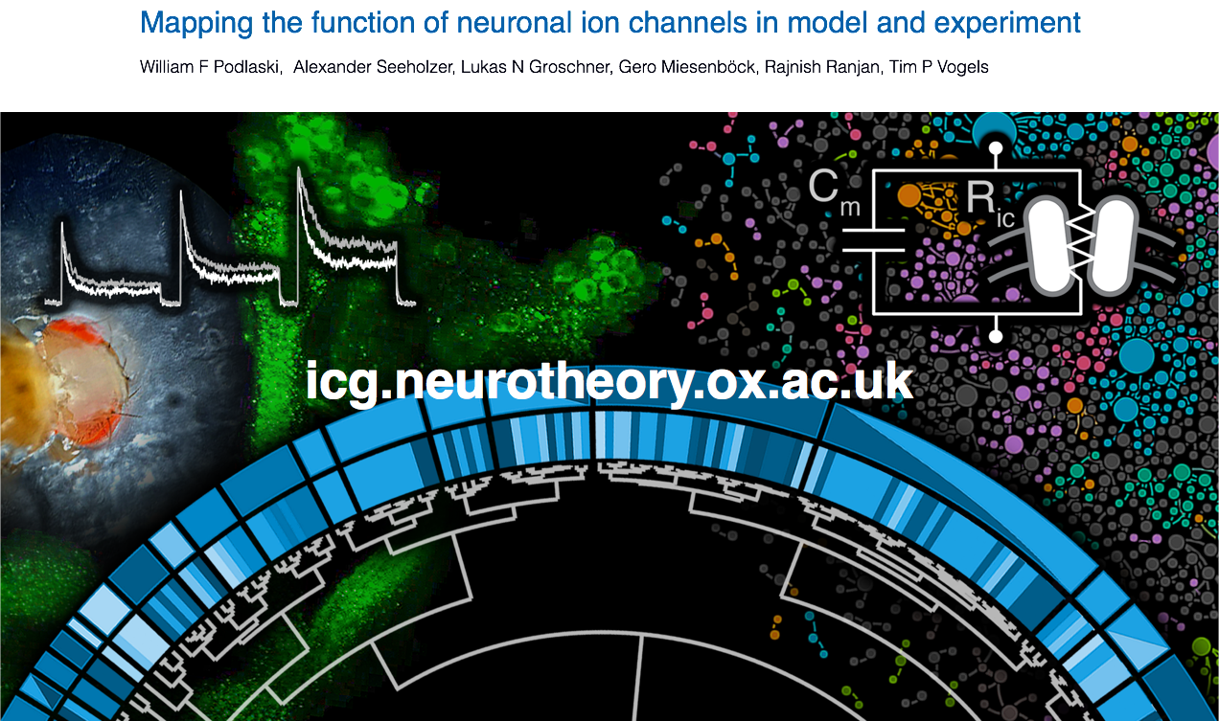
Notes:
2

Slide 3
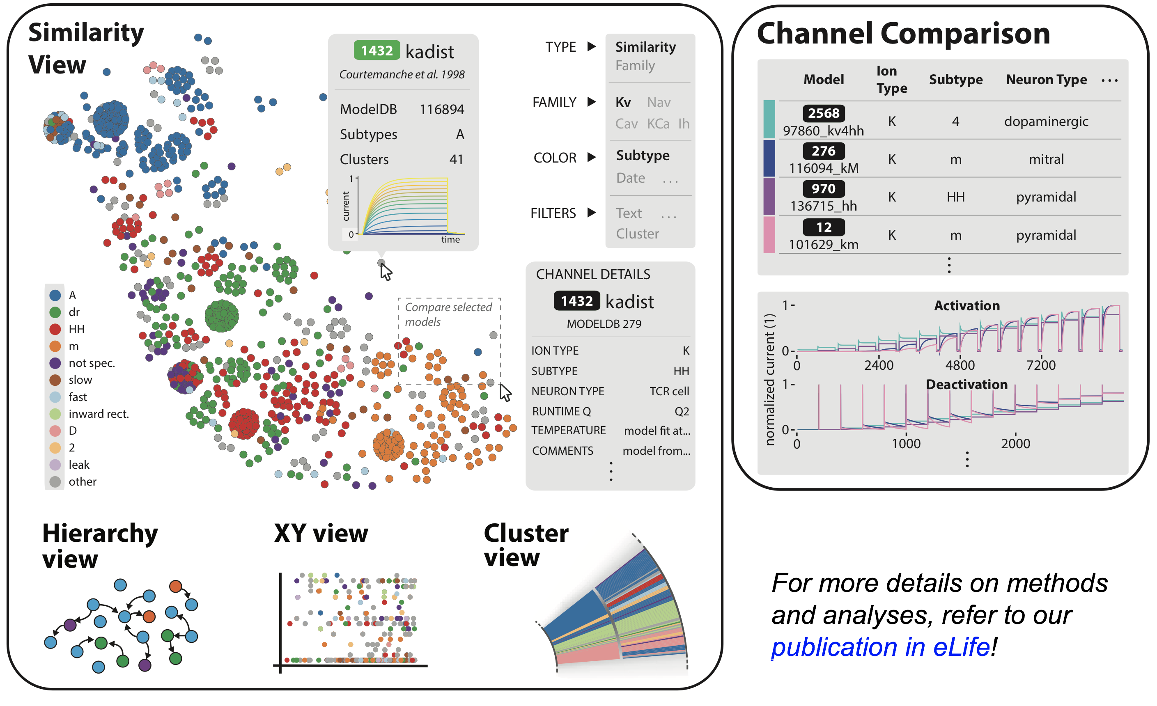
The ICG website
(2) Compare ion channel metadata
and kinetics side by side:
(1) Browse database through four interactive views:
For more details on methods
and analyses, refer to our
publication in eLife!

Slide 4
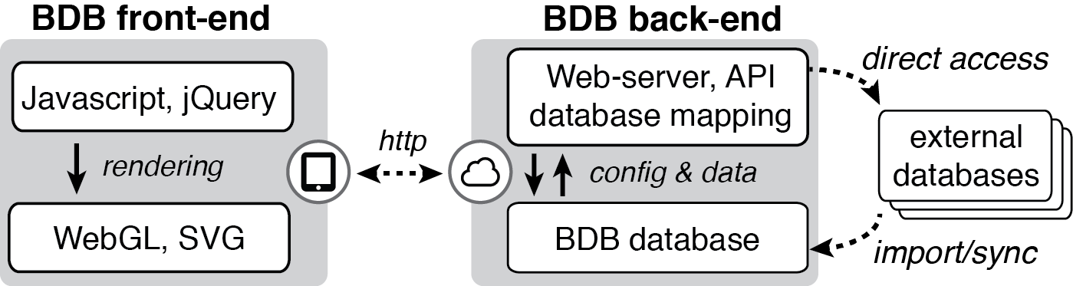

Current and future work
Addition of models in other programming languages & channel types
Maintenance of database with new models
& collection of experimental traces
Integration with existing resources
(ModelDB, NeuroML, etc.)
Extension to combinations of
ion channel models, morphology,
and other neuroscience datasets
Generalisation of the database and
visualisation software
Continued support thanks to
funding from the BBSRC
Notes:
4

