Slide 1
Neuroscience Gateway (NSG)
http://www.nsgportal.org
NSG facilitates access and use of High Performance Computing resources freely and openly for the neuroscience community via web-based and programmatic (RESTful API) access. Various computational neuroscience tools, libraries, pipelines and data processing software are made available on HPC resources.
Neuroinformatics tutorial
1.6 Computing infrastructure
Notes:
1

Slide 2




NSG - Portal and Programmatic Access
NSG Portal: Simple and easy to use web interface
NSG–R: Programmatic access through RESTful services
NSG user interface
Browser interface
HPC resource 1
Programmatic access
NSG
HPC resource 2
Other Neuroscience community projects
RESTful web services
HPC resource3

Slide 3
Currently available tools/software/pipelines
New tools are added continuously based on request from users, researchers, and developers
Current ( July, 2017) tools, libraries, software, pipelines
BluePyOpt, Michele Migliore et al, National Research Council, Italy | PyMoose
BRIAN | NEST
CARLsim, Jeffrey Krichmar, UC Irvine | NEURON
The Virtual Brain Personalized Medicine Pipeline, Petre Ritter, Humboldt University | Parameter Search Dieter Jaeger, Emory University
FreeSurfer | PyNN
Large Scale Neural Simulator Antonio Ulloa, Neural Bytes | Python
Matlab | R
TensorFlow | Octave
GENESIS

Slide 4
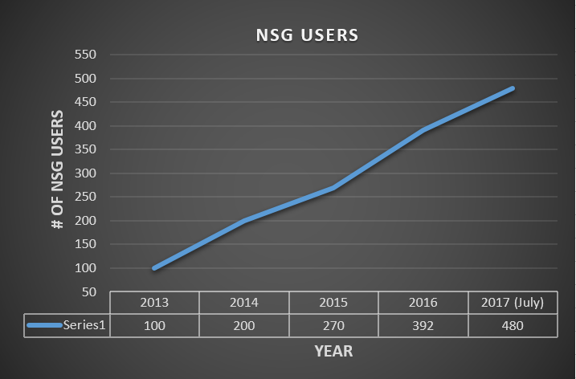
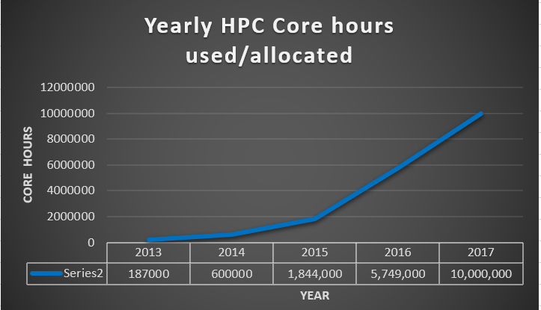


NSG usage growing – since 2013

