Slide 1
Amazon Web Services
http://aws.amazon.com
Amazon Web Services (AWS) is a cloud computing platform by Amazon which provides on demand or 24/7 access to virtual computing resources such as computing (CPU & GPU), storage, databases, etc.
Neuroinformatics tutorial
1.6 Computing infrastructure
Notes:
1

Slide 2

Amazon Web Services
Widely used cloud computing platform
Can be used for:
Web hosting
Databasing
Compute intense tasks
Useful for short or long term managed computing (easier than maintaining your own servers)
Example: OSB is hosted on AWS (live and development servers)
Notes:
2

Slide 3
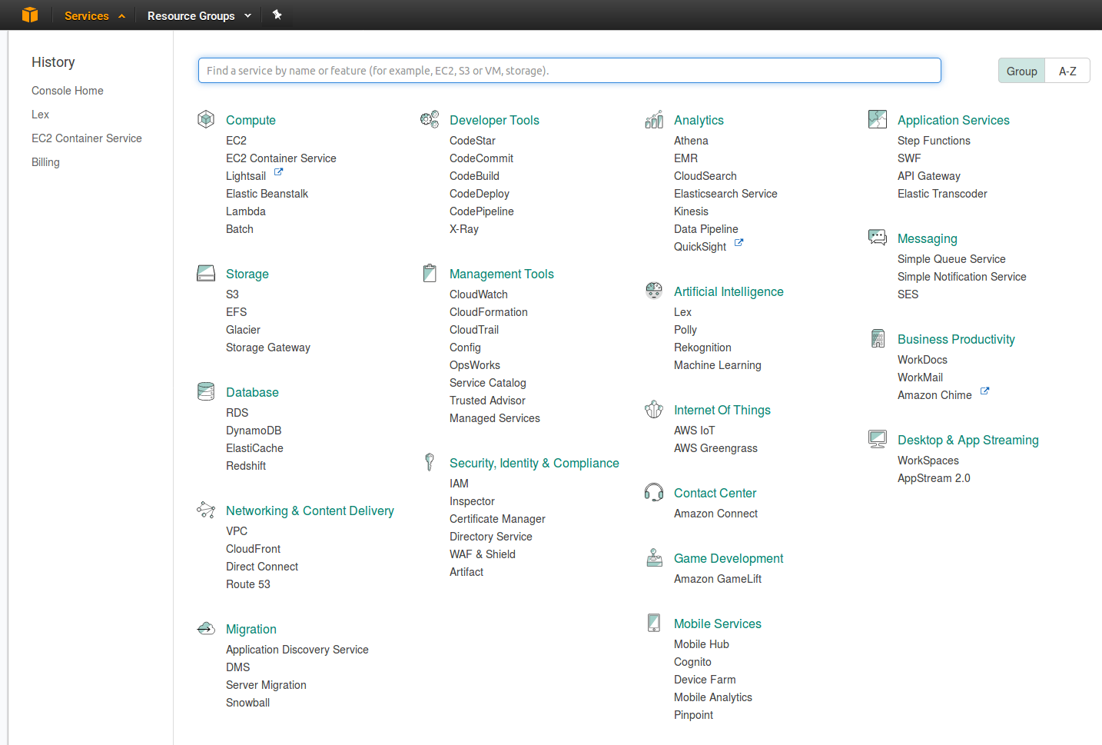

Slide 4
