Slide 1
Neuroinformatics resources for computational modellers
Padraig Gleeson (University College London, UK)
Andrew Davison (CNRS, Gif-sur-Yvette, France)
&
https://github.com/NeuralEnsemble/NeuroinformaticsTutorial/blob/master/CONTRIBUTORS.md
Neuroinformatics tutorial
Notes:
1

Slide 2
Introduction
Neuroinformatics (like computational neuroscience, connectomics, etc.) means many different things to different people…
Neuroimaging
Brain Atlases
Electrophysiology
data sharing
Notes:
1

Slide 3
Current tutorial
Focus on neuroinformatics resources which may be of use for those creating and analysing computational models of neuronal systems
Notes:
1

Slide 4
Topics
Experimental datasets
Structured data from literature
Analysis tools
Simulation environments
Model sharing
Computing infrastructure
Open source initiatives
Web portals
Notes:
1

Slide 5
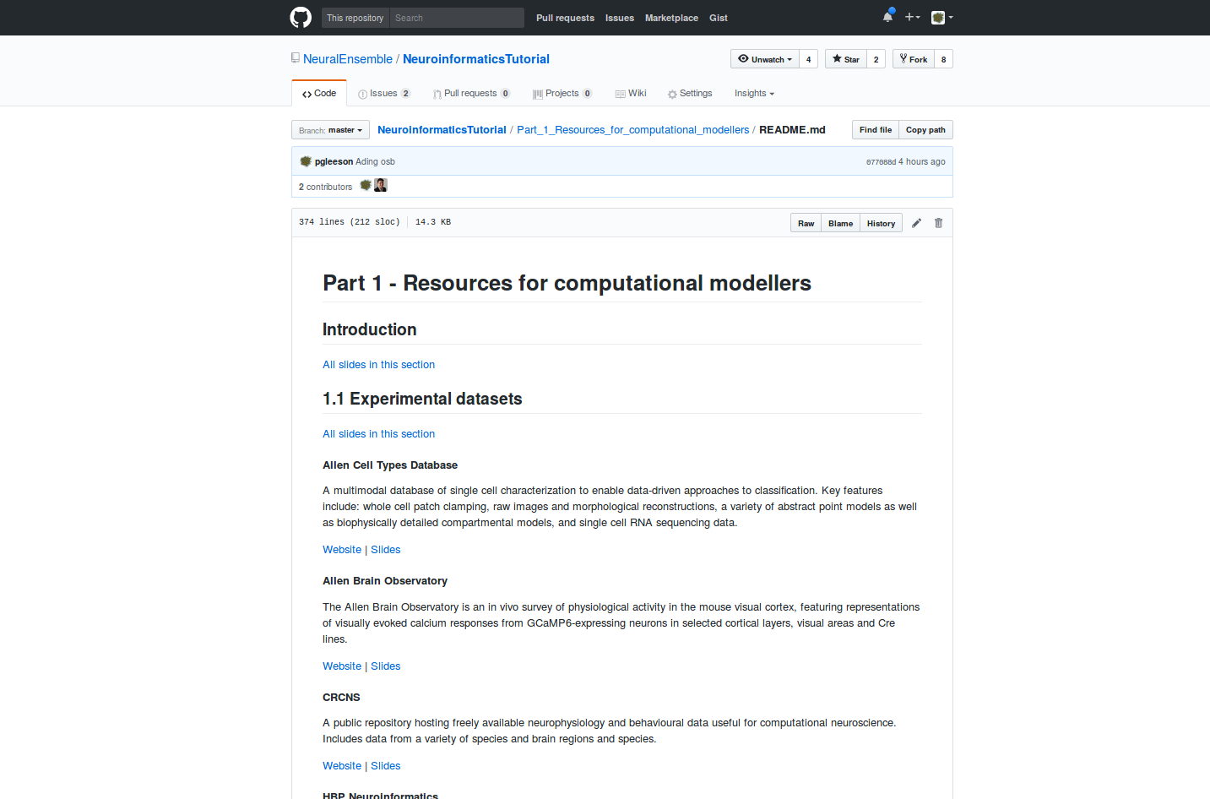
Online tutorial
Notes:
1

Slide 6
Exercises
Notes:
1

Slide 7
Practicalities
(CNS Antwerp 15th July 2017)
Notes:
<number>

