Slide 1
BigNeuron
https://alleninstitute.org/bigneuron
BigNeuron is a community effort to define and advance state-of-the-art of single neuron reconstruction: an essential unsolved challenge in brain science. The project will both standardize the methods to generate high quality and consistent data, and mobilize the reconstruction community to generate interest in solving these complex and interesting algorithmic problems.
Neuroinformatics tutorial
1.7 Open source initiatives
Notes:
1

Slide 2
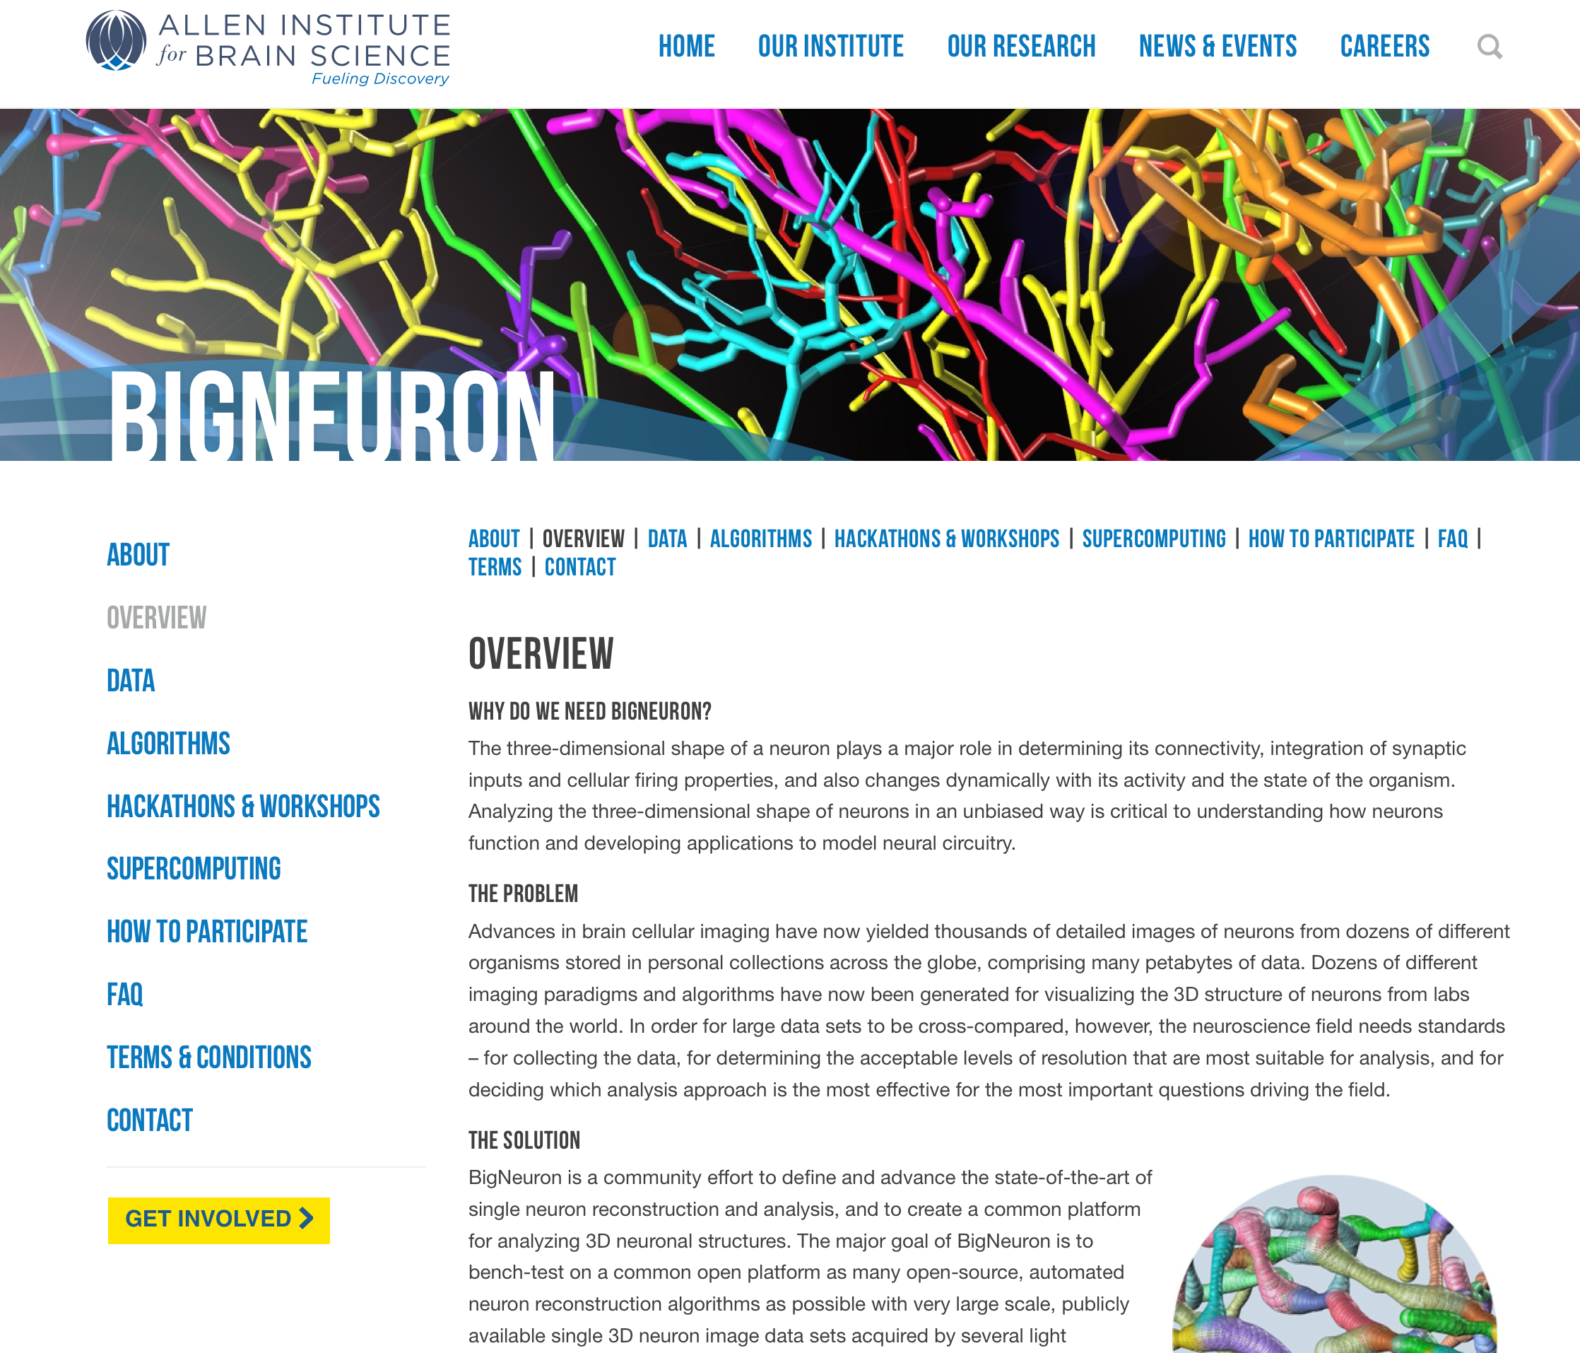

Slide 3
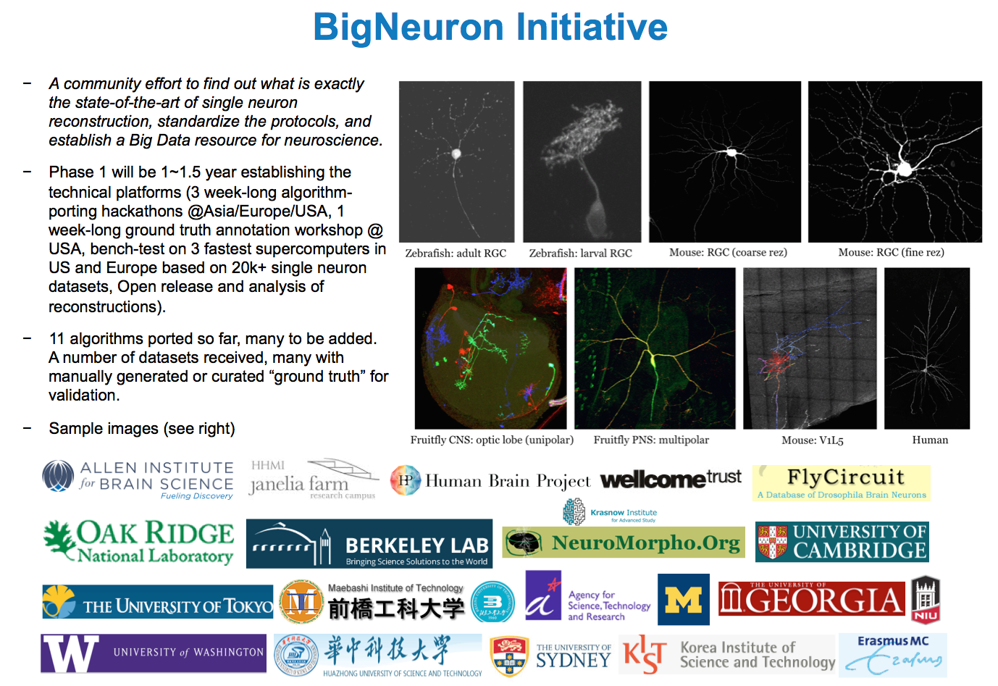
29+ algorithms ported, 30,000+ neurons collected, 166 gold standard neuron reconstructions produced (6~7 annotators per neuron), ~140 silver standard annotations
Notes:
Clearly, another level of thinking about the Big Data challenges for neuroscience goes beyond one single very large dataset. Indeed we have started to thinking about better ways to disseminate our technologies to produce something really useful for our community in general. One such effort is the BigNeuron initiative, which tries to call for the participation of the computational neuroscience field to establish common platform, protocol, and data resources that can be better shared and used for further research.
In short, BigNeuron is a community effort to find out what is exactly the state-of-the-art of single neuron reconstruction, standardize the protocols, and establish a Big Data resource for neuroscience. It is being sponsored by Allen, with partners of Janelia Farm of HMMI, two DOE national labs, Wellcome Trust, Human Brain Project, NeuroMorpho.org, and others. We are planning a joint press release involving 10 partners at the end of Feb or the first week of March. A series of hackathons and workshops will be organized to port the neuron reconstruction algorithms onto a common Vaa3D platform, generate the ground truth annotation for evaluation, and bench test all these methods against all the data sets contributed worldwide for many different species and brain regions using several top supercomputers in the world, including TITAN the fastest machine in USA. We will also work on the open data analysis and open data access for the massive amount of data to be generated in the BigNeuron project.
1

Slide 4
~50 Ported Neuron Tracing Algorithms and Implementations
https://docs.google.com/spreadsheets/d/1eU0QYomvs4SQVfFbnnnIdAYh0g-u_2ozqG6rFzW3isQ/edit#gid=1009169397
Algorithms developed from different perspectives
Other neuron preprocessing, utility, search, post-processing, visualization methods also ported
Snapshot of bench testing results
00352.FruMARCM-M002585
01726.TPHMARCM-M001802

