Slide 1
NeuroElectro.org: a window to the world’s intrinsic electrophysiology data
http://neuroelectro.org
The goal of the NeuroElectro Project is to extract information about the intrinsic electrophysiological properties of diverse neuron types from the neuroscience literature and place it into a centralized database for widespread comparison, reuse, and reanalysis.
Neuroinformatics tutorial
1.2 Structured data from literature
Notes:
<number>

Slide 2
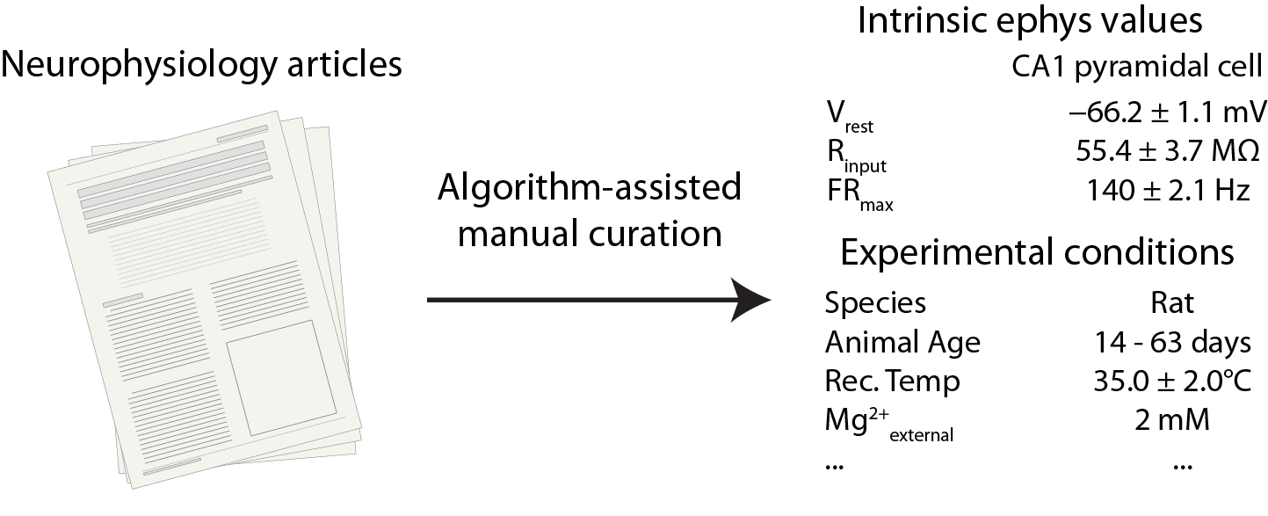
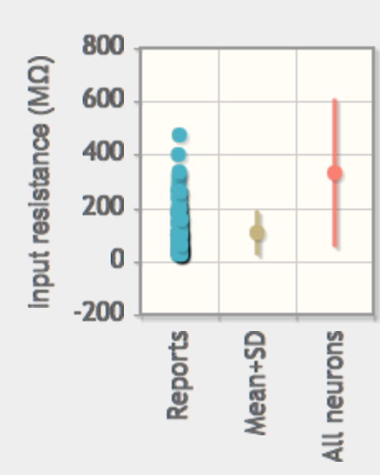
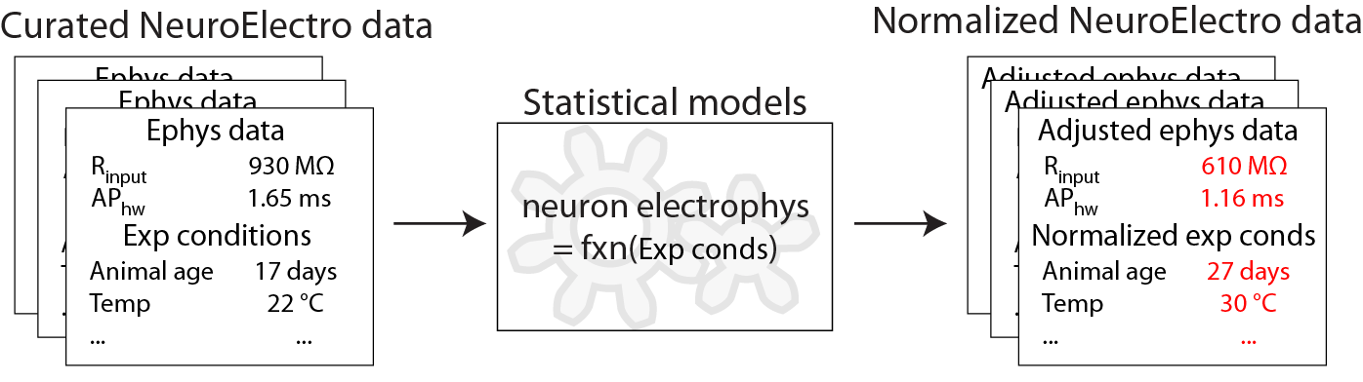
Database population
Visualization
968 curated articles from ~100 neuron types recorded under control conditions (as of 2016)
Neuron search
Methodology-based normalization
“layer 2-3 fast-
spiking cell”
32 hits from 19 articles
Notes:
<number>

Slide 3
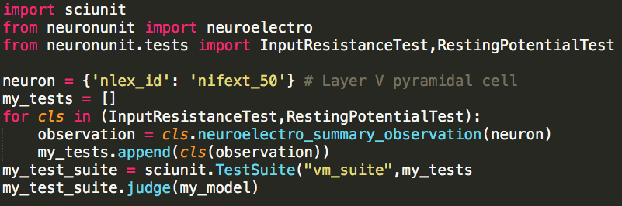


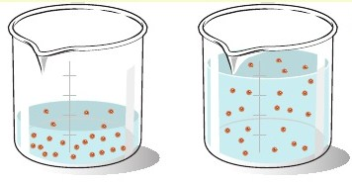
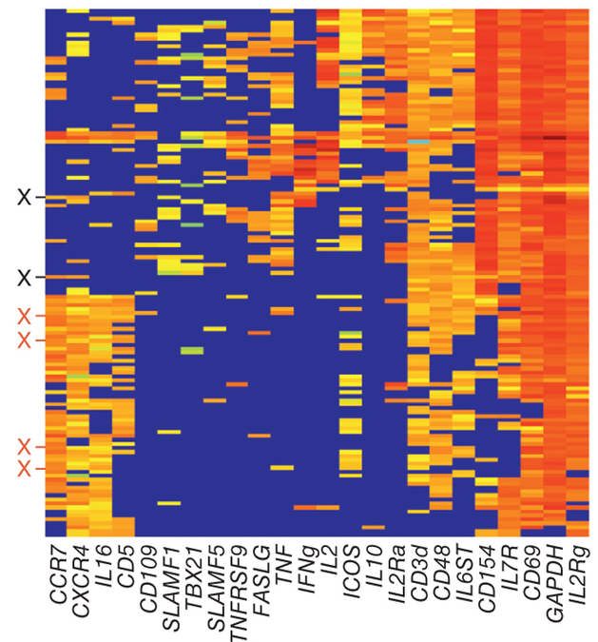
REST API for Applications
URL Request -> JSON containing a statistical summary of a neuron’s ephys properties
Documentation: http://neuroelectro.org/api/docs/
Used to create data-driven tests for model development and validation
How do academic lineage, experimental conditions, and gene expression determine reported physiological properties?
Notes:
<number>

