Slide 1
Hippocampome.org: An open-access knowledge base of neuronal type properties for the rodent hippocampus
http://hippocampome.org
Hippocampome.org is a resource that combines approximately 21,000 pieces of experimental evidence about neuron types in the rodent hippocampus into a unified database. Analyzing these data has revealed about 10,500 different neuron properties and has identified over one hundred different neuron types.
Neuroinformatics tutorial
1.2 Structured data from literature
Notes:
1

Slide 2
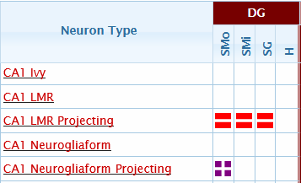
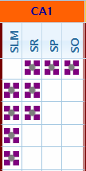
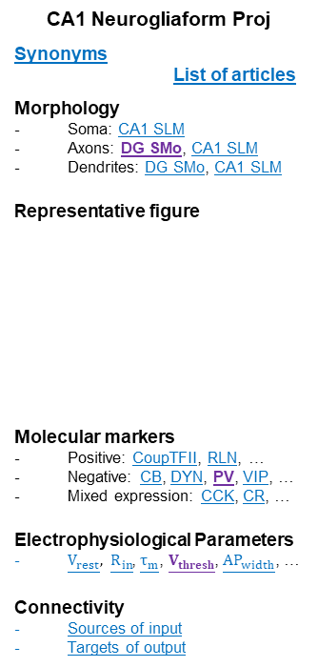
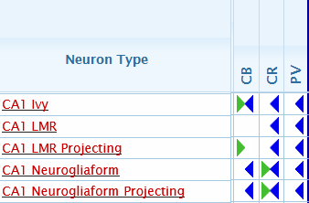
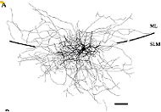

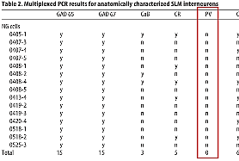
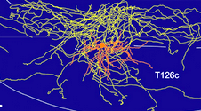
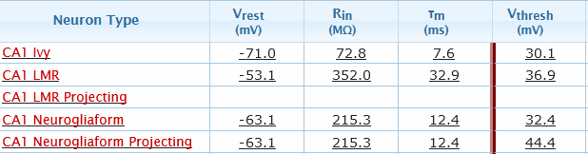
Browse by morphology
Search by property
Search by author/PMID
Fuentealba P
 | Neuron Types
DG | Granule
 | Mossy
CA3 | Spiny Lucidum
 | Mossy Fiber-Associated
CA1 | CA1 Neurogliaform Proj
Year | Journal | Neuron Types
2005 | J Neurosci | Schaffer Collateral-Associated
2007 | J Neurosci | CA1 Trilaminar
2008 | Neuron | CA1 Neurogliaform CA1 Neurogliaform Proj
2008 | J Neurosci | CA1 Hippocampo-Subicular Proj ENK+
2010 | J Neurosci | CA1 Pyramidal CA1 Neurogliaform CA1 Neurogliaform Proj
Year
Journal
Neuron Types
Axon in DG
V_{thresh} > 20mV
PV–
Axon present
Axon & Dendrite present
Possible somata locations
Neuron type page
Browse by biomarker
CA1 Neurogliaform Proj
V_{thresh} Evidence Page
Interpretation: V_{thresh} = 32.0 mV
Protocol: patch clamp
Source: Price CJ, Cauli B, Kovacs ER, Kulik A, Lambolez B, Shigemoto R, Capogna M. Neurogliaform neurons form a novel inhibitory network in the hippocampal CA1 area. J Neurosci, 2005, 25 (29), pages 6775-6786. PMID: 16033887
Page location: p6780, Figure 3A
Linking PMID: 16033887
Linking quote: All necessary
Evidence pages
CA1 Neurogliaform Proj
PV Evidence Page
Interpretation: PV negative
Protocol: mRNA
Source: Price CJ, Cauli B, Kovacs ER, Kulik A, Lambolez B, Shigemoto R, Capogna M. Neurogliaform neurons form a novel inhibitory network in the hippocampal CA1 area. J Neurosci, 2005, 25 (29), pages: 6775-6786. PMID: 16033887
Page location: p6779, Table 2
Linking PMID: 16033887
Linking quote: All necessary
CA1 Neurogliaform Proj
Axon Evidence Page
Interpretation: Axons in DG SMo
Source: Fuentealba P, Klausberger T, Karayannis T, Suen WY, Huck J, Tomioka R, Rockland K, Capogna M, Studer M, Morales M, Somogyi P. Expression of COUP-TFII nuclear receptor in restricted GABAergic neuronal populations in the adult rat hippocampus. J Neurosci, 2010, 30 (5), pages: 1595-1609. PMID: 20130170
Page location: p1602, Figure 6
SMo
Positive
No data found
SLM
Negative
Search incomplete
(Price et al., 2005)
Positive-Negative (subtypes)
DG SMo
Browse by electrophysiology
CA1 SLM
CA1 SR
"Axodendritic distribution and molecular profile of neurogliaform cells recorded in vivo. ... B, Partial reconstruction of the neurogliaform cell (T126c). Top: soma and dendrites complete (orange), axonal arborization (yellow) only from 5 coronal sections (60 μm). Note the dendrites biased to [SLM]."
Notes:
1

Slide 3
Neuron Term Portal
Allen Mouse Brain Atlas data
Initial
Neuron Term - Selector
Focus on principal cell layers of DG, CA3, CA2, CA1.
Mouse in situ hybridization data.
Increases the biomarker pieces of knowledge (PoK) from ~1100 to more than ~6800.
S
soma
Resource
Definition
Neurolex
The portion of a neuron that includes the nucleus, but excludes cell projections such as axons & dendrites.
CRISP
The cell body of a neuron.
Gene
Ontology
The portion of a cell bearing surface projections such as axons, dendrites, cilia, or flagella that includes the nucleus, but excludes all cell projections.
Acetylcholinesterase (Ache) is expressed in CA3c Pyramidal cells and not expressed in DG Granule cells.
Interactive connectivity navigator
Forthcoming additions
Biomolecular marker inferences
DG MOLAX
32 In-degree connections
17 Out-degree connections
Relational expression inferences supplement direct expression evidence.
Contrapositive inferences.
Glutamatergic
GABAergic
Self-connection
Firing pattern phenotypes
9 firing pattern elements.
Modeling firing patterns
Firing patterns simulated using Izhikevich models (IEEE Trans Neural Netw 14:1569-1572 (2003)).
New neuron types
Splitting of CA1 Pyramidal cells into Superficial and Deep types.
Inclusion of Adult-Born Immature Granule cells.
Notes:
1

