Slide 1
Geppetto
http://www.geppetto.org
Geppetto is a web-based visualisation and simulation platform engineered to explore complex biological systems. In use by a number of neuroinformatics resources including Open Source Brain and Virtual Fly Brain, Geppetto facilitates integration of diverse data and models, and can support different standard formats for both experimental and computational data.
Neuroinformatics tutorial
1.5 Model sharing
Notes:
<number>

Slide 2


Geppetto is an open source web platform to explore and simulate
neuroscience models and data
in a web browser

Slide 3
What can Geppetto do?
Visualize neuroscience data in the browser
Computational Neuroscience Models (NeuroML, NEURON)
Morphology reconstructions (SWC, OBJ, Collada)
Electrophisiology recordings (NWB, HDF5)
Medical data (MRI, Electromicroscopy via DICOM, NIFTI, DZI)
Record variables, set parameters, an run simulations from the browser
Simulation can run in the same server where Geppetto is running or in a remote one (e.g. San Diego Supercomputer center)
Connect to Jupyter Notebook
Seamless exploration of data and models in the browser
Facilitates reproducibility of workflows
The entire user interface works on top of an API layer. Every user action corresponds to an API command easy to inspect and reproduce.

Slide 4
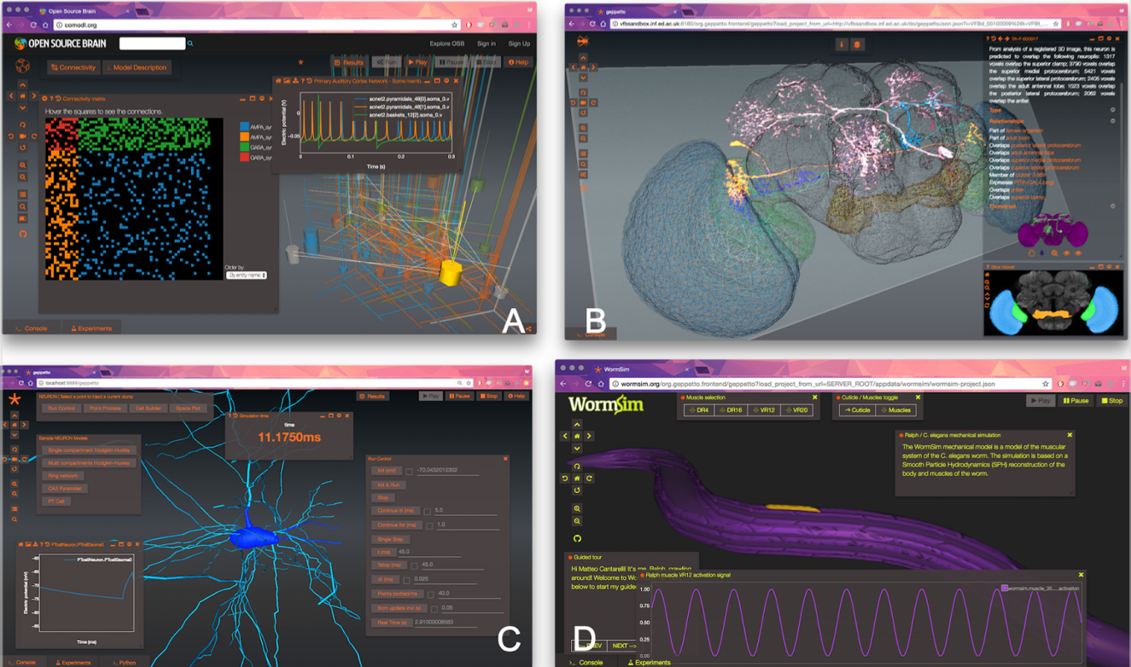
Notes:
<number>

