Slide 1
NEURON
http://neuron.yale.edu
NEURON is a tool for developing, simulating, and analysing empirically-based models of neurons and networks of neurons. NEURON supports all classes of spiking models and runs on both desktops and supercomputers.
Neuroinformatics tutorial
1.4 Simulation environments
Notes:
<number>

Slide 2
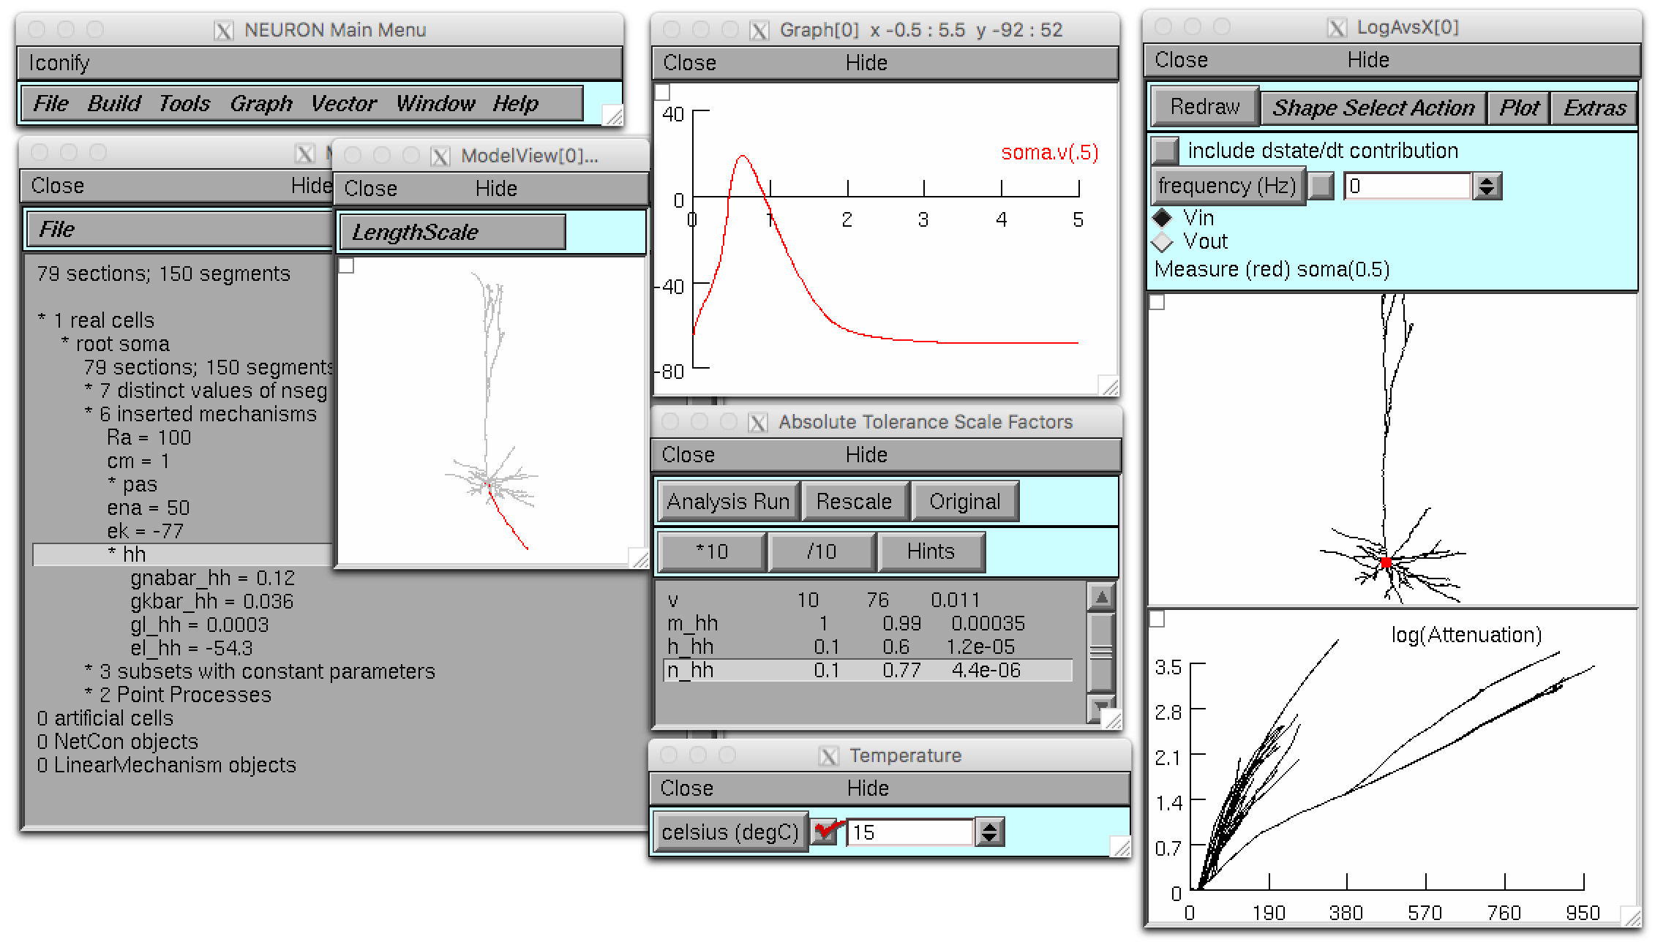
Powerful GUI tools • Fully Python scriptable • Large networks and single cells • Morphologically and biophysically detailed cells, integrate-and-fire cells, and anything in between • Run on a single core or on 128,000 processors.
Notes:
<number>

Slide 3
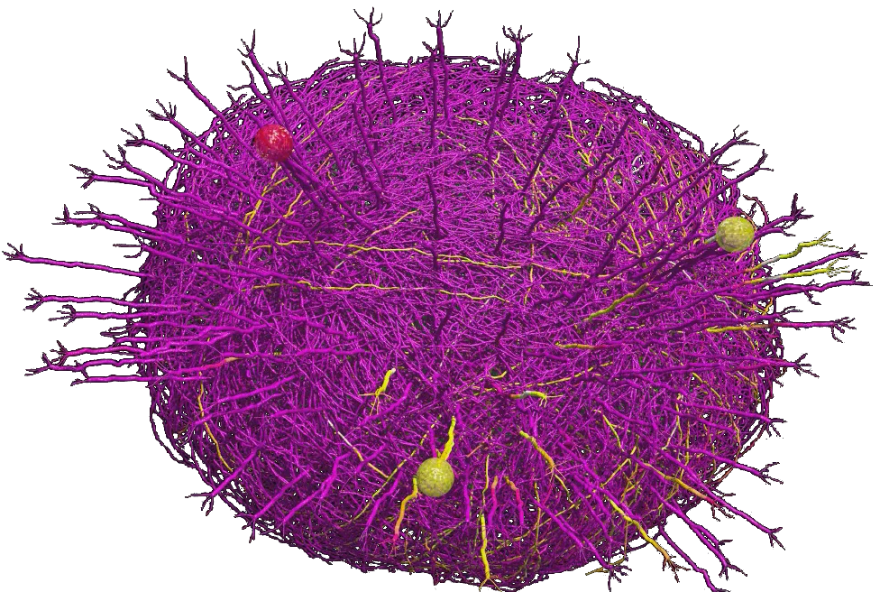
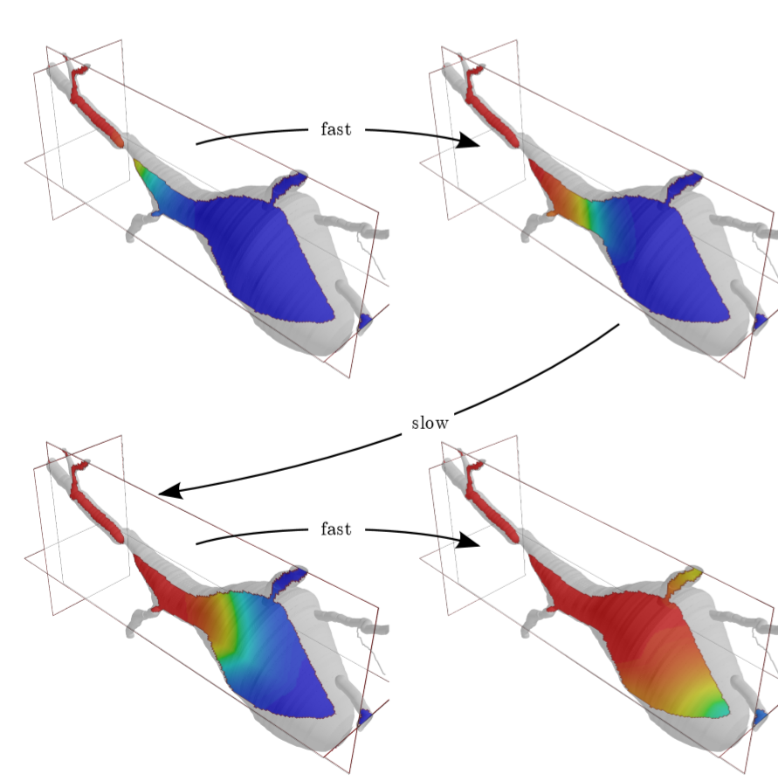
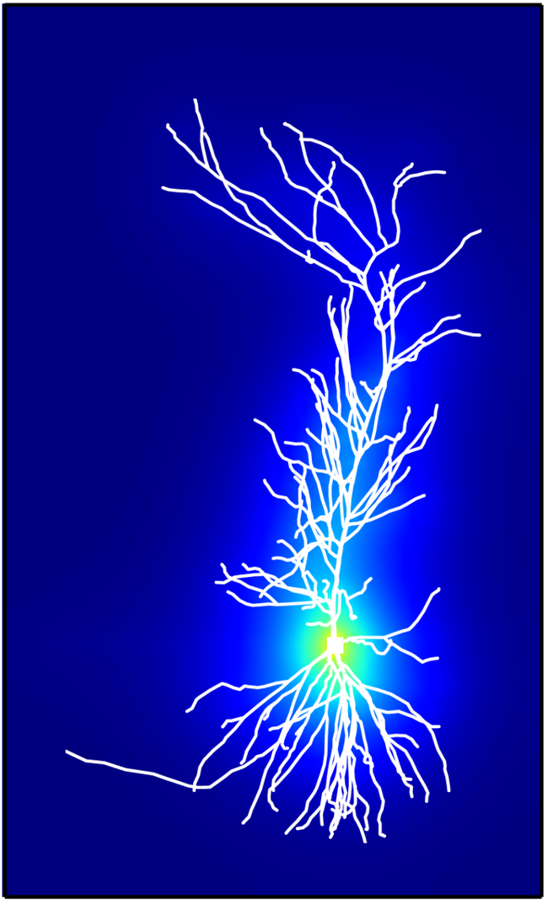
Plans and in development
Features
Standards support: NeuroML, SBML.
Extracellular reaction-diffusion (rxd).
Stochastic rxd simulations.
3D intracellular rxd simulation.
Performance enhancements
GPU support.
Faster reaction-diffusion.
Better documentation
Recently released Python programmer’s reference.
Migliore et al 2014. Olfactory bulb network model. Up to 69,000 cells. modeldb.yale.edu/151681
3D intra- (left) and extracellular (right) reaction-diffusion simulations.
Notes:
<number>

Slide 4
More NEURON Resources
API documentation (both Python and HOC):
https://neuron.yale.edu/neuron/static/py_doc/index.html
ModelDB (over 575 NEURON models):
http://modeldb.yale.edu
NEURON forum (over 14,000 posts):
https://neuron.yale.edu/phpBB/
Tutorials:
http://neuron.yale.edu/neuron/docs
NEURON courses:
Week-long NEURON course every summer.
Day-long NEURON course before each Society for Neuroscience conference.
Notes:
<number>

