Slide 1
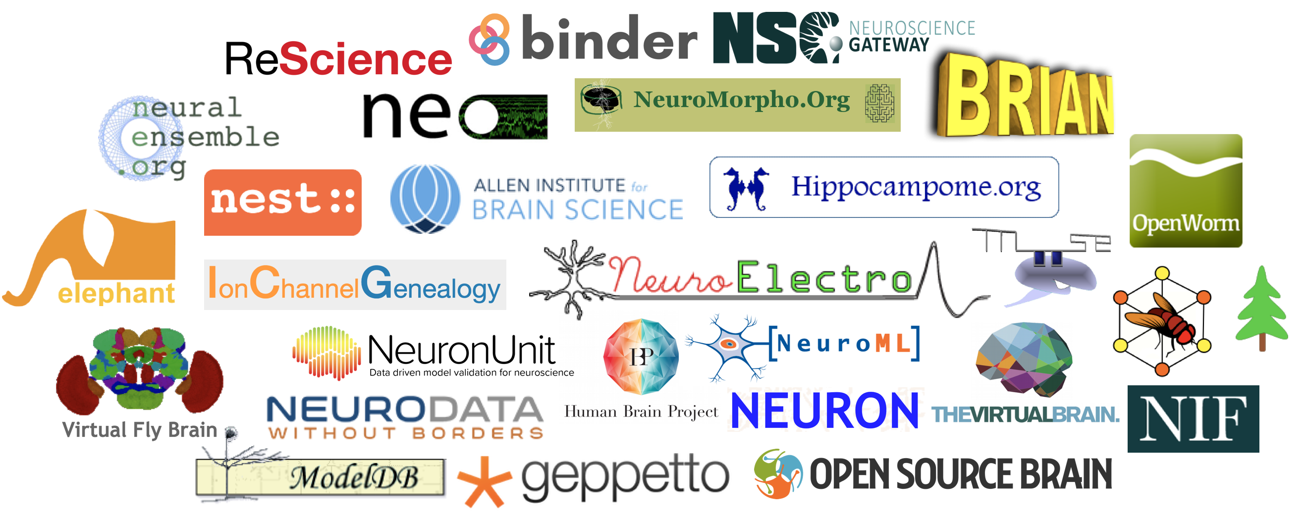
Neuroinformatics resources for computational modellers
Padraig Gleeson (University College London, UK)
Andrew Davison (CNRS, Gif-sur-Yvette, France) &
https://github.com/NeuralEnsemble/NeuroinformaticsTutorial/blob/master/CONTRIBUTORS.md
Neuroinformatics tutorial
Notes:
1

Slide 2
Introduction
Neuroinformatics (like computational neuroscience, connectomics, etc.) means many different things to different people…
Neuroimaging
Brain Atlases
Open source tools
Computing resources
Anatomical datasets
Connectivity data
Model sharing
Electrophysiology
data sharing
Gene expression
Notes:
2

Slide 3
Current tutorial
Focus on neuroinformatics resources which may be of use for those creating and analysing computational models of neuronal systems
Notes:
3

Slide 4
Topics
Experimental datasets
Structured data from literature
Analysis tools
Simulation environments
Model sharing
Computing infrastructure
Open source initiatives
Web portals
Notes:
4

Slide 5
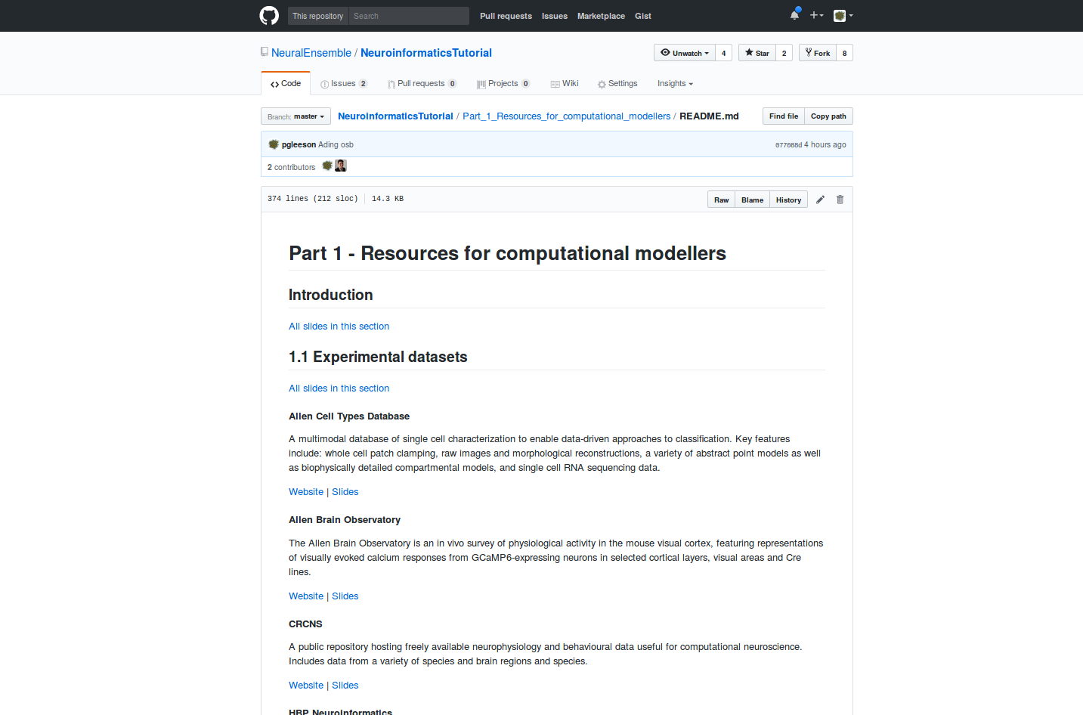

Online tutorial materials
https://github.com/NeuralEnsemble/NeuroinformaticsTutorial
Notes:
5

Slide 6
Exercises
Hands on demonstrations
Human Brain Project Collaboratory
Run Allen Institute cell model on NSG via OSB
Demonstration of Neo/PyNN using Jupyter notebooks
Participant Exercises
Cell morphology from NeuroMorpho.Org visualised on Open Source Brain
Exploring Brain Circuits with the Fruit Fly Brain Observatory
OpenWorm tutorials
Notes:
6

Slide 7
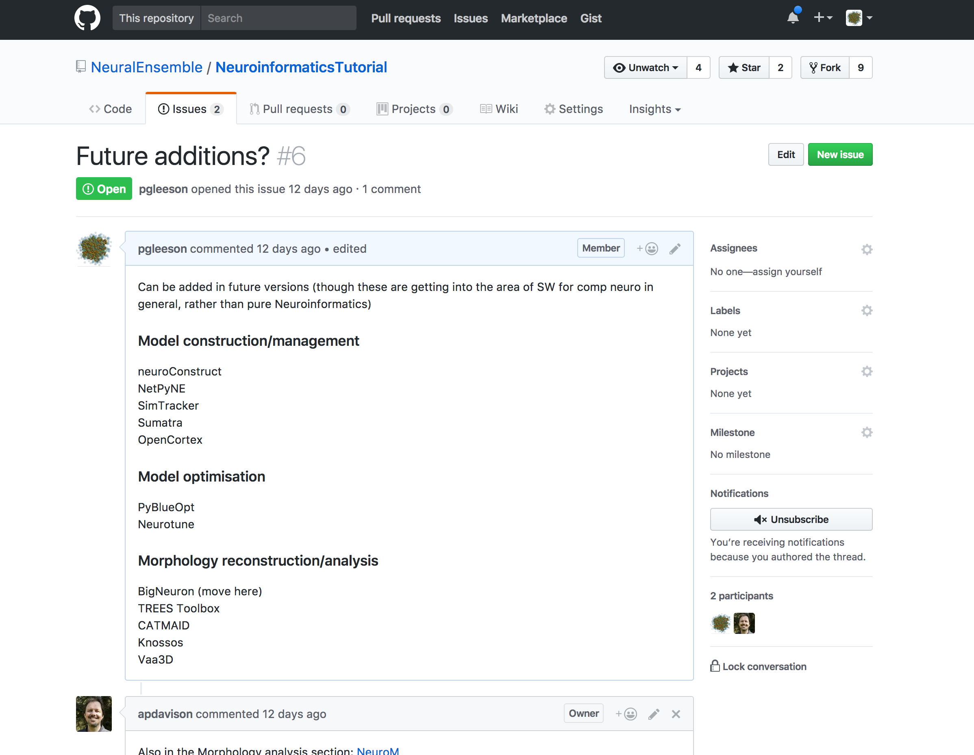
Suggestions
welcome!

