Slide 1
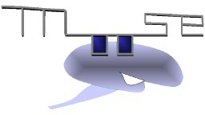
MOOSE
Multiscale Object Oriented Simulation Environment
https://github.com/BhallaLab/moose
MOOSE is designed to simulate neural systems ranging from biochemical signaling to
complex models of single neurons, circuits, and large networks. MOOSE can operate
at many levels of detail, from stochastic chemical computations, to multicompartment
single-neuron models, to spiking neuron network models.
Neuroinformatics tutorial
1.4 Simulation environments
Notes:
‹#›

Slide 2
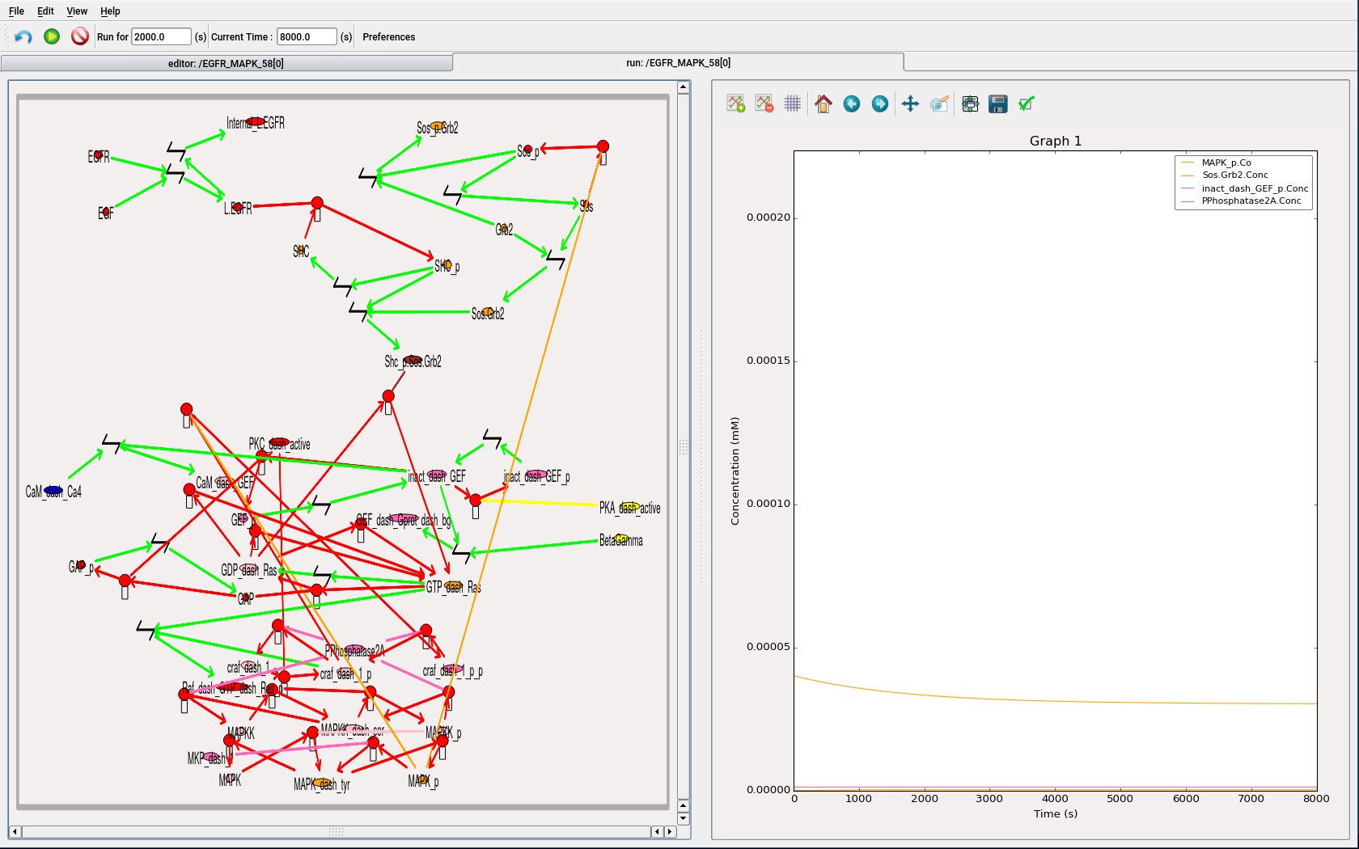
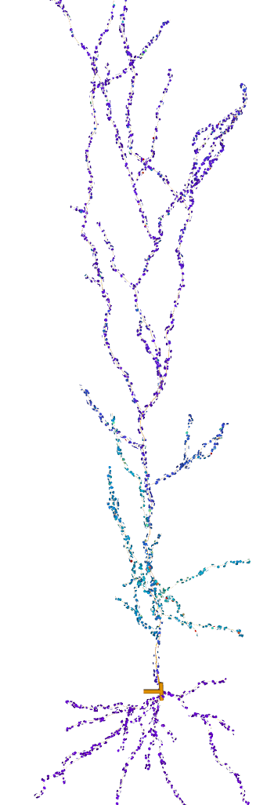
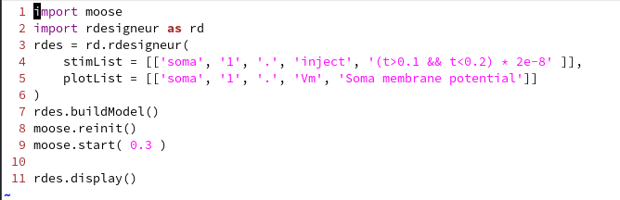
Example: multiscale model
Morphology from Hippocampal CA1 pyramidal neuron
NeuroMorpho.org
More than 3000 compartments, ion channels in each.
Roughly 5000 spines with user defined distribution.
Full reaction set in each spine and morpho compartment
Background synaptic input at 0.1 Hz
Patterned synaptic input on groups of spines → Ca influx
Ca → signaling, signaling → channel modulation
GUI for building and running chemical models.
Fully Python scriptable. rdesigneur interface to integrate chemical and electrical model.
3d visualizer for neural activity (Linux Only).
Notes:
‹#›

Slide 3
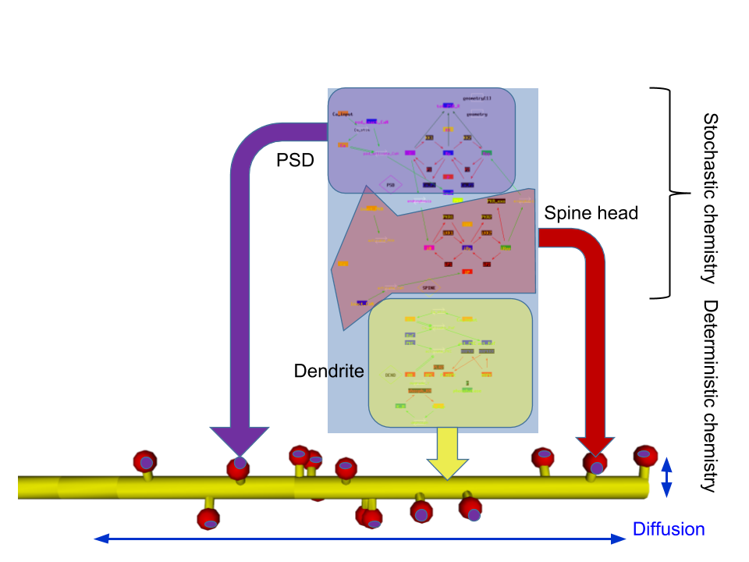
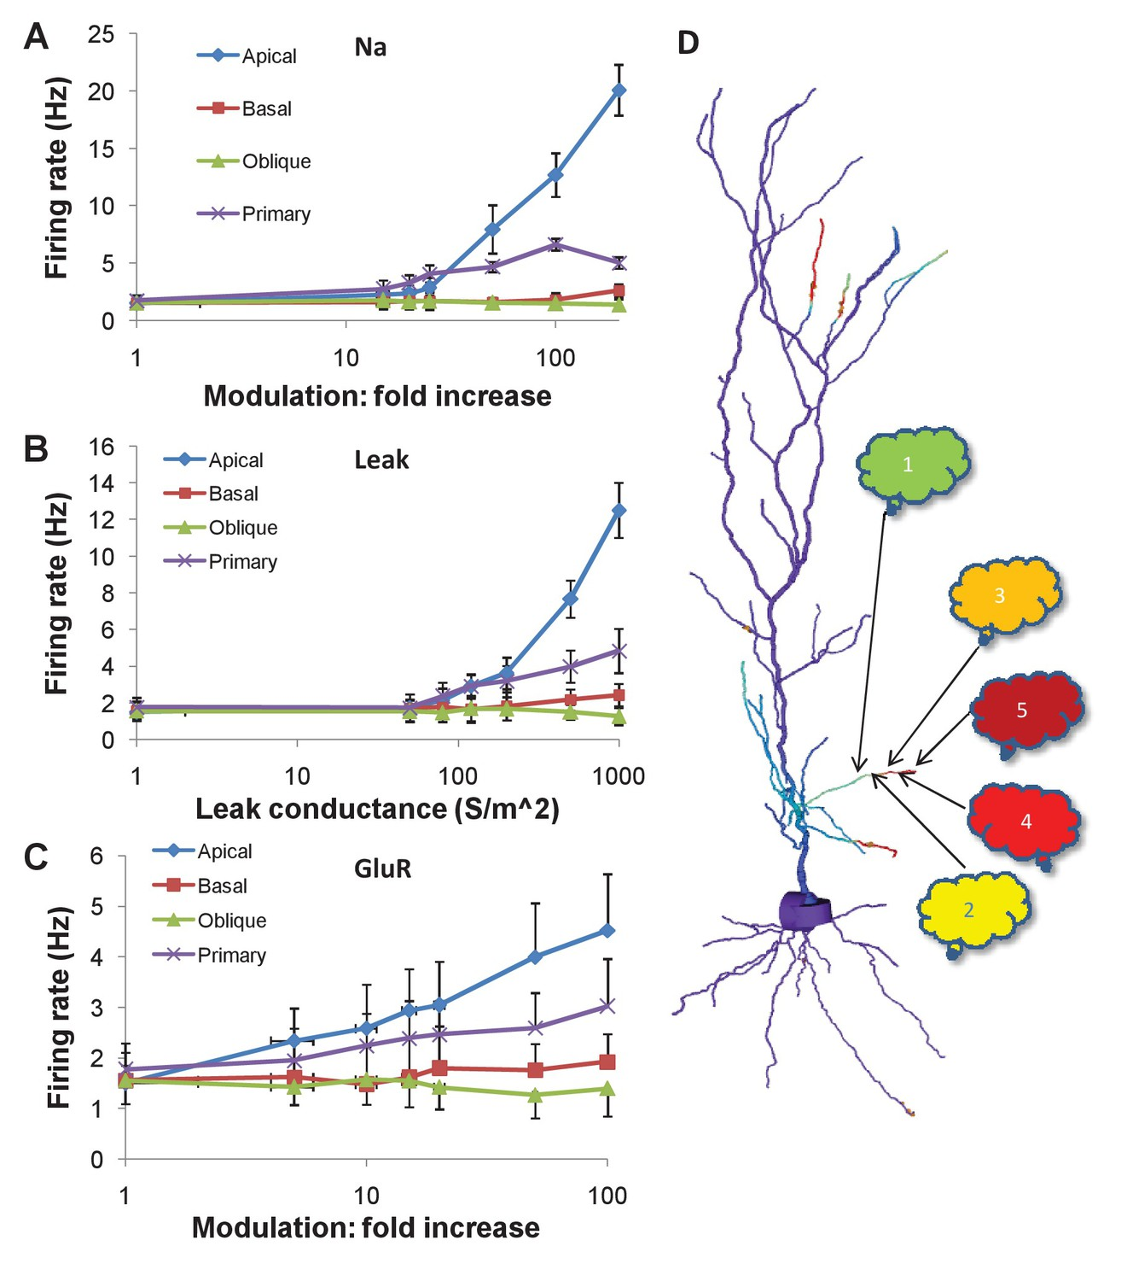
Features and Plans
Features
Fast (written in C++) and easy to use (Python scriptable). Rdesigneur library to integrate chemical and electrical models easily.
Chemical model formats support: SBML, NeuroML(v-1.8) and genesis format. Neuron morphology: SWC format.
GUI for building chemical models.
User documentation and many examples
Linux (via OBS) and MacOSX (via Homebrew).
In development
Hsolve being ported to GPU (alpha). Credit: GSoC-2015,2017).
Multithreaded chemical solvers Gsolve/Ksolve/Dsolve (beta). Speed improves roughly linearly with number of cores.
Major upgrade of documentation.
Activity-driven morphology change
Future Plans
Enhanced GPU and openMP support for various solvers.
Bhalla eLife-2017. Mass action model of a
MAPK switch exhibits sequence selectivity
Bhalla, eLife-2017
Notes:
‹#›

