Slide 1
ModelDB
http://modeldb.yale.edu
ModelDB promotes discoverability and reproducibility of computational neuroscience research by serving as a platform for curated sharing and visualization of published models.
Neuroinformatics tutorial
1.5 Model sharing

Slide 2
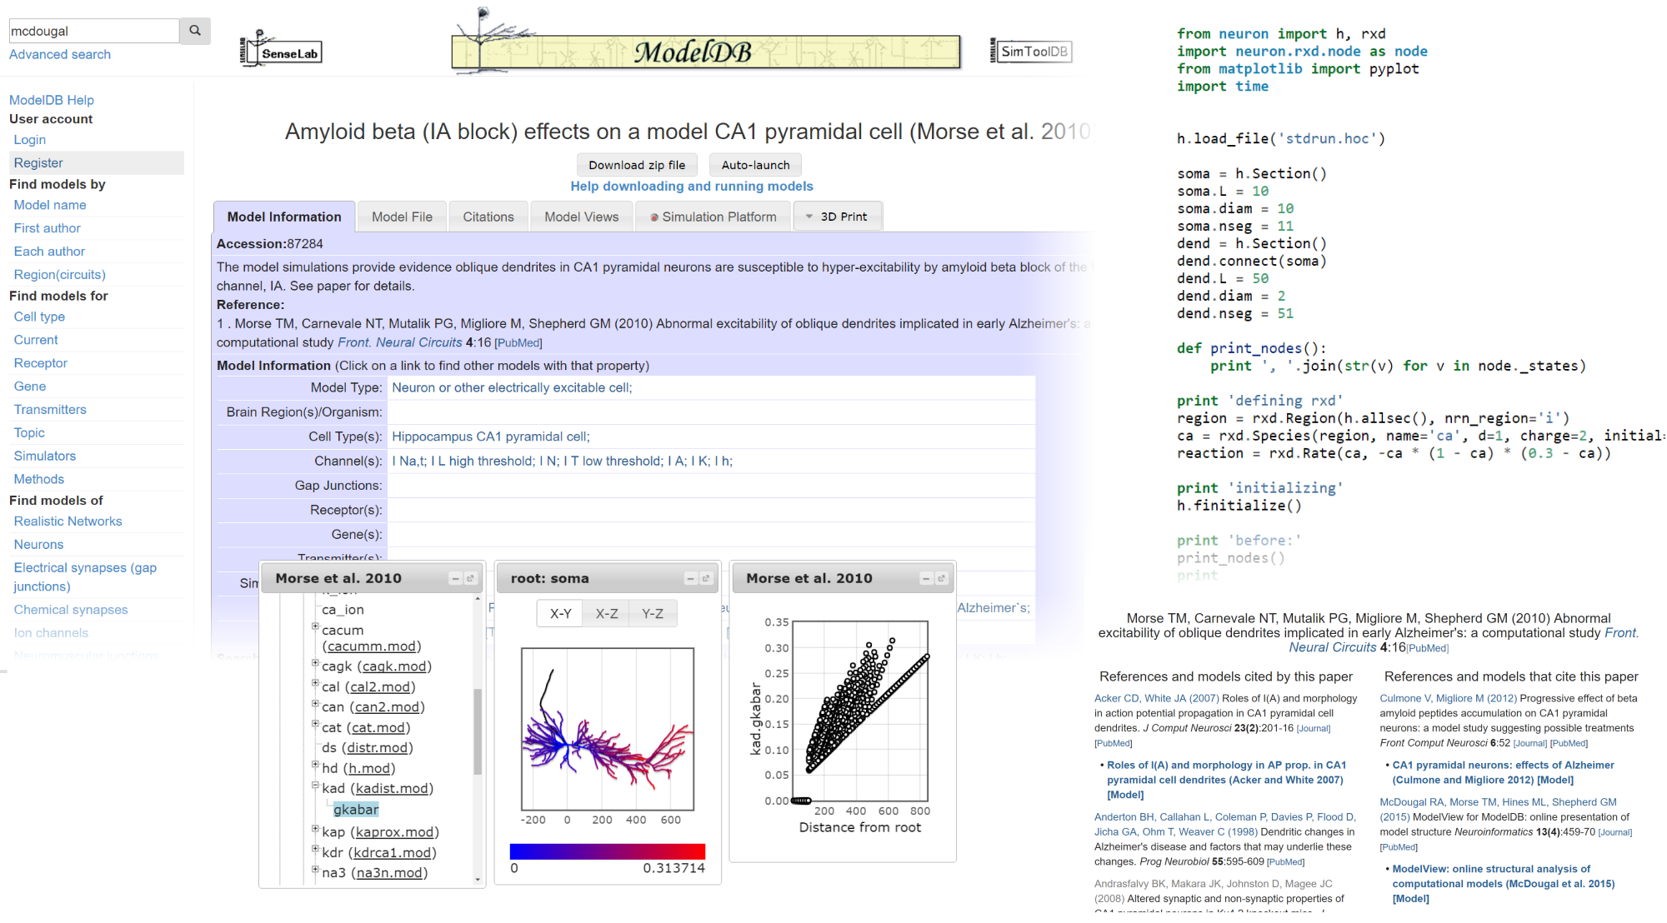
Over 1200 models · 76 simulation environments · 178 cell types · 145 topics (Alzheimer’s, STDP, etc) · 16+ species · 54 ion channels, pumps, etc ·
24+ mammalian brain regions
Over 1200 models · 76 simulation environments · 178 cell types · 145 topics (Alzheimer’s, STDP, etc) · 16+ species · 54 ion channels, pumps, etc ·
24+ mammalian brain regions

Slide 3
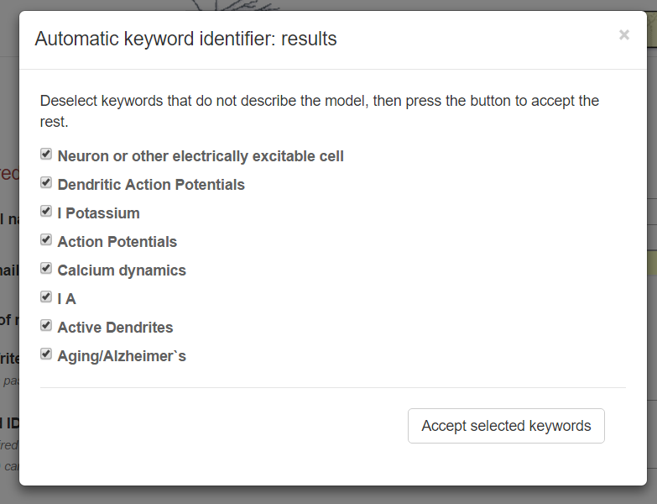
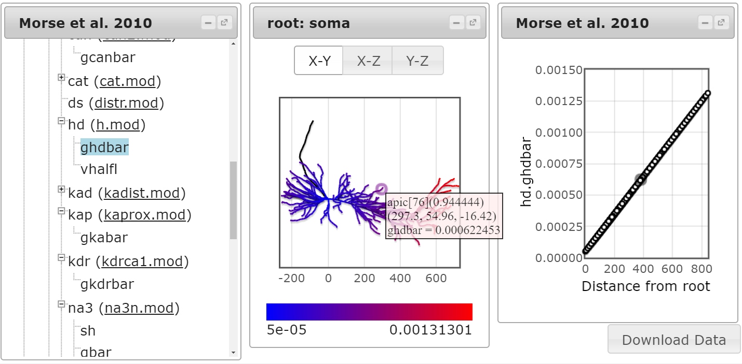
Ongoing ModelDB projects
Improving quantity and quality of model entries by actively identifying new modelling literature and providing NLP tools to assist entry of descriptive metadata.
Model visualization tools make models more accessible by allowing insight into the model structure without reading code.

Slide 4
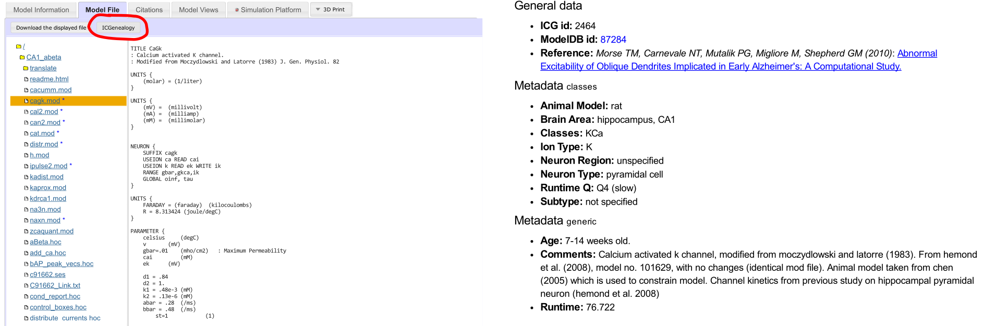
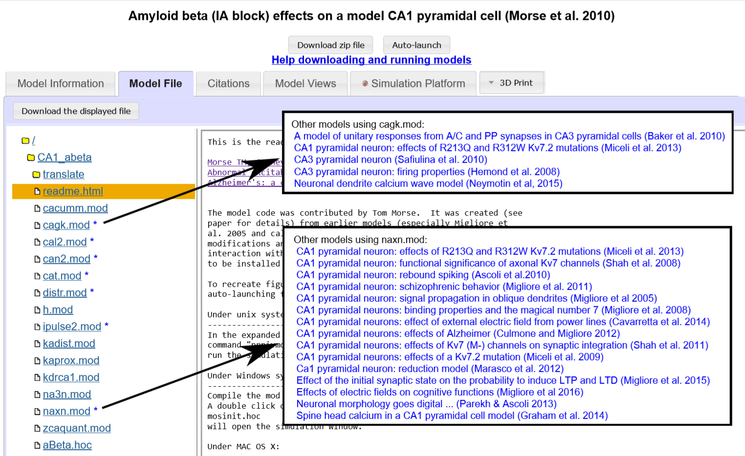
Better model context through partnerships with external neuroinformatics resources like the Ion Channel Genealogy (above) and through identifying repeated patterns within ModelDB itself (right).

