Slide 1

http://neuralensemble.org/neo/
Neo is a package for representing electrophysiology data in Python, together with support for reading a wide range of neurophysiology file formats, including Spike2, NeuroExplorer, AlphaOmega, Axon, Blackrock, Plexon, Tdt, and support for writing to a subset of these formats, plus non-proprietary formats including HDF5.
Neuroinformatics tutorial
1.3 Analysis tools

Slide 2
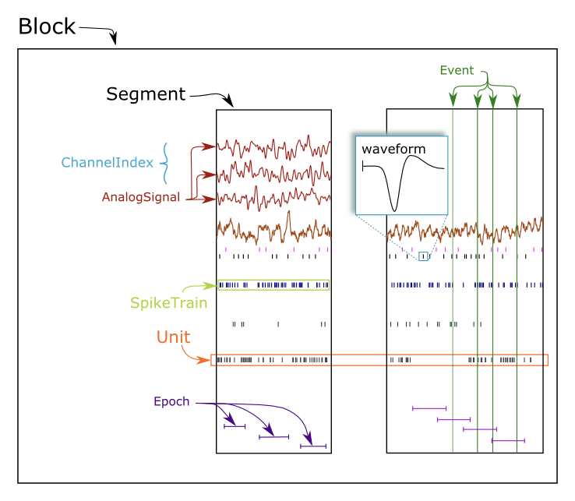
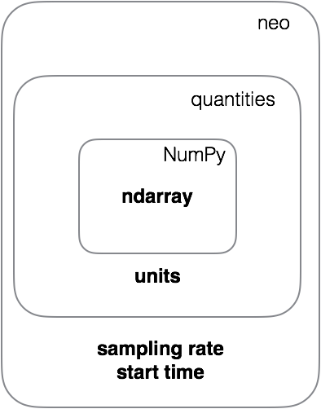

Slide 3
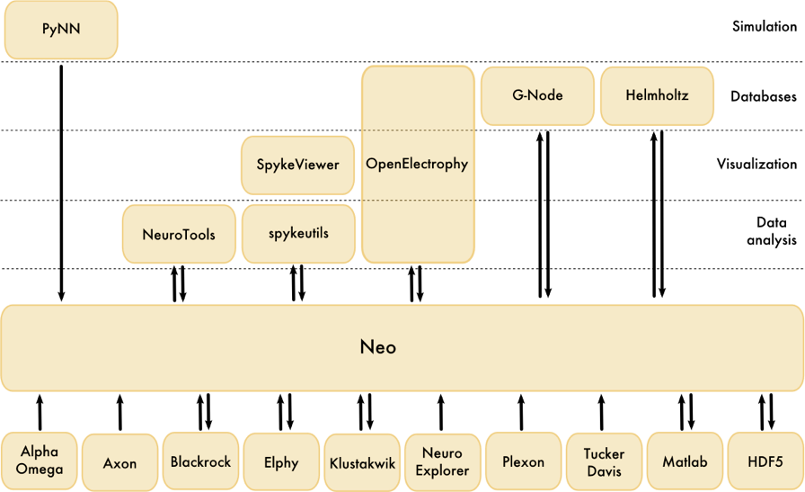

Slide 4
Plans
new, high-performance I/O API supporting
fast lazy/partial loading, streaming
support for Neurodata Without Borders format
performance improvements

