Slide 1

http://neuralensemble.org/elephant/
Elephant is an open-source, community centered library for the analysis of electrophysiology data in the Python programming language.
Neuroinformatics tutorial
1.3 Analysis tools

Slide 2
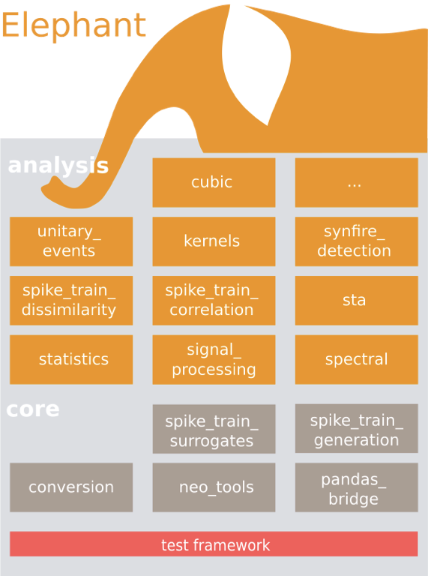

Slide 3
Goals:
improve quality of data analysis code in neuroscience
and reduce duplication of effort by:
developing community Python library of well-tested, well-documented data analysis functions
encouraging contributions from users
friendly peer-review of code
Plans:
continued efforts to grow community of contributors
parallelization on clusters, GPUs, supercomputers

