Slide 1
PyNN
http://neuralensemble.org/PyNN/
PyNN (pronounced 'pine') is a simulator-independent language for building neuronal network models.
In other words, you can write the code for a model once using the PyNN API and then run it without modification on any simulator that PyNN supports (currently NEURON, NEST, and Brian), and on the SpiNNaker and BrainScaleS neuromorphic hardware systems.
Neuroinformatics tutorial
1.5 Model sharing

Slide 2
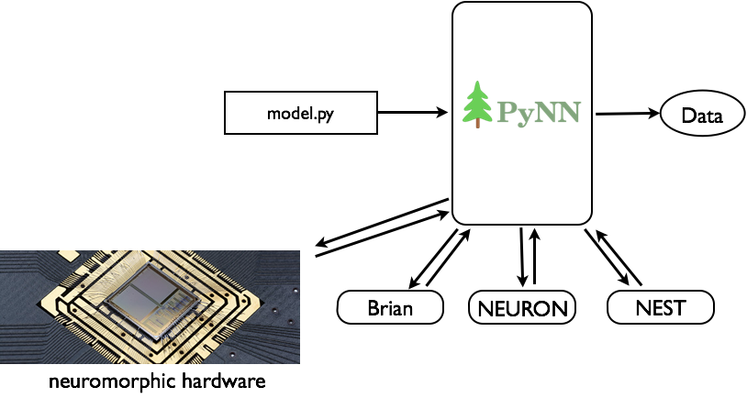
A common API for neuronal network modelling

Slide 3
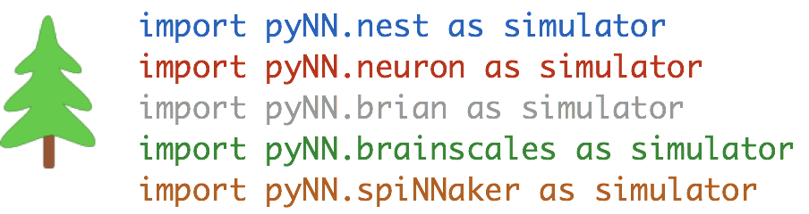

Slide 4
Goals
facilitate model sharing and reuse
simplify validation of simulation results
provide a common platform on which to build other tools
provide a powerful API for neuronal network modelling
hide complexity of parallelization from user
Plans
polishing the rough edges → v 1.0 in 2018
multicompartmental models with full NeuroML support → v 2.0 in 2019

