Slide 1
Nengo 2.0
http://nengo.github.io
Nengo is a graphical and scripting based software package for simulating large-scale spiking and non-spiking neural systems. It supports CPUs, GPUs (single and multi), MPI, and neuromorphic chips.
Neuroinformatics tutorial
1.4 Simulation environments
Notes:
1

Slide 2
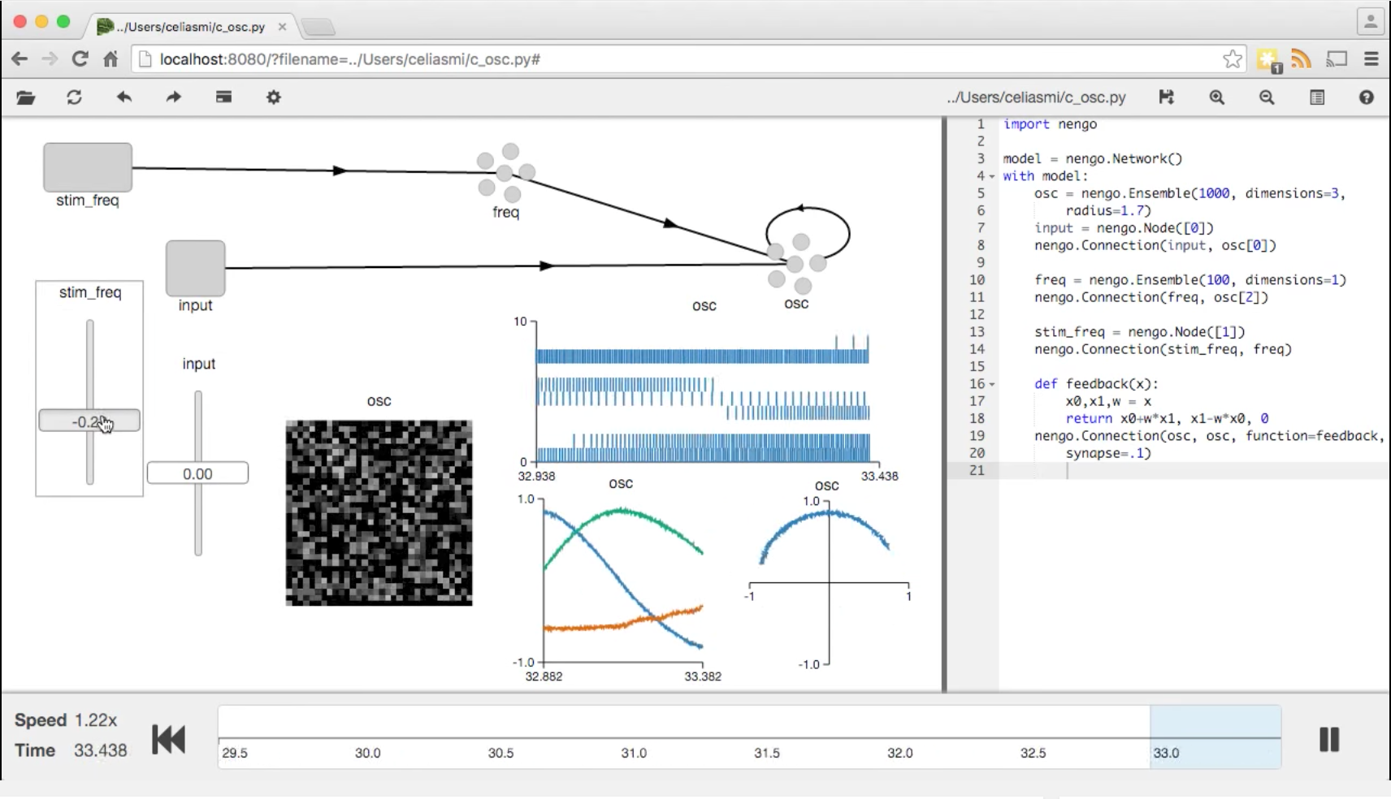
Network graph
Live input
Live coding
Real-time visualization
Interactive simulation timeline
Documentation -- Usage and API documentation is at:
https://pythonhosted.org/nengo/
Getting Help -- Nengo forum at:
https://forum.nengo.ai
Screen cap from https://youtu.be/UVeIPKnQAL4
Notes:
1

Slide 3
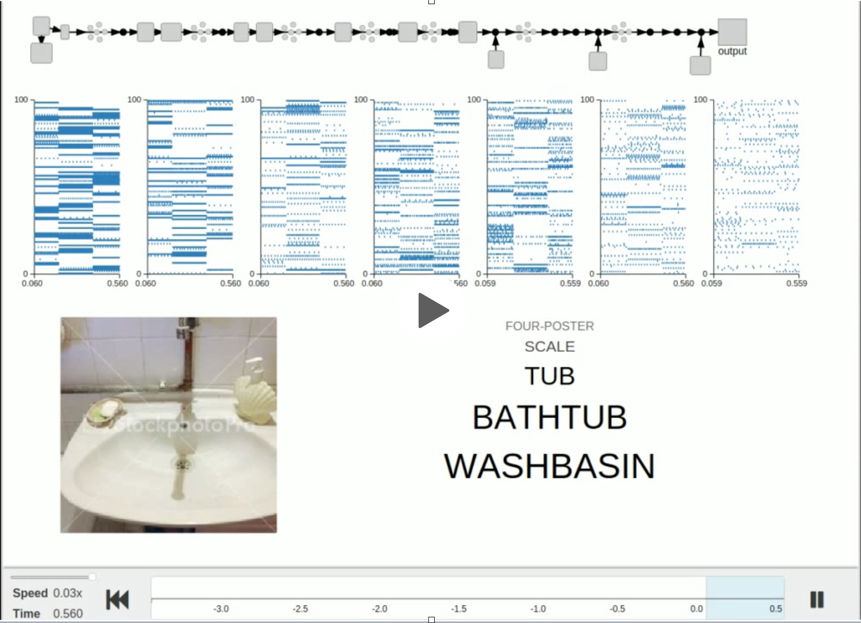
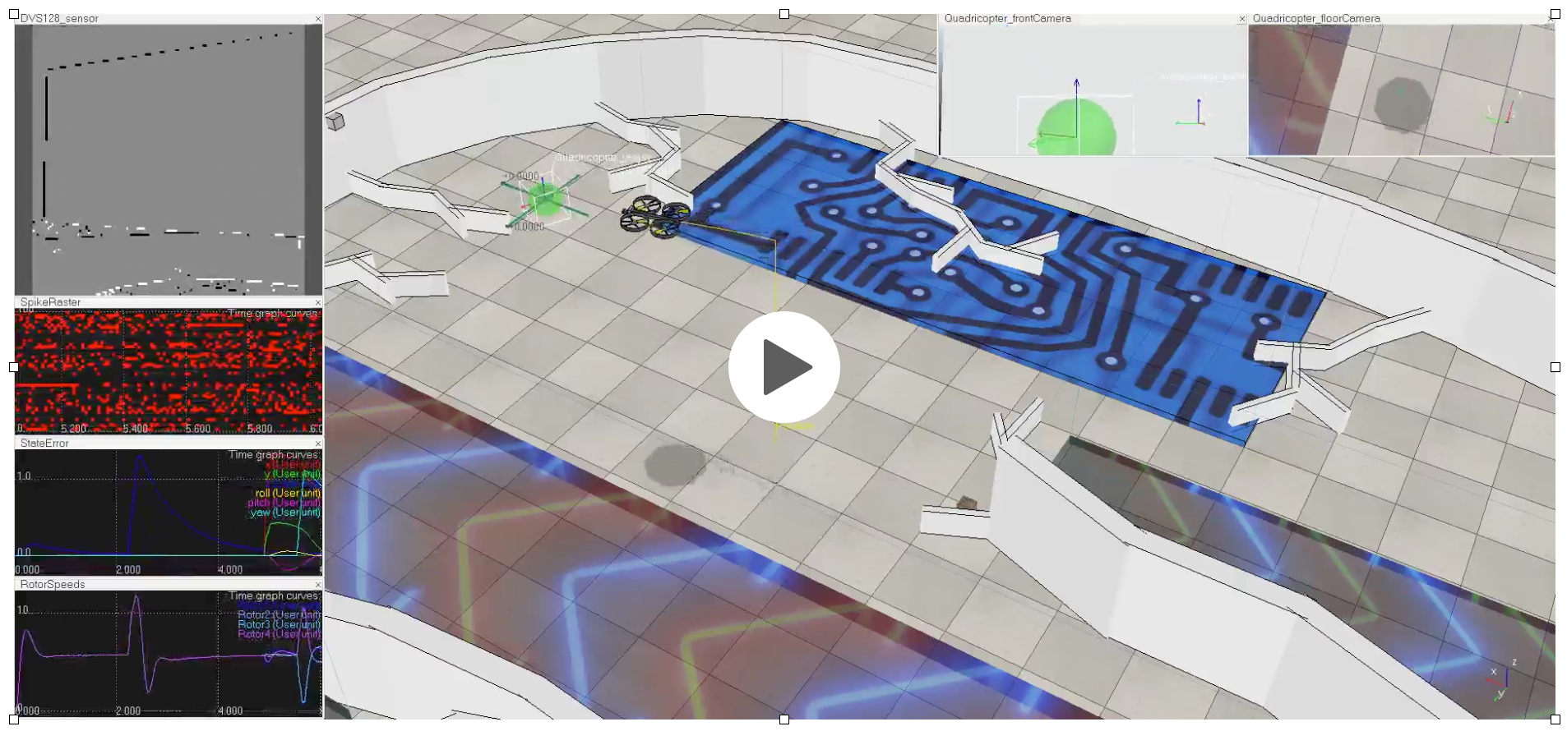
Application Highlights
Used to develop large-scale spiking deep networks
Integration with robot simulators & platforms
6 DOF nonlinear adaptive control on neuromorphic hardware for 30x power savings
Spaun large-scale neuro-cognitive model published in Science
Strengths
Scalability: simulate millions of neurons efficiently
Integration: combine deep learning, spiking, recurrent, and NEF networks
Learning: on-line, spike-based, off-line, batch processing, STDP, RL, customizable
Spiking ImageNet in Nengo
https://youtu.be/7R5F4mNURGc
Nengo adaptive quadcopter control in VREP
https://youtu.be/KBwBX7bzohA
Notes:
1

Slide 4
More Nengo Resources
In Development
More complete NEURON integration
Fully featured Semantic Pointer Architecture (SPA) library for cognitive modeling
Additional tools for TensorFlow integration (Nengo DL)
Additional backends for FPGAs, neuromorphic ASICs, etc.
Online Tutorials & Examples (in addition to documentation)
Covering NEF and SPA methods in Nengo GUI
https://github.com/nengo/nengo_gui/tree/master/nengo_gui/examples/tutorial
>40 Jupyter notebook examples covering core Nengo usage
https://pythonhosted.org/nengo/examples.html
To accompany the book How to Build a Brain (2013)
https://github.com/nengo/nengo_gui/tree/master/nengo_gui/examples/hbb_tutorials
Additional resources
Annual Nengo Summer School
http://nengo.ca/summerschool
Information for current or prospective developers can be found at
https://nengo.github.io/contributing.html
Notes:
1

