Slide 1
ModelDB
http://modeldb.yale.edu
ModelDB promotes discoverability and reproducibility of computational neuroscience research by serving as a platform for curated sharing and visualization of published models.
Neuroinformatics tutorial
1.5 Model sharing
Notes:
<number>

Slide 2
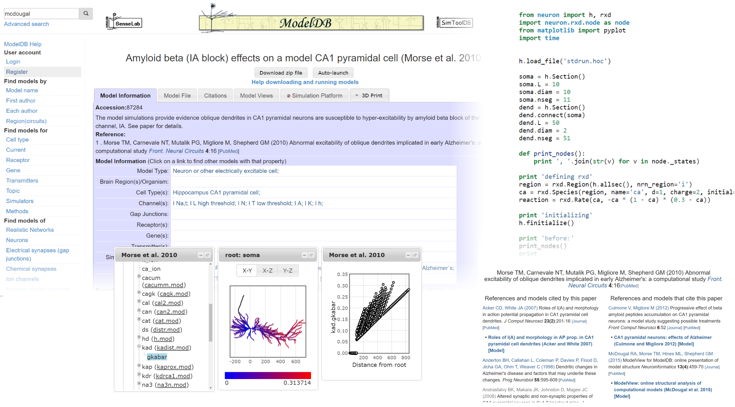
Over 1200 models · 76 simulation environments · 178 cell types · 145 topics (Alzheimer’s, STDP, etc) · 16+ species · 54 ion channels, pumps, etc ·
24+ mammalian brain regions
Notes:
<number>

Slide 3
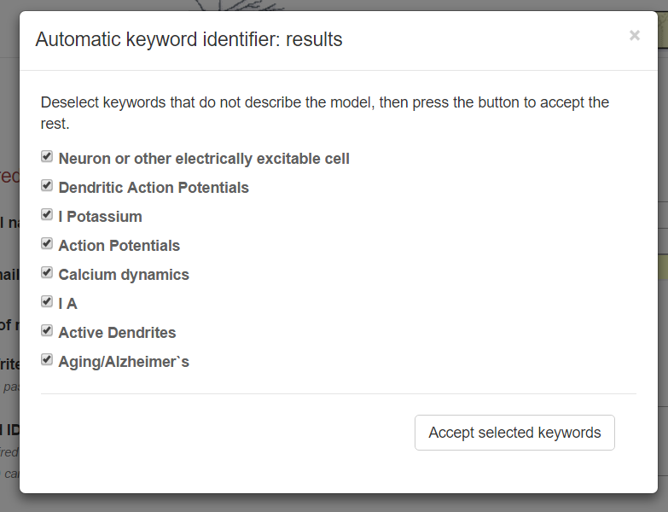
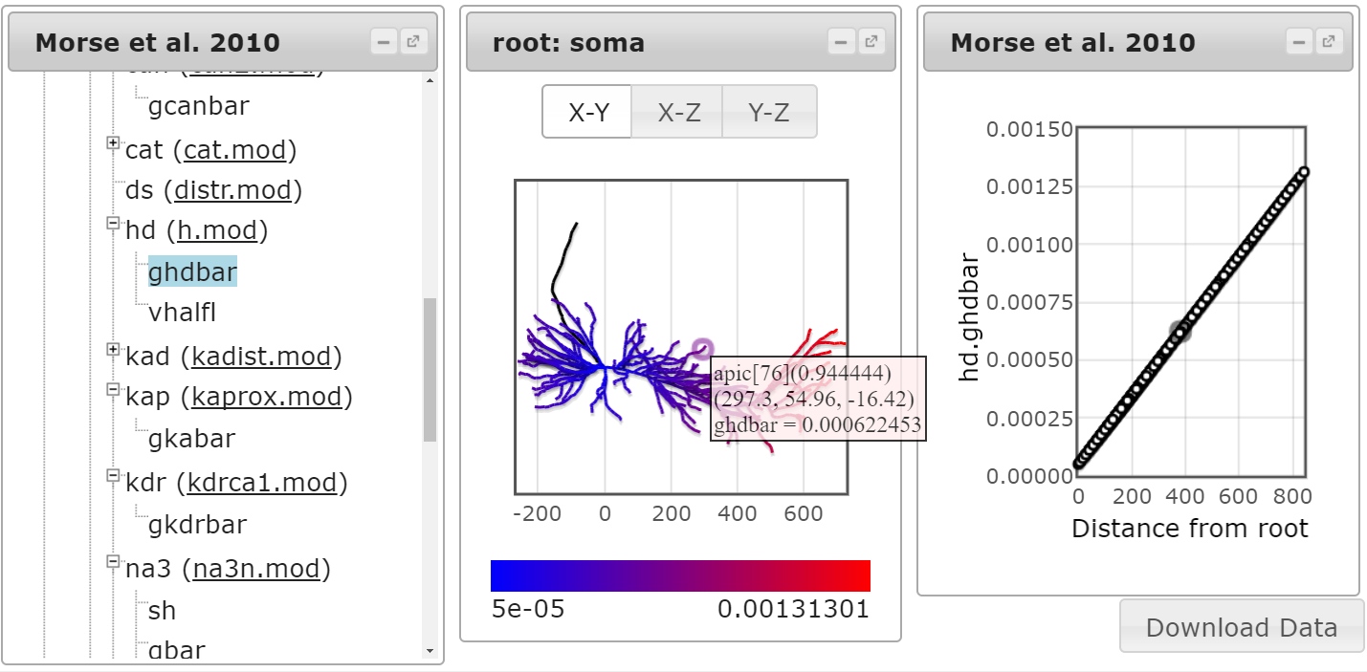
Ongoing ModelDB projects
Improving quantity and quality of model entries by actively identifying new modelling literature and providing NLP tools to assist entry of descriptive metadata.
Model visualization tools make models more accessible by allowing insight into the model structure without reading code.
Notes:
<number>

Slide 4
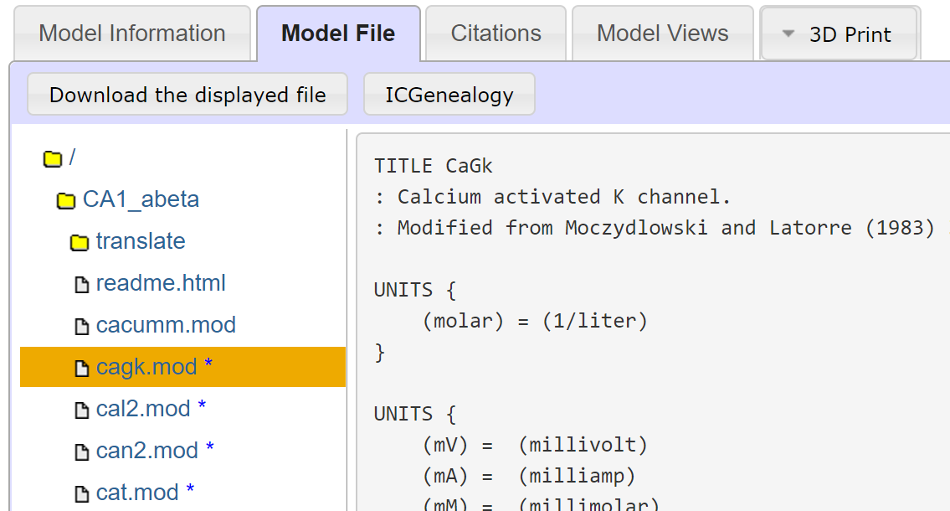
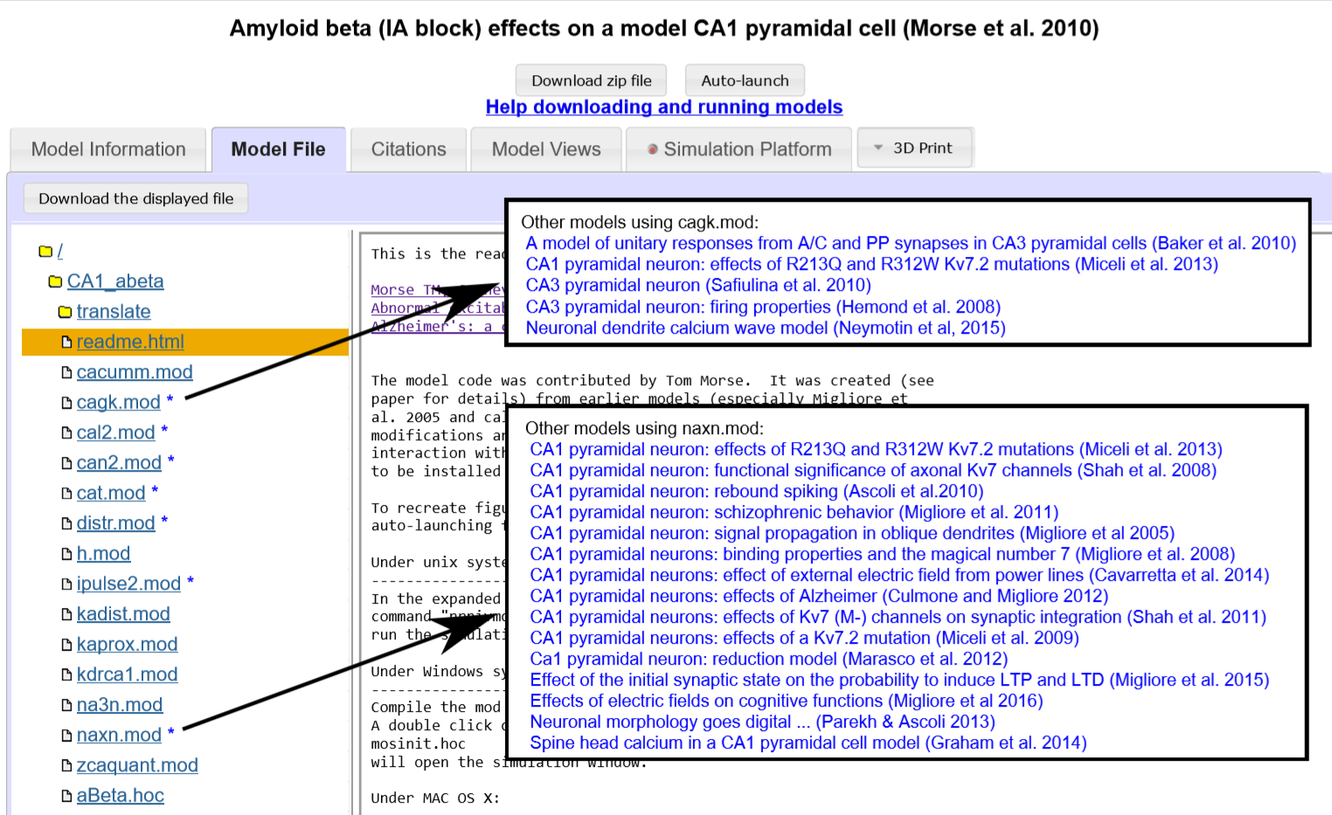
General data
ICG id: 2464
ModelDB id: 87284
Reference: Morse TM, Carnevale NT, Mutalik PG, Migliore M, Shepherd GM (2010): Abnormal Excitability of Oblique Dendrites Implicated in Early Alzheimer's: A Computational Study.
Metadata classes
Animal Model: rat
Brain Area: hippocampus, CA1
Neuron Region: unspecified
Neuron Type: pyramidal cell
Runtime Q: Q4 (slow)
Subtype: not specified
Metadata generic
Age: 7-14 weeks old.
Authors: M Migliore.
Comments: Calcium activated k channel, modified from moczydlowski and latorre (1983). From hemond et al. (2008), model no. 101629, with no changes (identical mod file). Animal model taken from chen (2005) which is used to constrain model. Channel kinetics from previous study on hippocampal pyramidal neuron (hemond et al. 2008)
Runtime: 76.722
Better model context through partnerships with external neuroinformatics resources like the Ion Channel Genealogy (above) and through identifying repeated patterns within ModelDB itself (right).
Notes:
<number>

