Slide 1
Neuroscience Information Framework
http://neuinfo.org
The Neuroscience Information Framework (NIF), an initiative of the NIH Blueprint for Neuroscience Research, is a semantically-enhanced portal to web-based neuroscience resources: data, materials, and tools. NIF has developed search tools, which expose the contents of federated databases and deep or “hidden” web resources hidden from traditional search engines. NIF is designed to serve the neuroscience research community and is actively looking for resource providers to make their resources accessible through NIF.
Neuroinformatics tutorial
1.8 Web Portals
Notes:
1

Slide 2
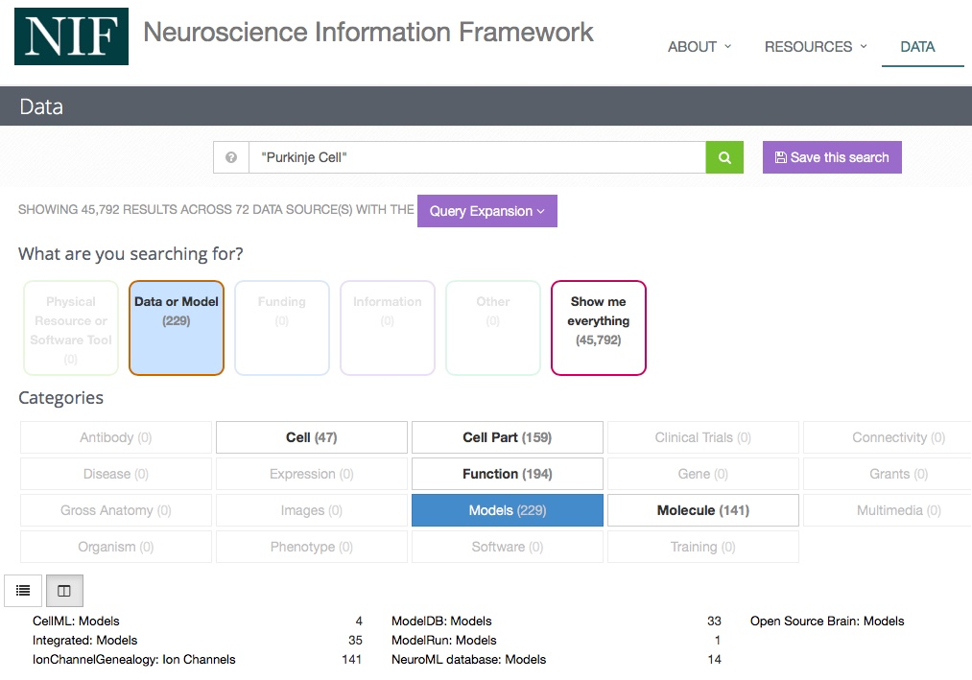
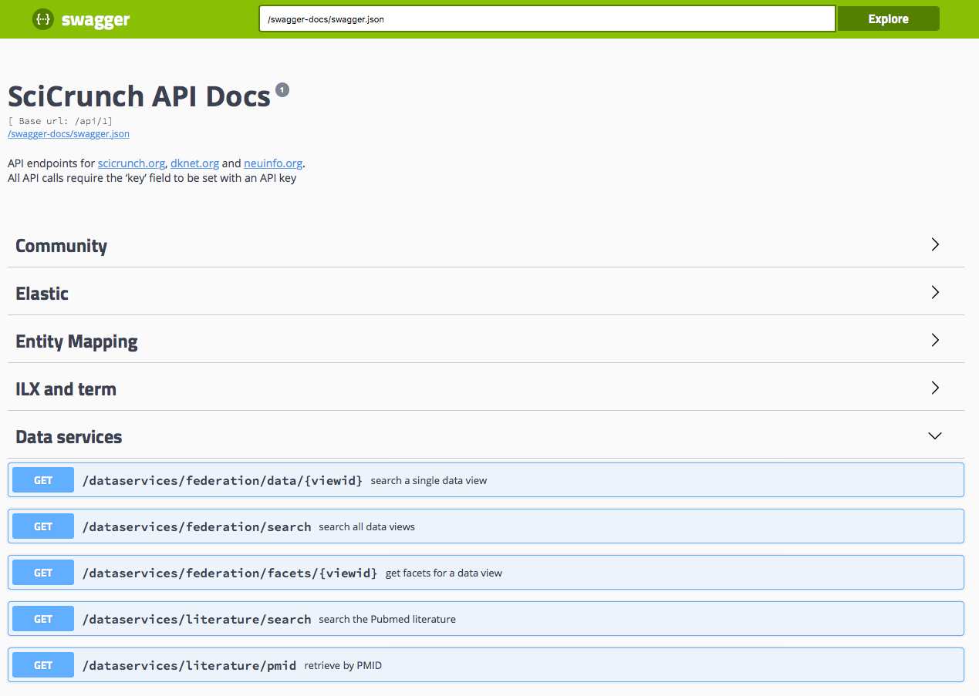
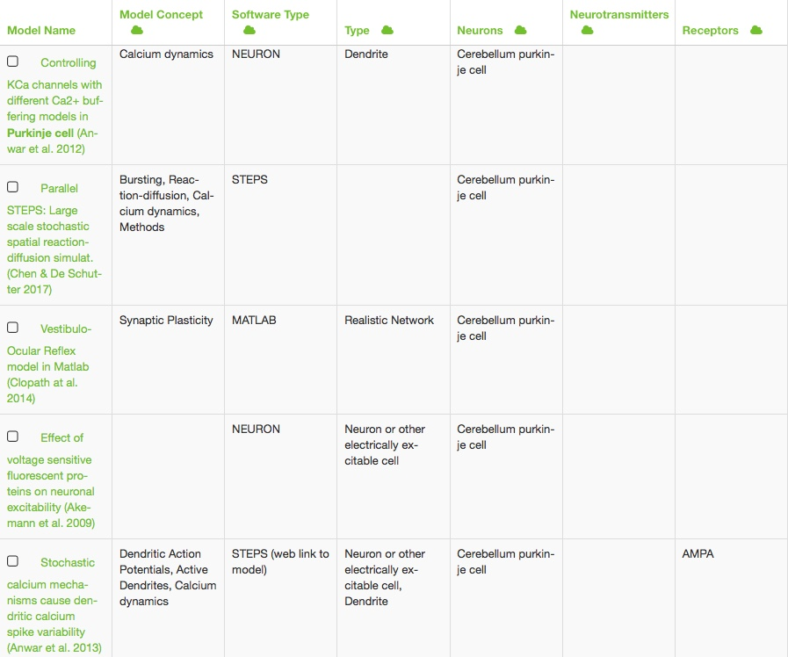
NIF allows you to find information and data from hundreds of neuroscience sources…
Access information or integrate information into your application or scripts via NIF provided services after registering for an API Key
Searching a diverse set of resources and making the search results intelligible are major challenges. NIF utilizes many advanced features for information retrieval and integration. Chief among these is the use of a shared vocabulary, InterLex (formerly NeuroLex) and the NIF Standard Ontology, for describing and querying resources. InterLex currently consists of thousands of concepts derived from community-built ontologies and vocabularies and enhanced through the input of neuroscience experts. Through intuitive query interfaces, users can make use of the InterLex vocabularies to expand or refine their search and to perform so-called “concept-based queries. ” Through a single interface, users can search across multiple information sources.
Notes:
2

Slide 3
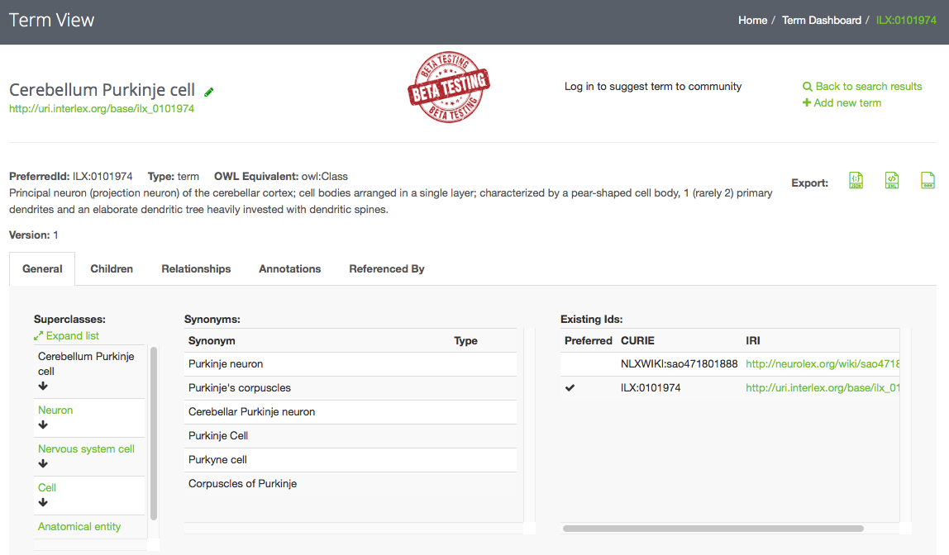
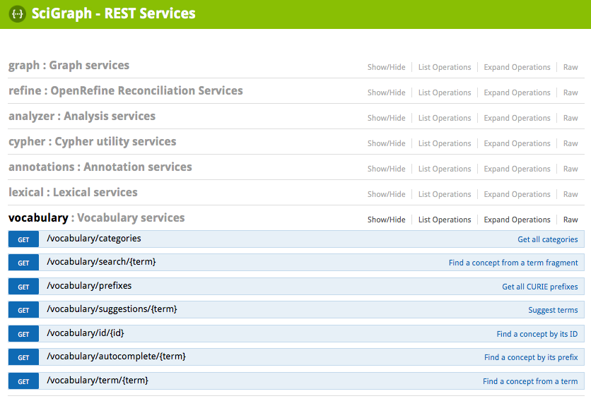
NIF is releasing new terminology tools and services
InterLex is a dynamic lexicon of biomedical terms that is being constructed to help improve the way that biomedical scientists communicate about their data, so that information systems can find data more easily and provide more powerful means of integrating data across distributed resources. One of the big roadblocks to data integration is the inconsistent use of terminology in databases and other resources such as the literature. InterLex allows for the association of data values (i.e. the value of a field or text within a field) to terminologies enabling the crowdsourcing of data-terminology mappings within and across communities.
InterLex was built on the foundation of NeuroLex (see Larson and Martone 2013). The initial entries in NeuroLex were built from the NIF Standard ontologies which currently has about 60,000 concepts (includes both classes and synonyms) that span gross anatomy, cells, subcellular structures, diseases, functions and techniques. InterLex models terms using primitives of the Web Ontology Language (OWL) and can export directly to a variety of standard ontology formats.
Access the NIF ontology or integrate the NIF ontology into your application or scripts via NIF provided services after registering for an API Key
Notes:
3

Slide 4
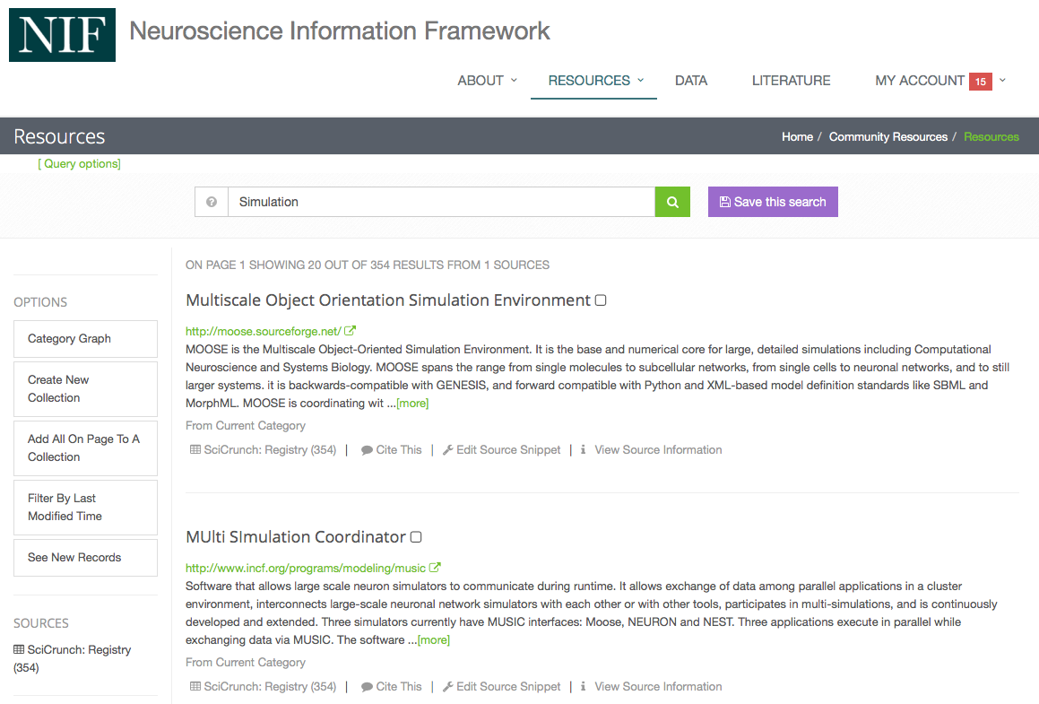
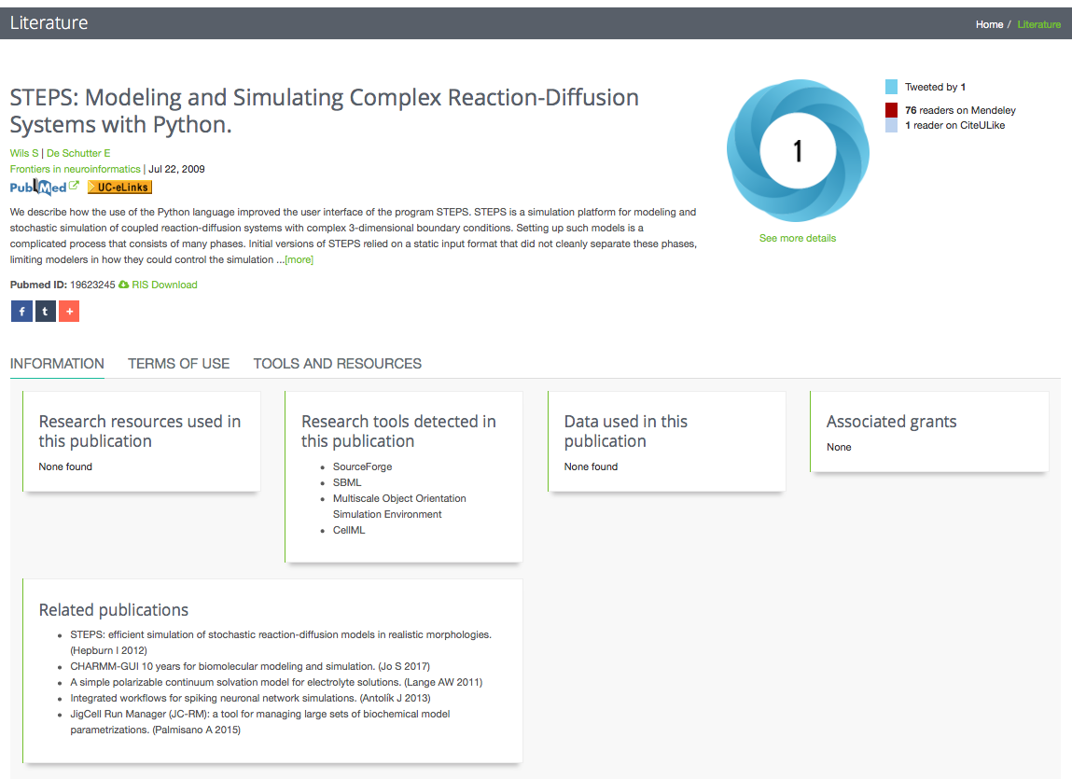
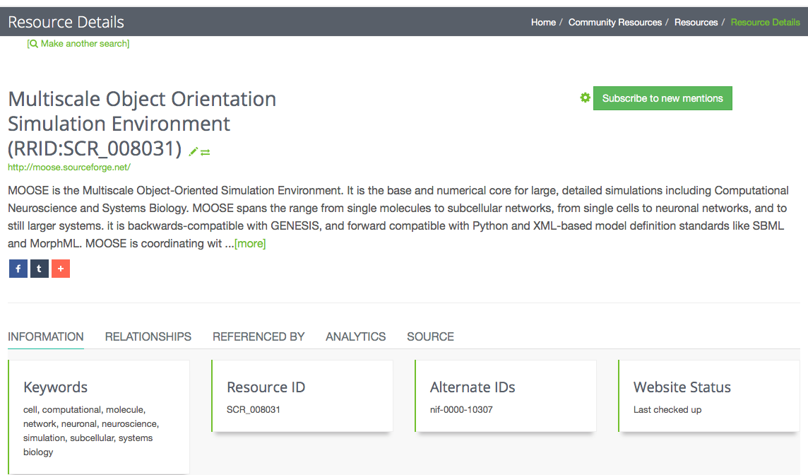
NIF assists users in finding scientific resources
The resource registry within NIF holds the largest collection of scientific resources, such as simulation environments. Resources are manually curated to make sure the information is accurate. Using NLP techniques we also look for literature mentions of resources in full text articles we have access to. This allows the registry to provide information on related resources and suggest other interesting resources.
Access resource information or integrate resource information into your application or scripts via NIF provided services after registering for an API Key
Notes:
4

