Slide 1
CA1 anatomy and model
An interactive anatomical database, graphical representation and full scale model of hippocampal area CA1
Estimation of cell numbers:
Graphical description of model:
Model code:
http://mariannebezaire.com/qagraphic/myQA.html
http://mariannebezaire.com/ca1_graphic/mymodel.html
http://mariannebezaire.com/models/ca1/
Neuroinformatics tutorial
1.2 Structured data from literature

Slide 2
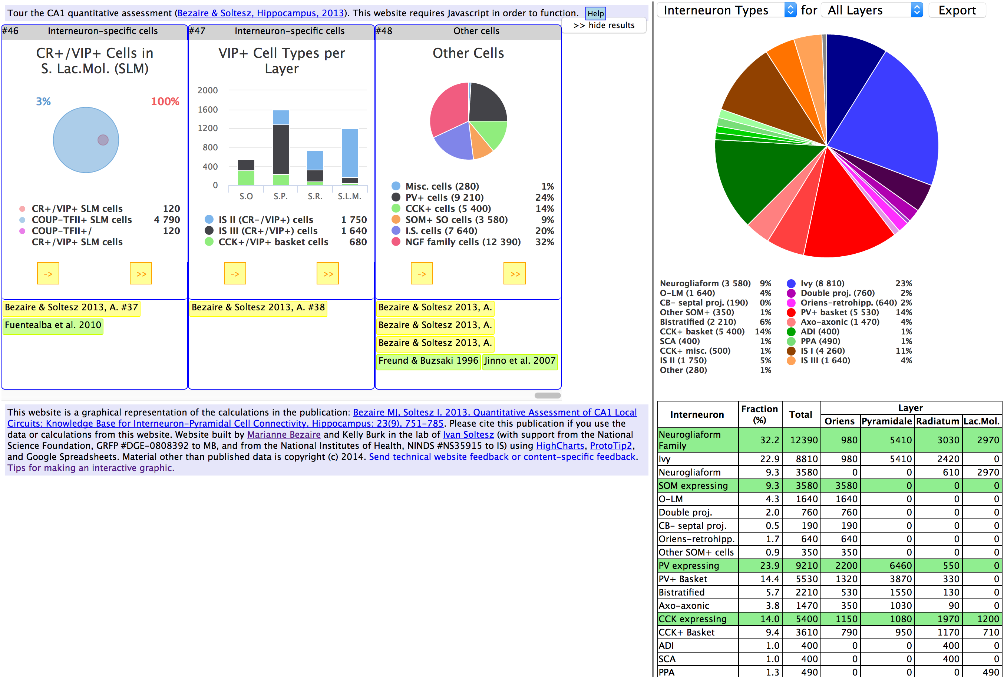
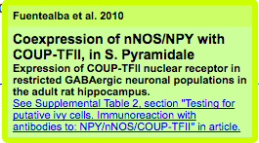
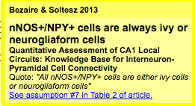
http://mariannebezaire.com/qagraphic/myQA.html
One slide giving an overview of the resource, example datasets, etc.
Each box represents a calculation towards cell number estimates, from Bezaire & Soltesz, 2013.
The green & yellow references can be clicked to show details:
Under development is the ability to edit assumptions or data and then recalculate estimates

Slide 3
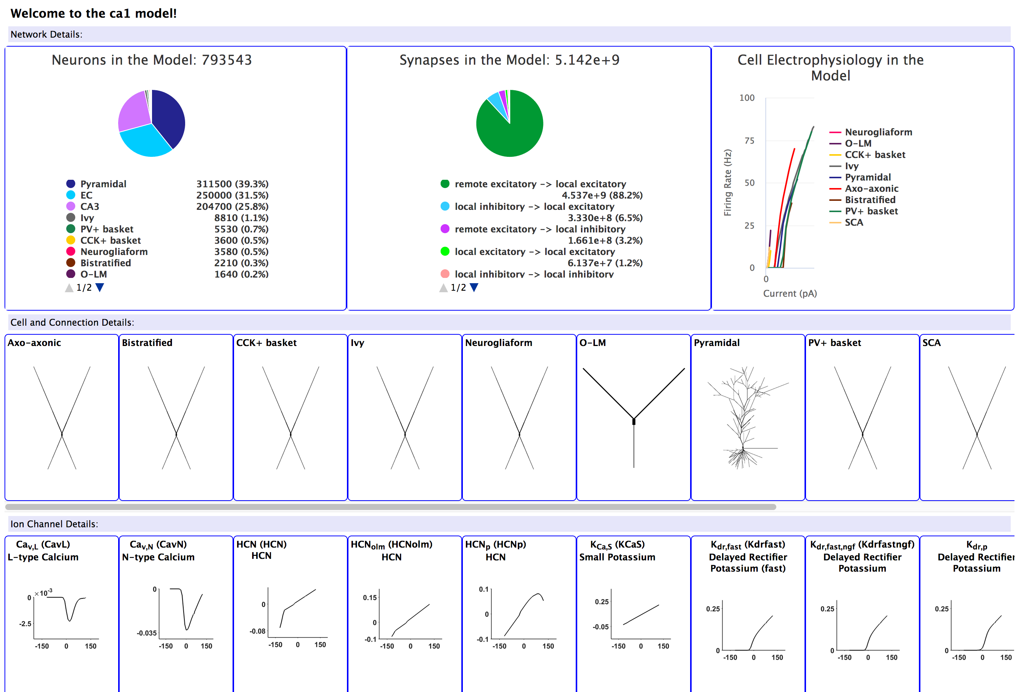
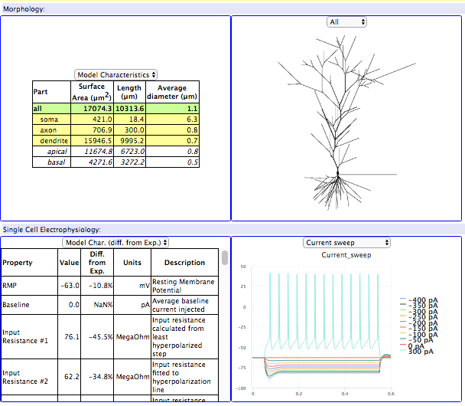
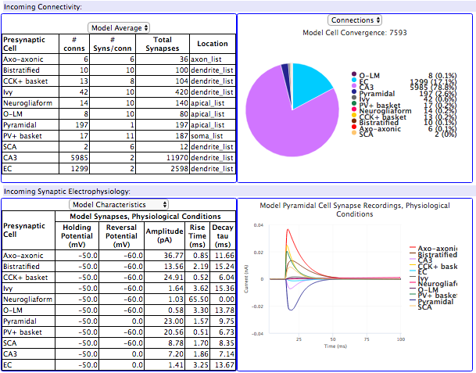
http://mariannebezaire.com/ca1_graphic/mymodel.html
One slide discussing current work/future plans
Click each cell or channel for additional information:

