Slide 1
GitHub
http://github.com
GitHub is a web-based version control repository based on Git and Internet hosting service. It is mostly used for open source code development. It offers all of the distributed version control and source code management functionality of Git as well as adding its own features.
Neuroinformatics tutorial
1.5 Model sharing
Notes:
1

Slide 2

GitHub
Most widely used open source code development platform
Offers free hosting of Git repositories with:
Version control
Issue tracking
Project/organisation management
Integration with multiple other platforms, e.g. Travis-CI for continuous integration
Most open source computational neuroscience tools developed here
Example: NEST Simulator...
Notes:
1

Slide 3
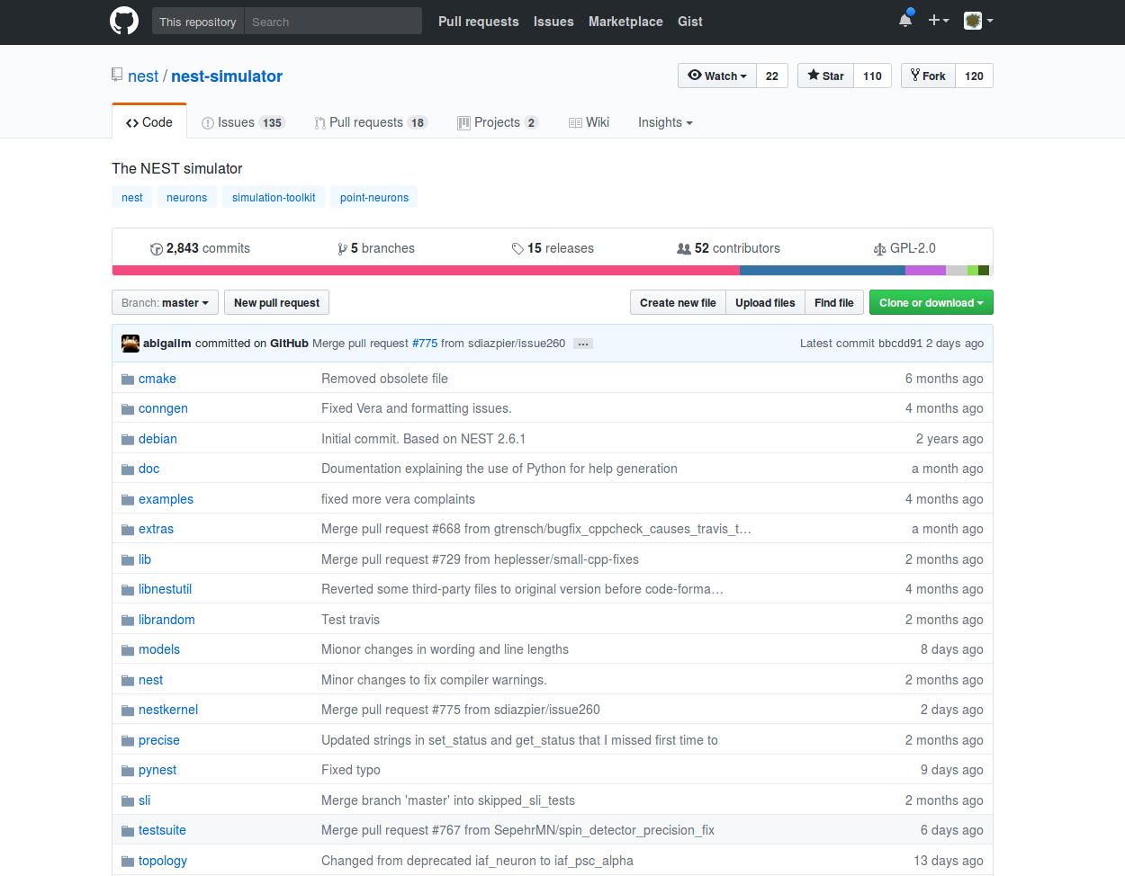
Notes:
1

Slide 4

Notes:
1

Slide 5
