Slide 1
NEST: The Neural Simulation Tool
http://www.nest-simulator.org
NEST is a simulator for spiking neural network models focussing on the dynamics, size and structure of neural systems rather than on the exact morphology of individual neurons. NEST is ideal for networks of spiking neurons of any size, from individual neurons to whole-brain models.
Neuroinformatics tutorial
1.4 Simulation environments
Notes:
<number>

Slide 2

NEST: A powerful simulator
Focused on networks of spiking point neurons
Supports
Many neuron models including Hogdkin-Huxley style and few-compartment models
Synaptic plasticity including neuromodulatory signals
Structural plasticity
Gap junctions
Spatially structured networks
Python interface
Scales from laptops to supercomputers
Active user and developer community
Systematic quality control by continuous integration testing and code review
Based on over 20 years of experience
Notes:
<number>

Slide 3
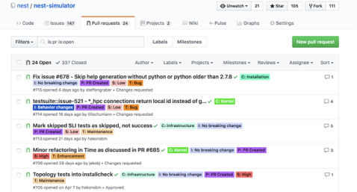
NEST Development
Active developer community on Github
Regular open developer video conferences
Focus on improving performance and usability
Some current projects
Support for rate models
NESTML: Automatic code generation for neuron models
NESTIO: Efficient data recording to binary file formats
Dry-run mode: Efficient performance analysis on supercomputers
Improved network construction speeds for highly threaded simulations
Regular publications on NEST simulation technology
Ippen et al (2017)
Notes:
<number>

Slide 4
More NEST Resources
Simulator homepage
http://www.nest-simulator.org
Github repository
http://github.com/nest/nest-simulator
NEST User mailing list
http://mail.nest-initiative.org/cgi-bin/mailman/listinfo/nest_user
NEST Initiative
http://www.nest-initiative.org
Annual NEST User Workshop
Notes:
<number>

