Slide 1
Virtual Fly Brain
https://www.virtualflybrain.org
A data integration hub for Drosophila neurobiology, integrating disparate, large-scale datasets and linking them to curated literature and other resources. VFB provides the data to generate circuit hypotheses and identify research tools to test them.
Neuroinformatics tutorial
1.8 Web portals
Notes:
1

Slide 2
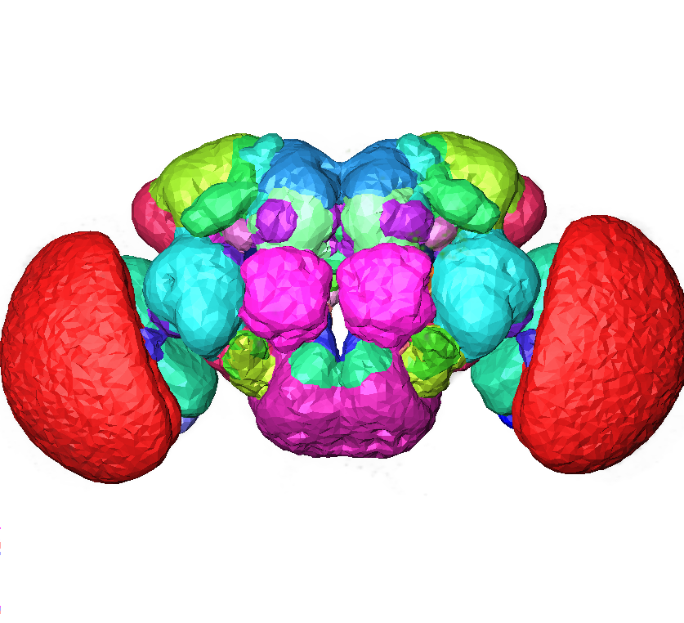
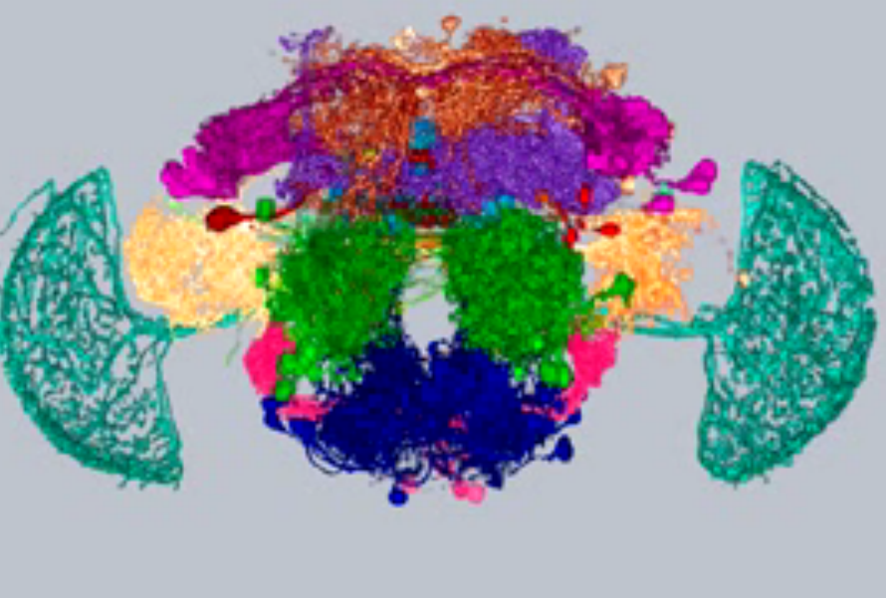
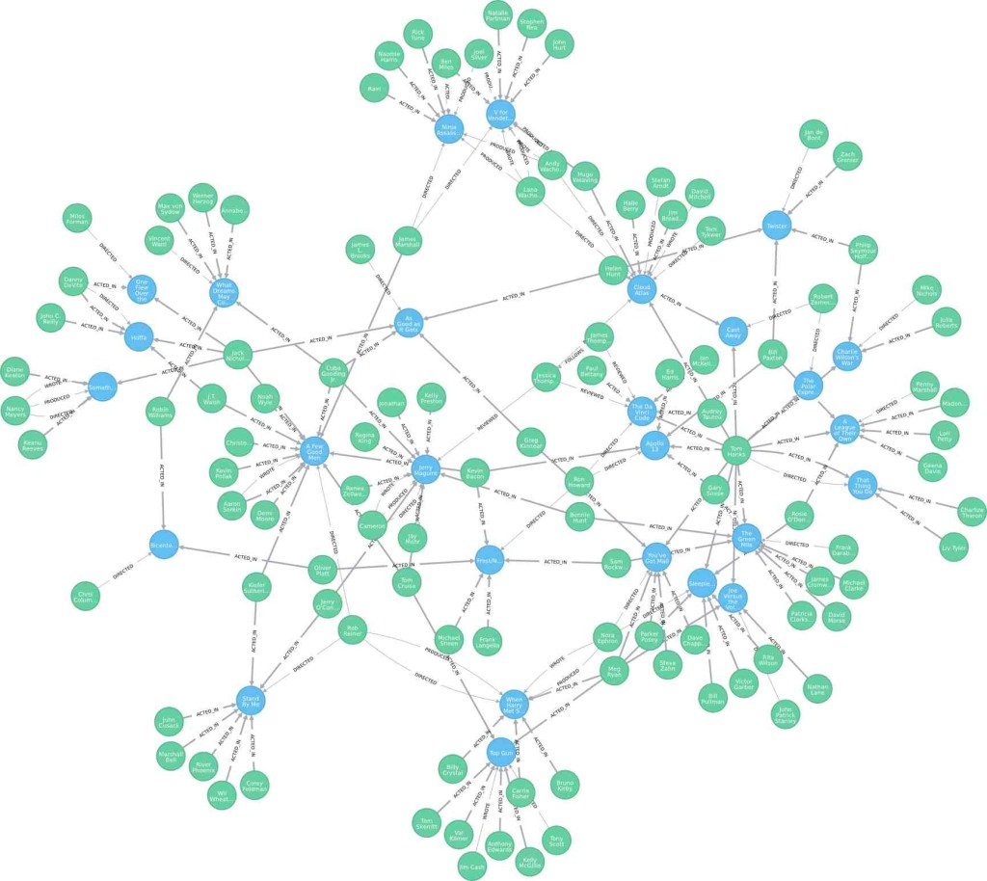





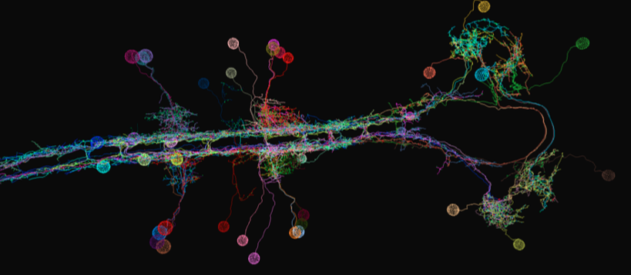
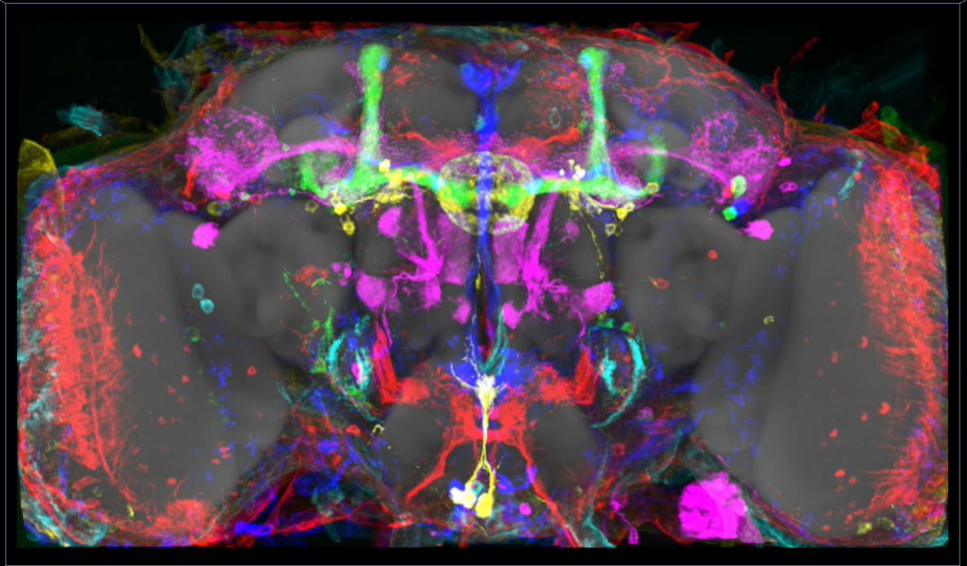





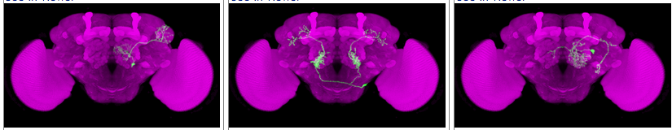

Combining 3D Anatomy, Light & EM Image Data
auditory neurons (Kamikouchi)
Clonal data (Ito, Yu, Jefferis)
Dopaminergic system neurons(Aso)
with semantic integration: image annotation
OWL2
DAO*
OWL individual
annotation
Notes:
2

Slide 3
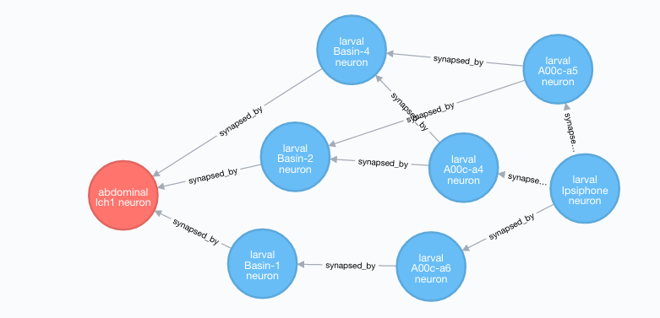
VFB 2 – interactive 3D circuit reconstructions
Ohyama et al., 2015
Context graphs: Exploring circuit paths
Query: circuit paths from 'abdominal vch1 neuron' to 'larval Ipsiphone neuron'
Notes:
3

Slide 4
Value added by VFB
OWL-based approach
scalable, queryable integration of knowledge and data about Drosophila neuroanatomy
Knowledge curated from the literature
context and queryability to bulk data
Tight integration with FlyBase
Expression
Phenotypes
Planned collaboration with EBI
integration transcriptomic data
Nblast
find morphologically similar neurons
find potential driver lines for a specific neuron
Direct API’s to query data.
Notes:
4

