Slide 1
CA1 anatomy and model
http://www.mariannebezaire.com/ca1_graphic
An interactive anatomical database, graphical representation and full scale model of hippocampal area CA1
Neuroinformatics tutorial
1.2 Structured data from literature

Slide 2
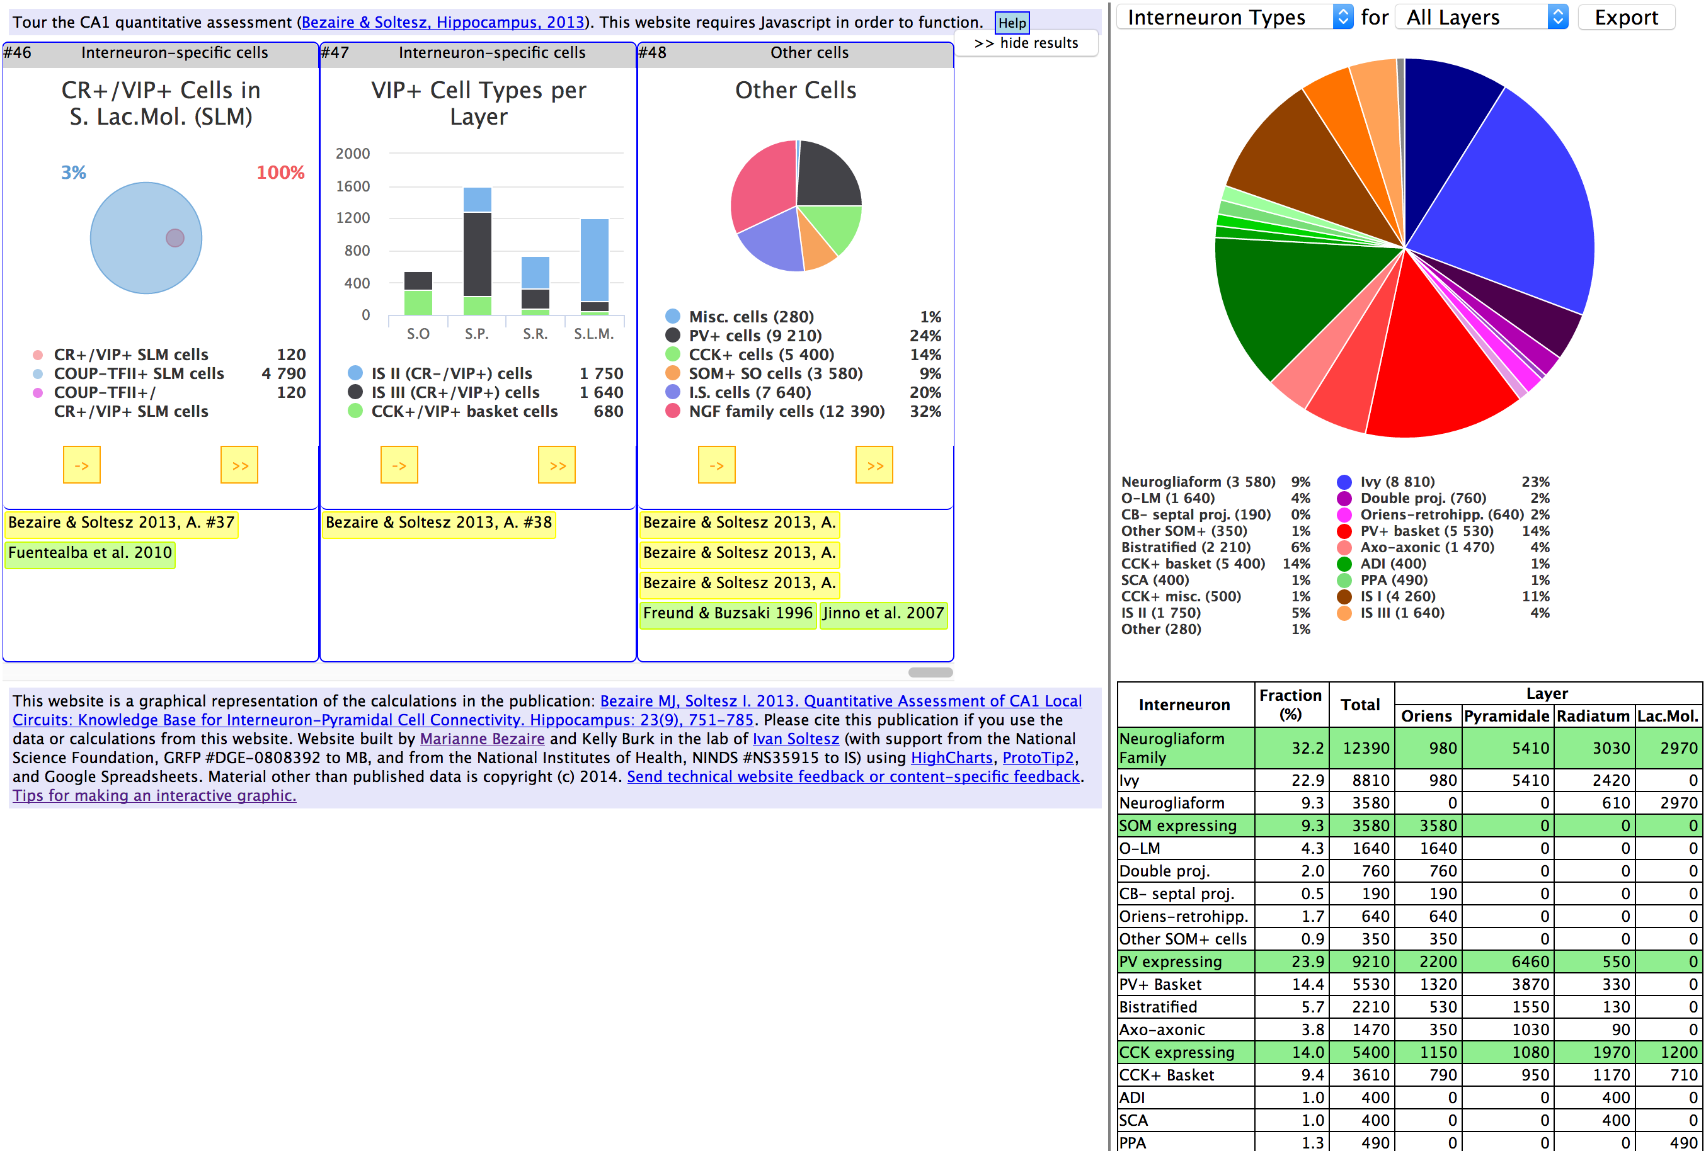
One slide giving an overview of the resource, example datasets, etc.

Slide 3
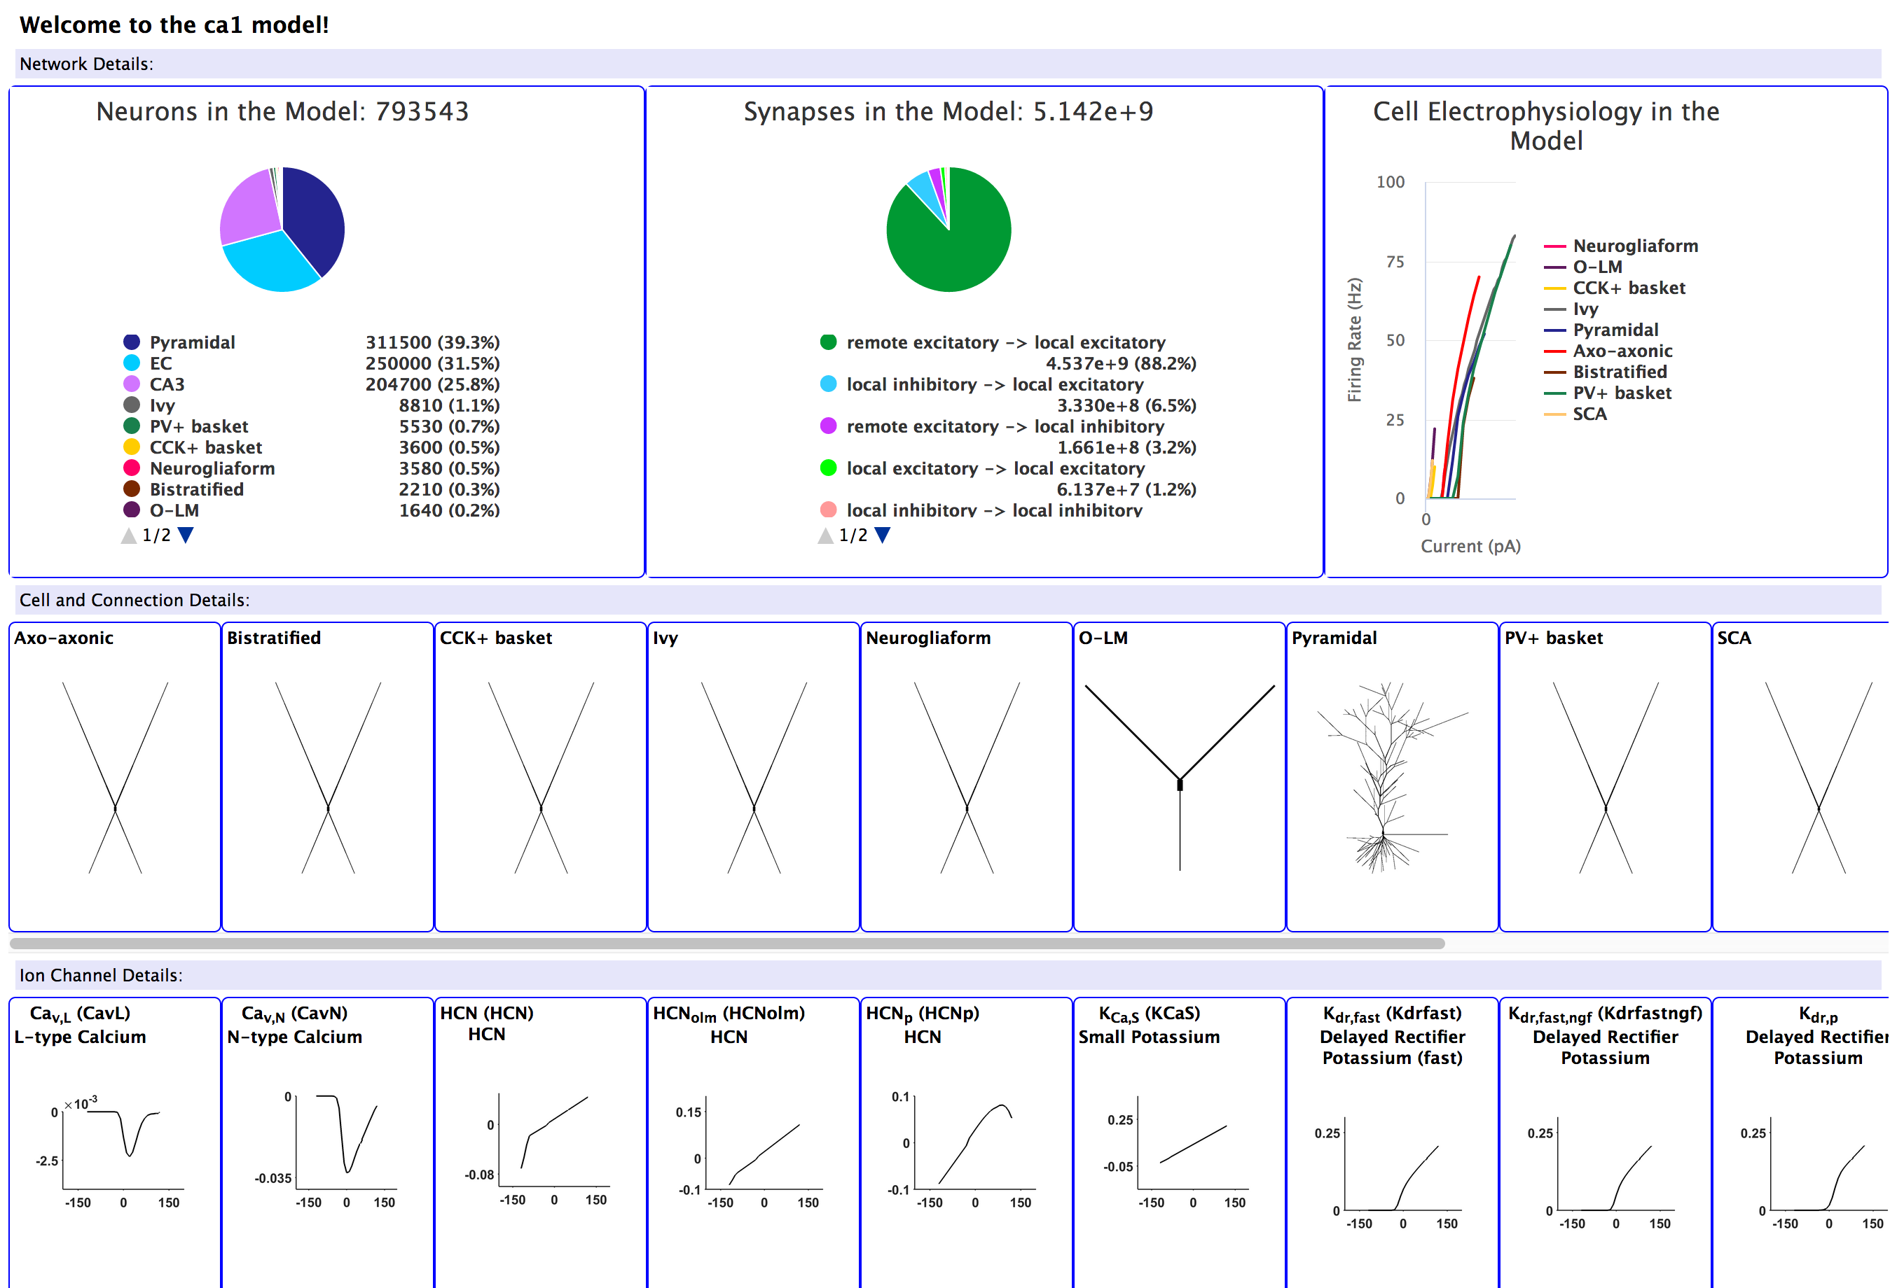
One slide discussing current work/future plans

