Slide 1
NITRC
https://www.nitrc.org
Neuroimaging Informatics Tools and Resources Clearinghouse (NITRC) is a free one-stop-shop collaboratory for science researchers that need resources such as neuroimaging analysis software, publicly available data sets, or computing power.
Neuroinformatics tutorial
1.8 Web portals
Notes:
1

Slide 2
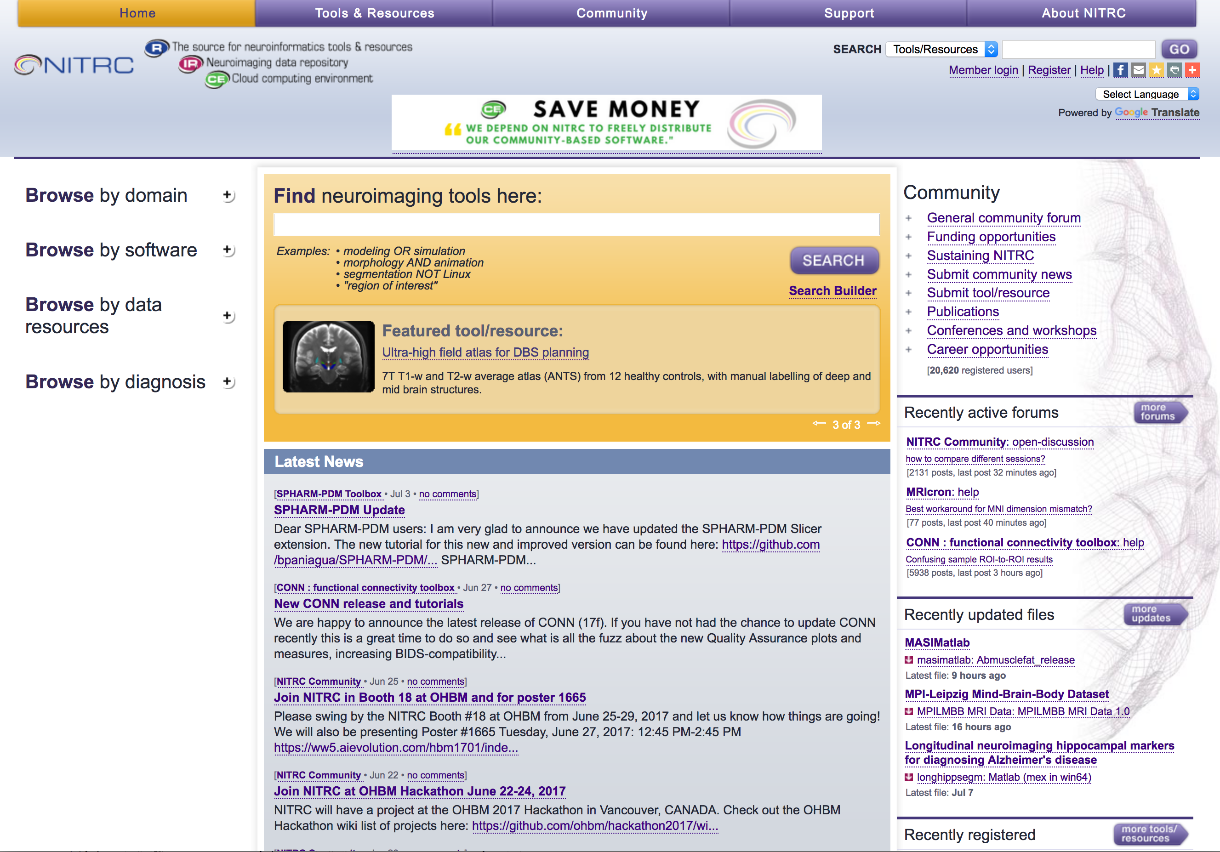
One slide giving an overview of the resource, example datasets, etc.
Notes:
2

Slide 3
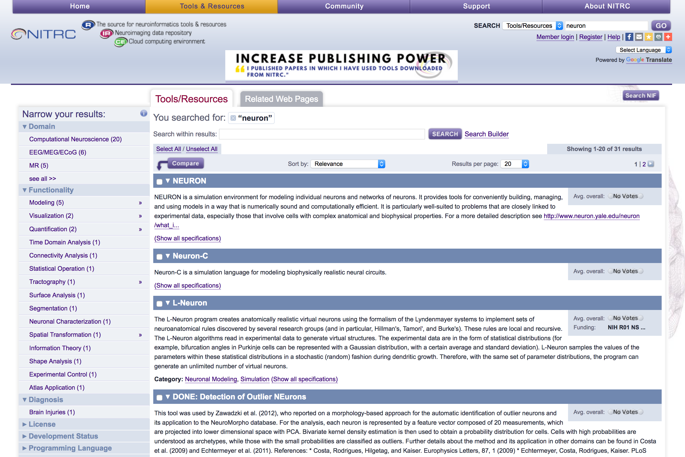
Notes:
3

Slide 4
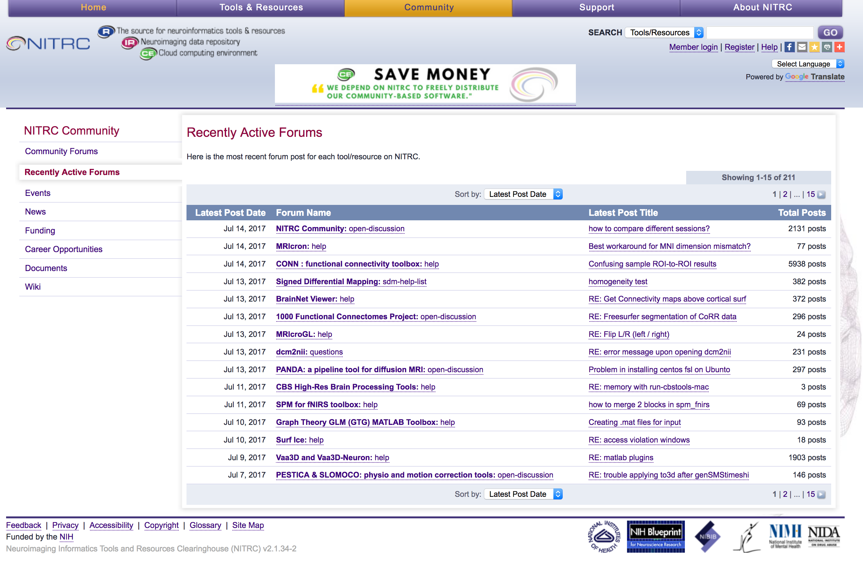
Notes:
4

