Slide 1
NeuronUnit
http://neuronunit.scidash.org
NeuronUnit facilitates data-driven validation of neurophysiology models, testing these models for agreement with experimental data. Progress in model development or appropriateness of published models can be evaluated according to performance on these tests.
Neuroinformatics tutorial
1.3 Analysis tools
Notes:
<number>

Slide 2

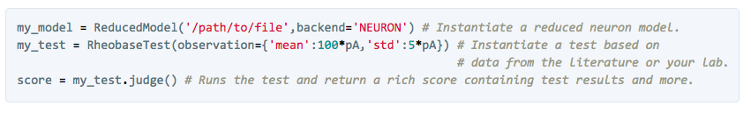
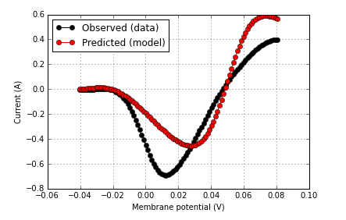
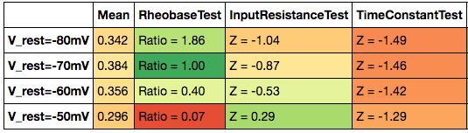
Write (or reuse) unit tests that each characterize one aspect of model behavior.
Visualize model/data
agreement for each test
Examine test performance for different parameterizations of a model, or different models
Notes:
<number>

Slide 3
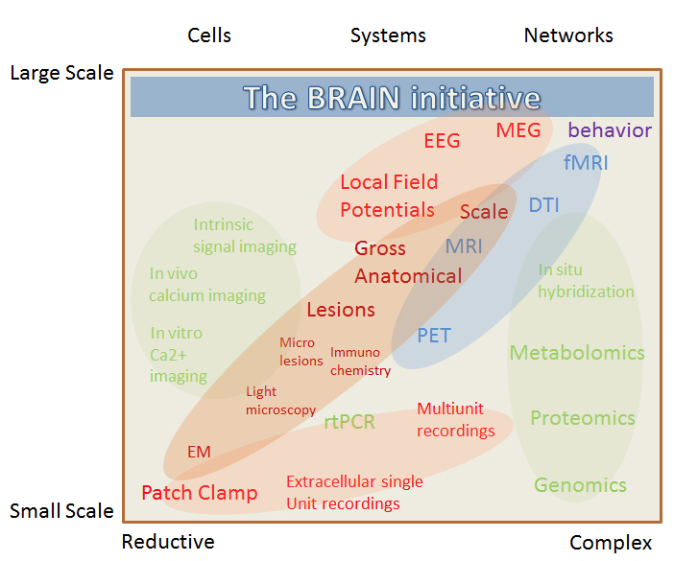
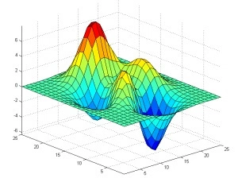

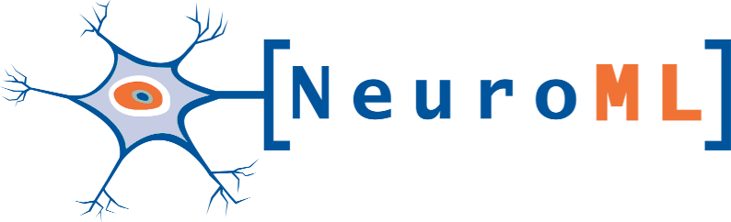

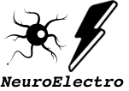

Optimization of model parameters using genetic algorithms
Support for models across multiple scales of neuroscience
Model and data integration with major simulator, data, and standards providers
Notes:
<number>

