Slide 1
Allen Cell Types Database
http://celltypes.brain-map.org/
A multimodal database of single cell characterization to enable data-driven approaches to classification. Key features include: whole cell patch clamping, raw images and morphological reconstructions, a variety of abstract point models as well as biophysically detailed compartmental models, and single cell RNA sequencing data.
Neuroinformatics tutorial
1.1 Experimental Datasets
Notes:
<number>

Slide 2
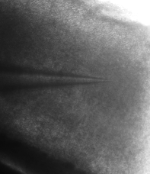
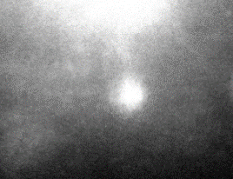
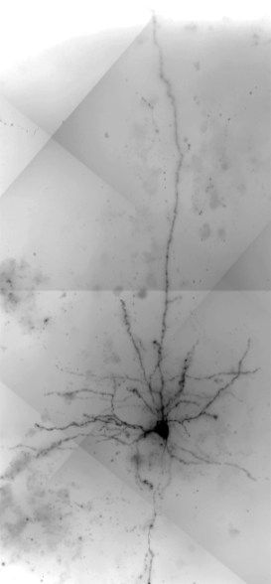
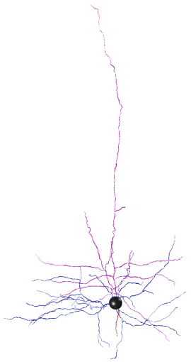
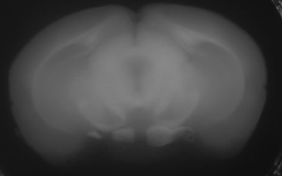
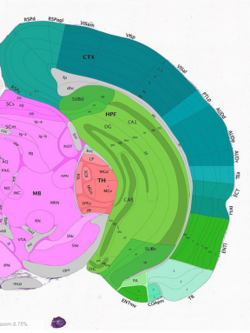
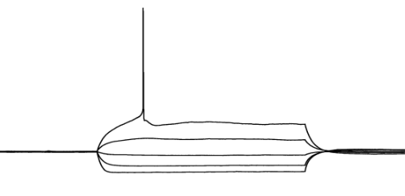
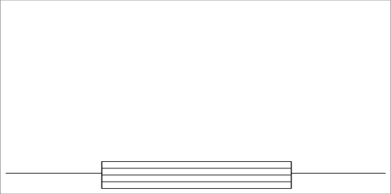
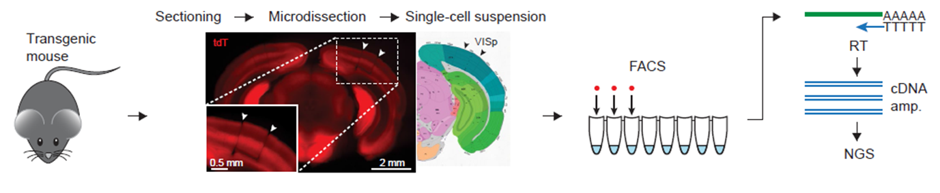
Single Cell Characterization: Electrophysiology & Morphology
A comprehensive dataset is acquired for each neuron. Here is an example of the multimodal data generation from one single experiment (Specimen 162961.04.02)
Mouse Metadata
Electrophysiology
Cell Imaging, Reconstruction
Genotype | Nr5a1:Ai14
Sex | M
Age | P56
100 µm
20 µm
Neuron Registration
Recording location and Cre label
are verified by images
X
30 mV
-76 mV
150 ms
30 µm
Cell location is marked on the
block face images to register to the Allen Reference Atlas
-90 → +70 pA
Raw and summary Ephys data for
sub and suprathreshold activity
63X image stack acquired for every well-filled neuron. Reconstructions prioritized based on Ephys and fill.
Transcriptomics: Isolating and profiling cells
Notes:
<number>

Slide 3
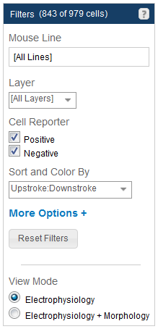
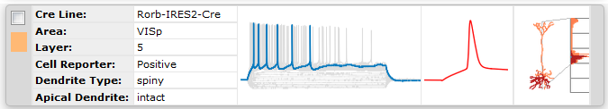
How to most effectively navigate and mine the Allen Cell Types Database
Electrophysiology & Morphology
Search for cells of interest using the Filters panel (Cre line, layer, ephys or morphological features) on the website. Click here for more information on advanced search features.
Clicking on a cell panel (see above) will take you to cell characterization data including stimuli, cell responses, models, links to download the NWB file for that experiment, as well as morphological images, reconstructions and features (when available).
Use the Allen SDK for sample code demonstrating how to download neuronal model parameters from the Allen Brain Atlas API and run your own simulations using stimuli from the Allen Cell Types Database or custom current injections:
Biophysical Models
Generalized LIF Models
Notes:
<number>

Slide 4
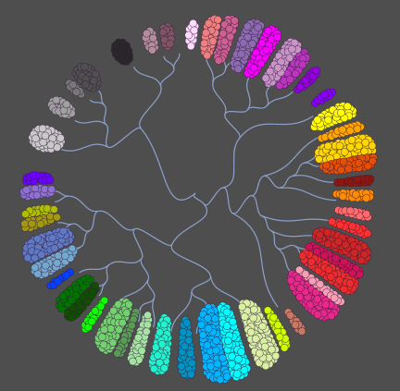
How to most effectively navigate and mine the Allen Cell Types Database
Single Cell RNA Sequencing
Prototype cell type classification was performed based on transcriptomics from single cells isolated from the primary visual cortex and is described here and here.
Follow up studies are in progress and include RNA Sequencing from single cells isolated from the lateral geniculate complex, the primary visual cortex and from the anterior lateral motor area. From this page, you can download gene level FPKM values (as might be used in a heatmap display of gene expression for neurotransmitters) or access FPKM and TPM values for each sample.
What analyses can you perform?
Compare the transcriptome of your cell to identify similar cells
Identify marker genes of cell types
Look at expression patterns of functional categories of genes (i.e. ion channels, GPCRs etc.)
Notes:
<number>

