Slide 1
NeuroMorpho.Org
http://neuromorpho.org/
NeuroMorpho.Org is a centrally curated inventory of digitally reconstructed neurons associated with peer-reviewed publications. It contains contributions from over 200 laboratories worldwide and is continuously updated as new morphological reconstructions are collected, published, and shared. To date, NeuroMorpho.Org is the largest collection of publicly accessible 3D neuronal reconstructions and associated metadata.
Neuroinformatics tutorial
1.1 Experimental Datasets
Notes:
<number>

Slide 2
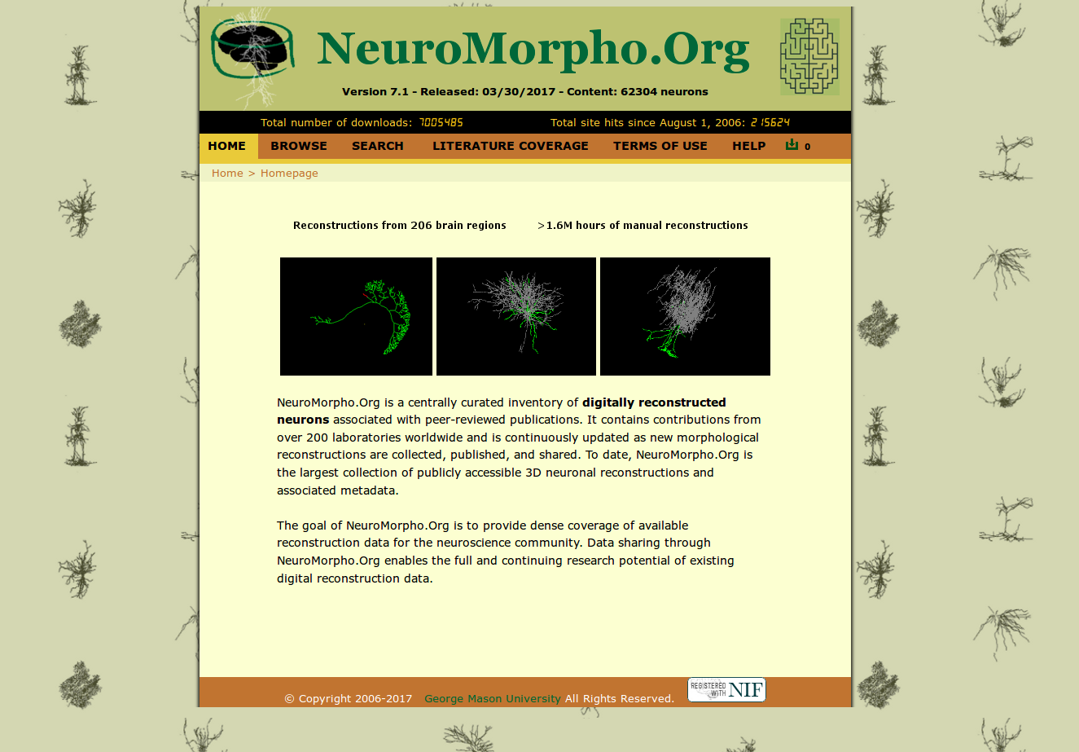
Notes:
<number>

Slide 3
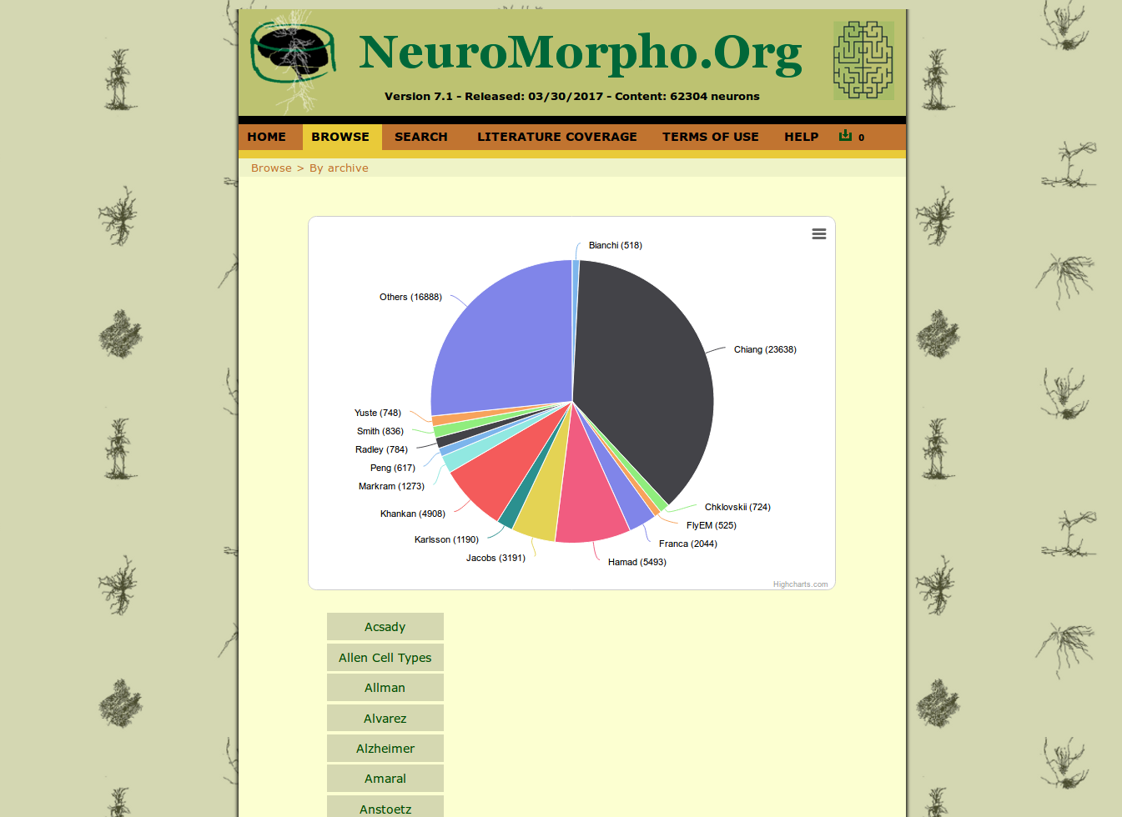
One slide discussing current work/future plans
Notes:
<number>

Slide 4
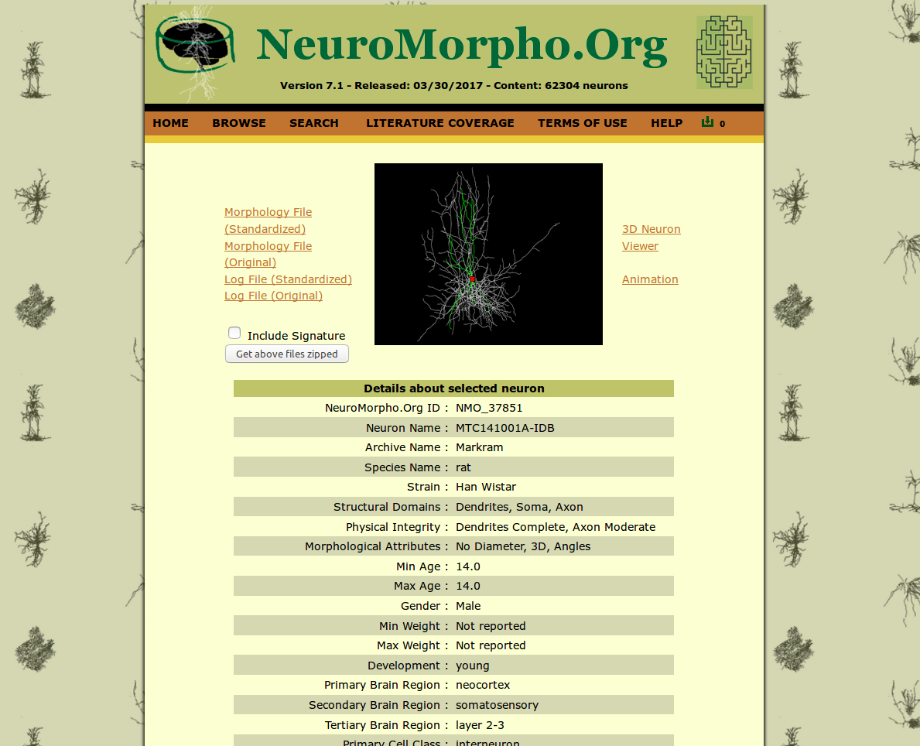
Optional 3rd slide…
General requests:
- Please favour graphical content over text where possible
- Please don’t use animation (use multiple slides if required)
- Try to keep to font Arial
- Save slides as .pptx (Powerpoint 2007-2013); slides will be concatenated into a single PDF presentation
Notes:
<number>

