Slide 1
HBP Collaboratory
http://collab.humanbrainproject.eu
The HBP Collaboratory collects tools from the HBP Platforms in one place and allows you to organize them into your own collaborative workspace or collab.
Neuroinformatics tutorial
1.8 Web portals
Notes:
<number>

Slide 2
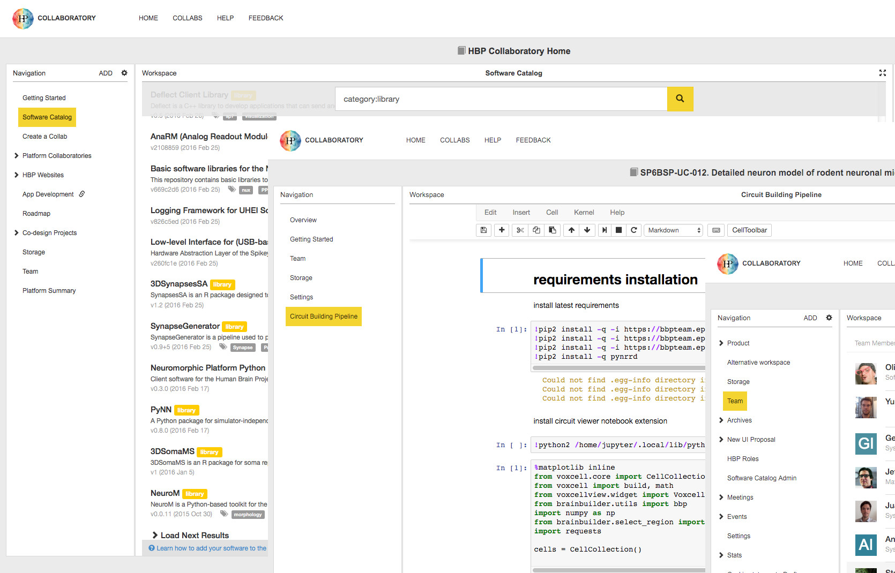
The HBP Collaboratory is your virtual lab bench
Explore, Work, Collaborate, Organize
Explore the HBP Platform ecosystem
Work with integrated web accessible scientific tools to analyze, visualize and share data.
Collaborate by adding team members to your collab to gain insights outside your areas of expertise
Organize your work with tools from the HBP Platforms integrated in the Collaboratory
Notes:
<number>

Slide 3
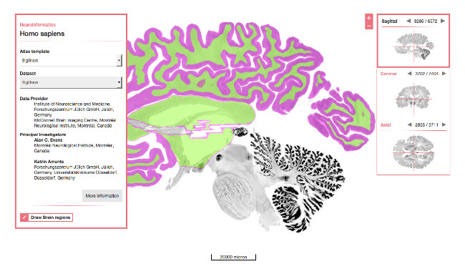
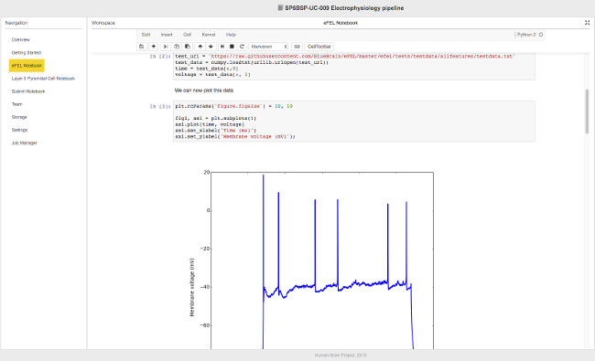
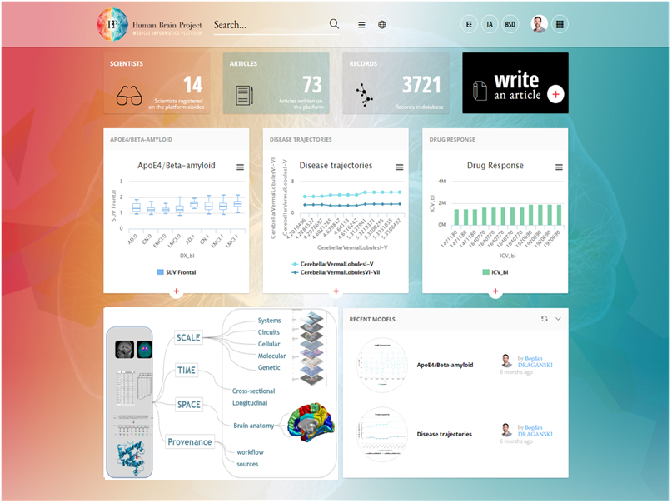
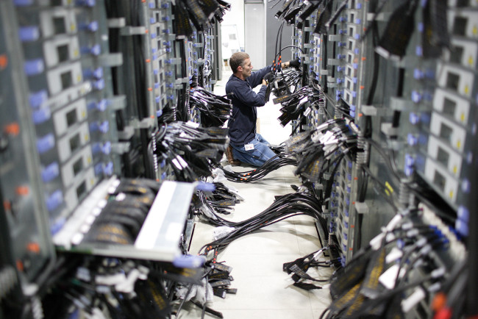
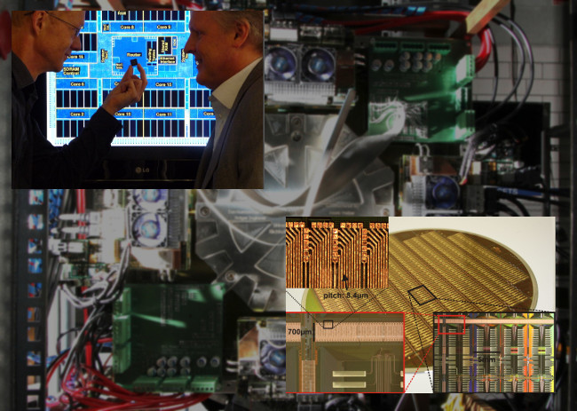
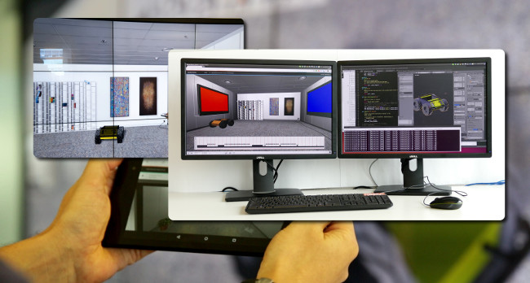
Explore and Use the HBP Platform Ecosystem
Federated across Europe, the HBP Platforms provide strategic tools in:
Neuroinformatics
Brain Simulation
Medical Informatics
High Performance Analytics and Computing (HPAC)
Neuromorphic Computing
Neurorobotics
Notes:
Neuroinformatics Platform - Objective: to organize and standardize a vast array of neuroscience data types to ensure accessibility and discoverability though brain atlases and other specialized databases.
Brain Simulation Platform - Objective: to develop apps, APIs, and Foundation Software to support productive collaborations to build, simulate, analyze, validate and disseminate data-driven brain models at many scales.
Medical Informatics Platform - Objective: to provide the tools to the experts to effectively analyse research and clinical data and advance more rapidly in understanding neurological and psychiatric diseases.
High Performance Analytics and Computing (HPAC) Platform- Objective: to enable the computationally intensive analysis, model building and simulation workflows of cutting edge neuroscience in the HBP and beyond.
Neuromorphic Computing Platform - Objective: Develop, operate and maintain two custom complementary neuromorphic machines for modelling neural microcircuits and applying brain-like principles in machine learning and cognitive computing.
Neurorobotics Platform - Objective: To develop and operate a suite of powerful web-based applications for performing complex neuro-robotics experiments. It provides a Robot Designer, an Environment Designer, and Designers for Experiments and Brain Interfaces and Body integrators (BIBI).
<number>

Slide 4
Getting Access
To access the HBP Collaboratory you need an HBP Identity account.
Information on how to request an account can be found here:
https://www.humanbrainproject.eu/en/hbp-platforms/getting-access/
With a basic HBP Identity Account you can access:
HBP Collaboratory:
Browse Platform collabs
Browse HBP Collaboratory public collabs
Add files to public collabs where the user is a member
Create public collabs and populate them with content
Create public Jupyter notebooks and edit them
Can be added to private collabs by collab owners
platform@humanbrainproject.eu
Notes:
<number>

