Slide 1
Brian 2
http://briansimulator.org
Brian 2 is a free, open source simulator for spiking neural networks. It is designed to be easy to learn and use, highly flexible and easily extensible.
Neuroinformatics tutorial
1.4 Simulation environments
Notes:
<number>

Slide 2
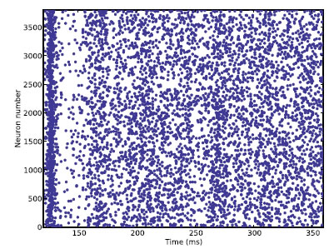
Brian 2 allows for concise but complete descriptions of neural and synaptic models, based on mathematical equations and physical units.
The user-provided model descriptions are transformed into executable code in a low-level language (e.g. C++). This code generation approach permits to benefit from the flexibility and ease-of-use of a high-level language with the execution speed of a low-level language.
Notes:
<number>

Slide 3
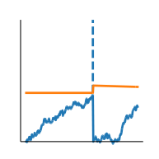
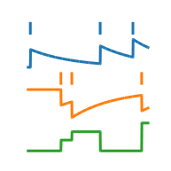
General formalism allows to define a wide range of neural and synaptic models
Noisy adaptive integrate-and-fire neuron
Spike-timing dependent plasticity (STDP)
Simulations can be executed on a variety of targets
“runtime mode” – generated code is executed directly from the Python main loop
→ generated code can be numpy or C++ code
“standalone mode” ­– generated code is written to disk and executed separately
→ C++ code, with optional support for multiple processor cores via OpenMP
→ with Brian2GeNN: C++ code for the GeNN simulator, compiling into CUDA code for the GPU
Notes:
<number>

Slide 4
Resources for Brian 2
Brian documentation (including examples and tutorials)
http://brian2.readthedocs.io
Mailing lists
https://groups.google.com/group/briansupport
https://groups.google.com/group/brian-development
Publications
Goodman DF and Brette R (2009). The Brian simulator. Frontiers Neurosci
doi: 10.3389/neuro.01.026.2009
Stimberg M, Goodman DFM, Benichoux V, Brette R (2014). Equation-oriented specification of neural models for simulations. Frontiers Neuroinf
doi: 10.3389/fninf.2014.00006
Related software packages
Brian2GeNN (code generation for GPUs via the GeNN simulator)
http://brian2genn.readthedocs.io
Brian2tools (tools for visualization and model export)
http://brian2tools.readthedocs.io
Notes:
<number>

