Slide 1
MOOSE: Multiscale Object Oriented Simulation Environment
https://github.com/BhallaLab/moose
MOOSE is designed to simulate neural systems ranging from biochemical signaling to
complex models of single neurons, circuits, and large networks. MOOSE can operate
at many levels of detail, from stochastic chemical computations, to multicompartment
single-neuron models, to spiking neuron network models.
Neuroinformatics tutorial
1.4 Simulation environments
Notes:
1

Slide 2
Notes:
1

Slide 3
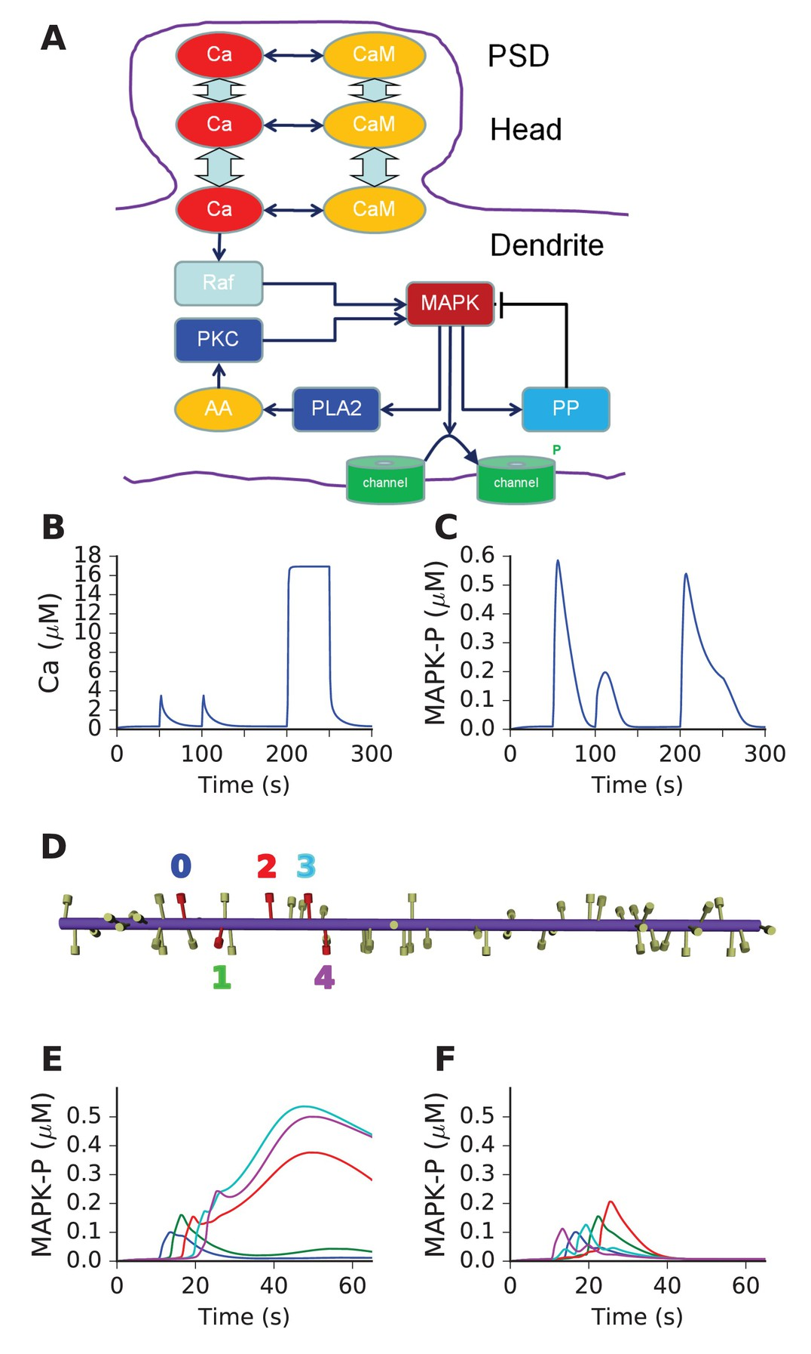
Current and future plans
Features
Fast (written in C++) but easy to use (Python scriptable). Rdesigneur library to integrate chemical and electrical models easily.
Chemical model formats support: SBML, NeuroML(v-1.8) and genesis format. Neuron morphology: SWC format.
GUI interface for building chemical models.
Documentation
Packages: Linux (via OBS) and MacOSX (via Homebrew).
In development
Hsolve being ported to GPU (alpha). Credit: GSoC-2015,2017).
Multithreaded chemical solvers Gsolve/Ksolve/Dsolve (beta).
Future Plans
GPU version of Ksolve/VGsolveDsolve
Bugfixes!
Bhalla eLife-2017. Mass action model of a
MAPK switch exhibits sequence selectivity
Notes:
1

