Slide 1
OpenWorm
http://www.openworm.org
OpenWorm aims to build the first comprehensive computational model of the Caenorhabditis elegans (C. elegans), a microscopic roundworm. With only a thousand cells, it solves basic problems such as feeding, mate-finding and predator avoidance. Despite being extremely well studied in biology, this organism still eludes a deep, principled understanding of its biology.
Neuroinformatics tutorial
1.7 Open source initiatives
Notes:
1

Slide 2
C. elegans background
Behavior
Seeks out food & mates
Avoids predators & toxins
Has social behaviors
Genomics
First fully sequenced organism
Cellular anatomy
302 neurons, 95 muscle cells, ~1000 total cells
Every cell division from fertilized egg to adult is known
Connectome
Only full organism connectome completed to date.

Slide 3
OpenWorm’s goals
Long term
Full scale simulation of an organism, C. elegans
Medium term
Accurately predict simple animal behavior using a computer model.
Szigeti et al,
Front. Comp. Neuro., 2014

Slide 4
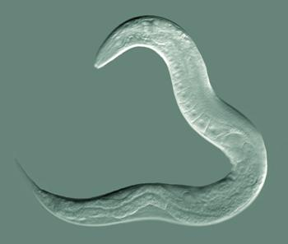
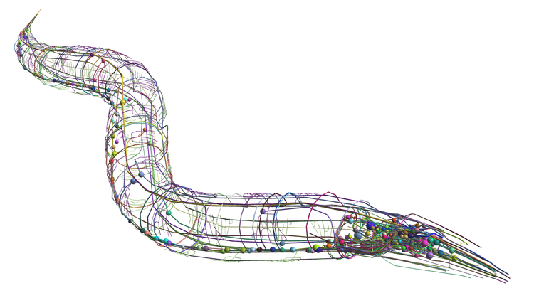
A complete simulation of the worm’s brain, body and environment
Simulated
World
Detailed simulation of worm neurons
Detailed simulation of worm body

Slide 5
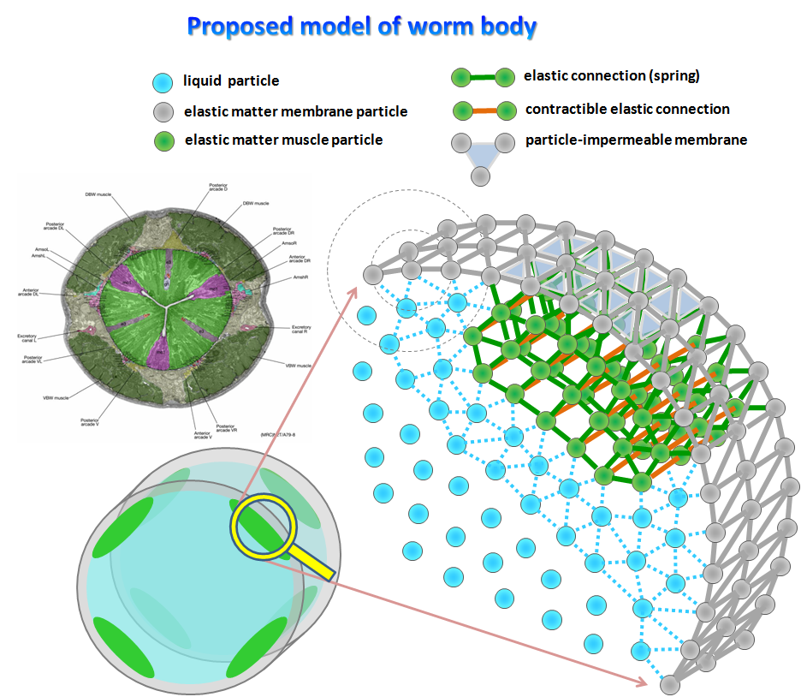
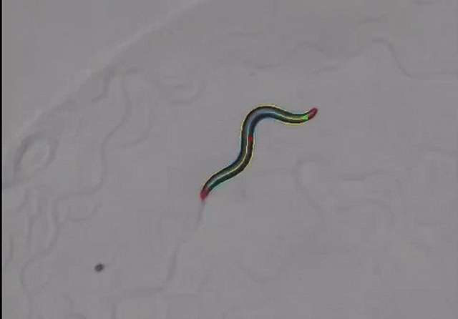

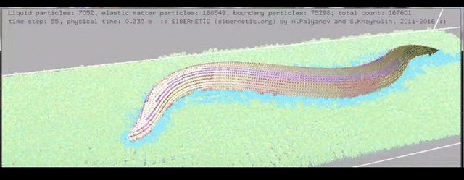
Palyanov, Khayrulin, (unpublished)

Slide 6
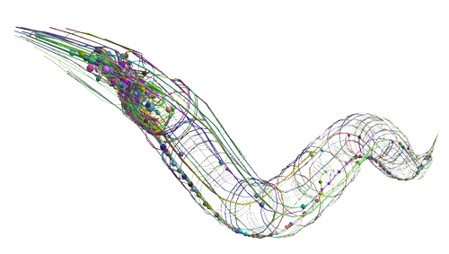
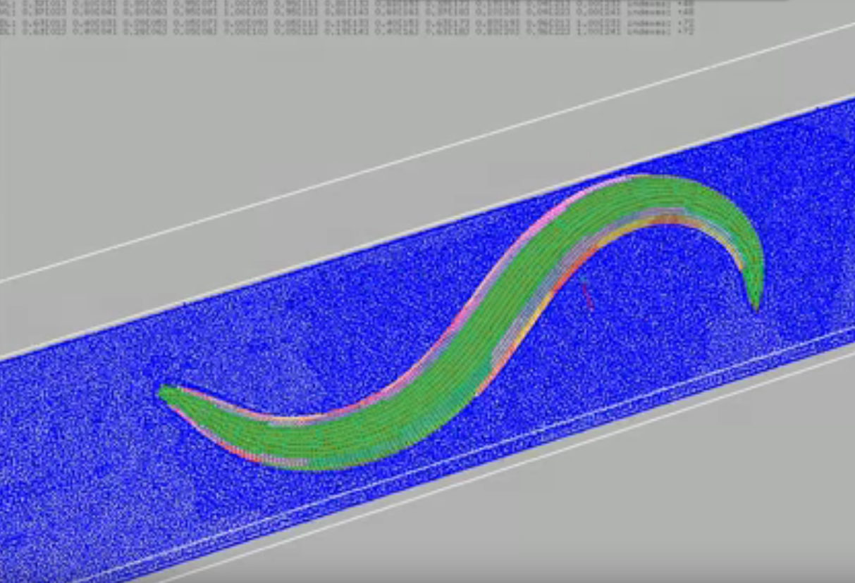
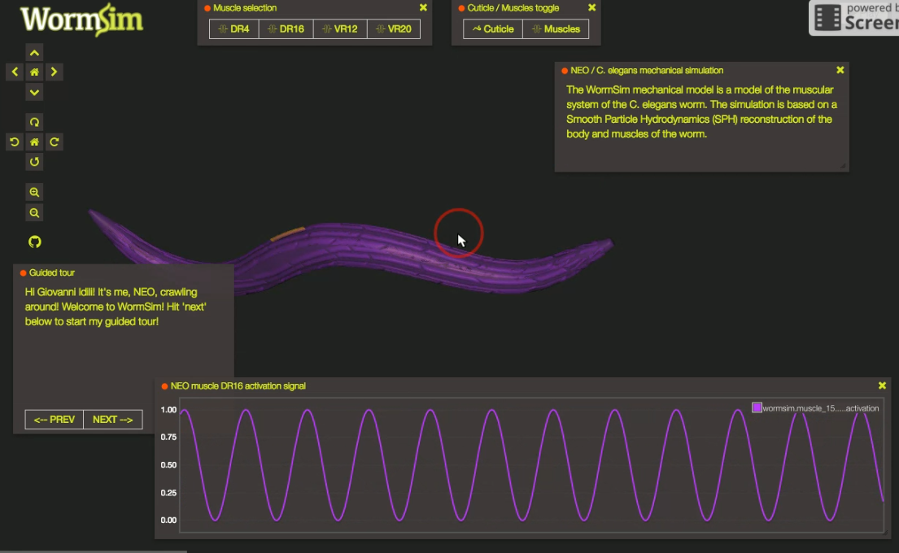

Whole worm
ADAL
c302
(Subsets of) 302 cell neuronal network in NeuroML
Head touch
pathway
Locomotion

Slide 7
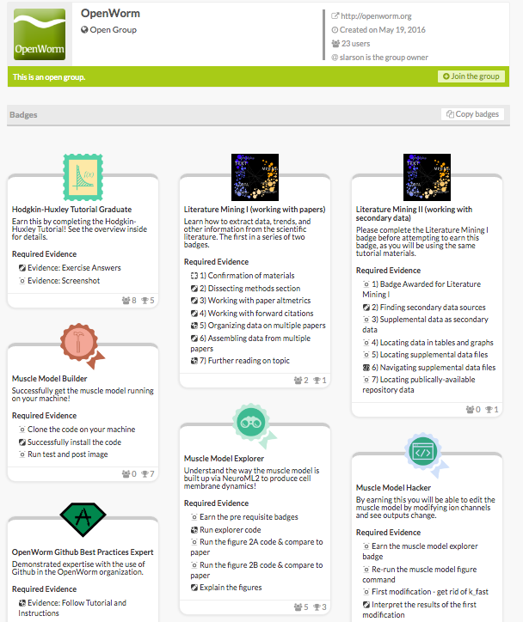
Try earning our badges at http://badgelist.com/openworm

