Slide 1
Allen Brain Observatory
http://observatory.brain-map.org/visualcoding
The Allen Brain Observatory is an in vivo survey of physiological activity in the mouse visual cortex, featuring representations of visually evoked calcium responses from GCaMP6-expressing neurons in selected cortical layers, visual areas and Cre lines.
Neuroinformatics tutorial
1.1 Experimental Datasets
Notes:
<number>

Slide 2
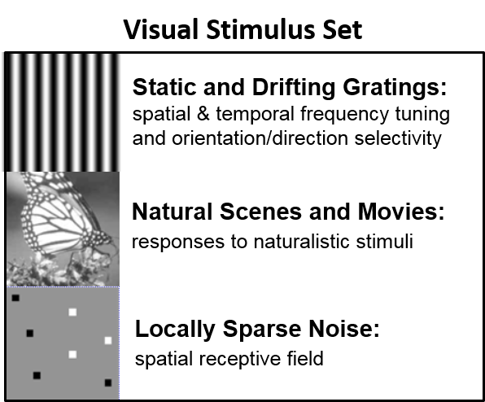
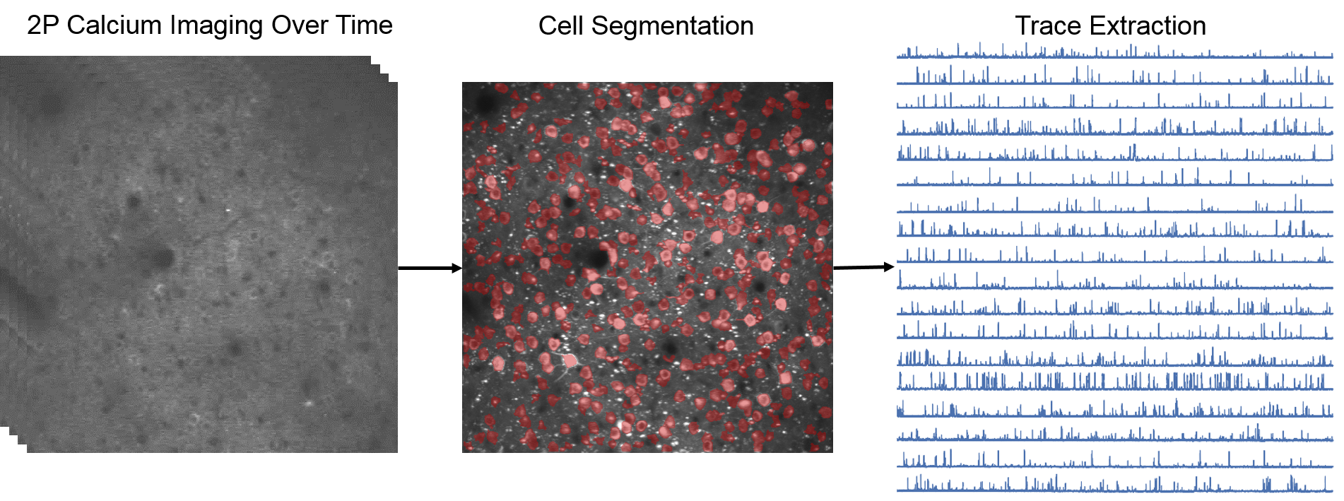
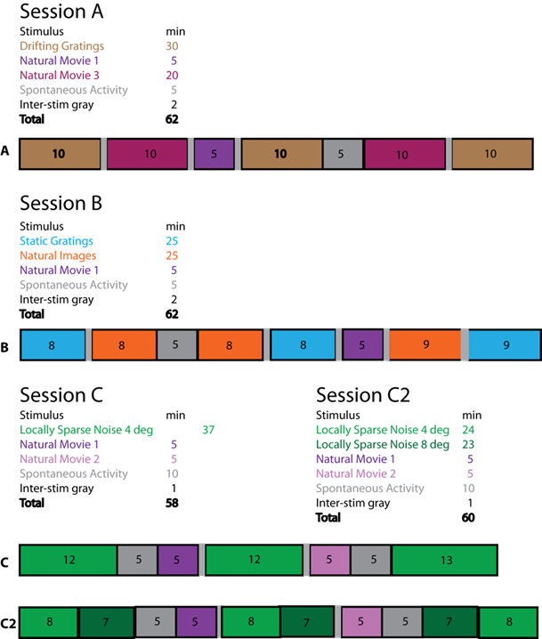
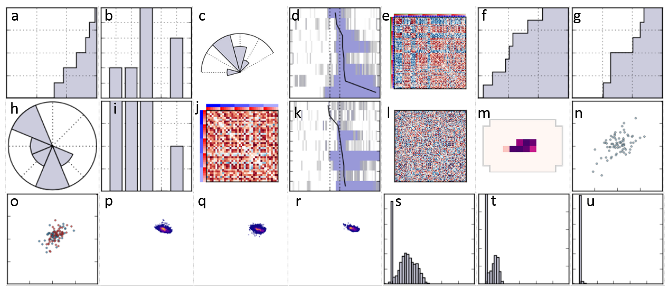
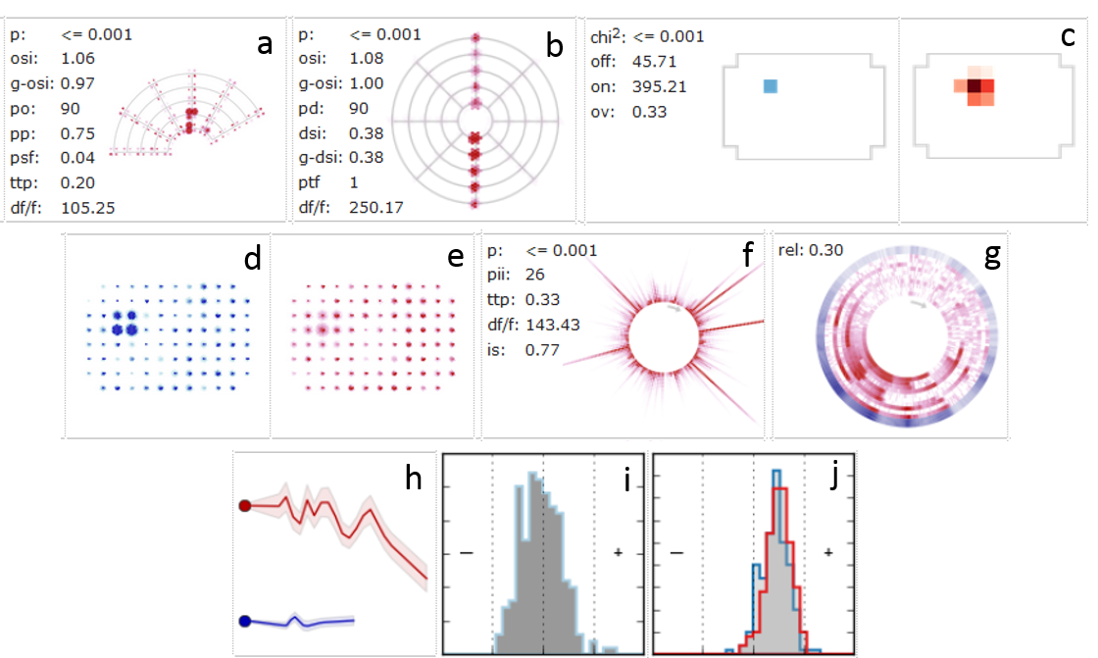
Population Responses
2016
2017
Cell Responses
Notes:
<number>
The Visual Stimulus Set includes 5 stimuli + spontaneous activity
Each experiment container includes three 1 hour long sessions
2P calcium imaging movies were collected, processed and translated into traces measuring change of fluorescence over time
From these traces, population and cellular responses were represented by thumbnails
More information on the experimental design, data analysis and population and cell response visualization is available from Documentation and Online Help (in the banner menu)

Slide 3
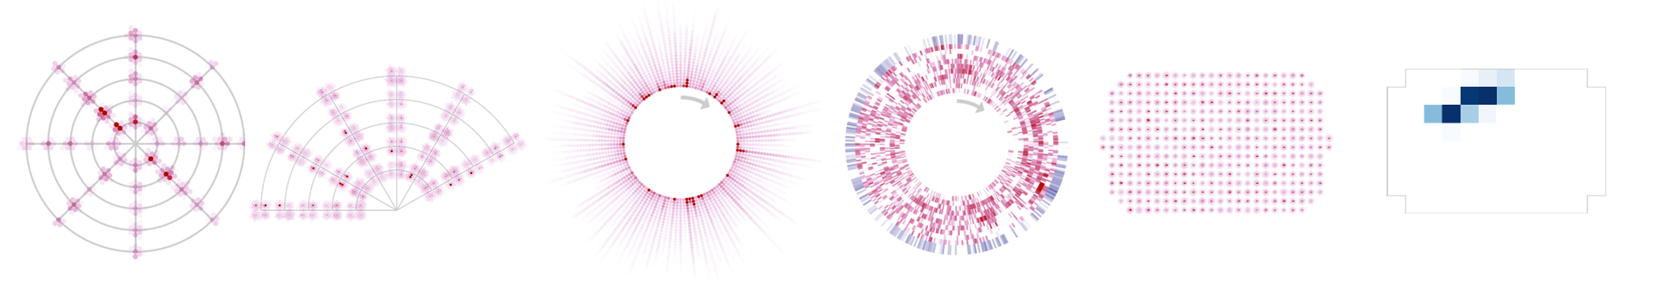
How to most effectively navigate and mine the Allen Brain Observatory – Visual Coding data set
Browse the Visual Stimuli (Drifting Gratings, Static Gratings, Natural Scenes, Natural Movies & Locally Sparse Noise) from the website to understand each stimulus, data analysis of the calcium responses, and the creation of the visualization.
Browse or search for experiments (mouse line, area of visual cortex, depth) or for cells with desired responses. See Documentation and Online Help for more information.
Download the computed features of a subset of cells (use the jupyter notebook located here) as a .csv file
Use the AllenSDK to access the NWB files for any of these experiments: to compute your own metrics, work with the fluorescent traces or analyze the eye tracking data
NWB file contents include: ROI masks, raw fluorescence for each ROI, ΔF/F for each ROI, running speed, eye tracking, motion correction (and more)
Notes:
<number>

