Slide 1
Neurodata Without Borders Neurophysiology format
http://nwb.org
A data format designed for storing neurophysiology data and related metadata in a structured manner. It currently stores the data within HDF5 files. A write API is available in Python and Matlab.
Neuroinformatics tutorial
1.3 Analysis tools
Notes:
<number>

Slide 2
NWB features
Has standard layouts for storing common Neurophysiology data types and metadata
Ability to link data between files
Extensible, e.g. allows defining schema for storing new types of data in a standard manner
Minimal library dependencies
Human-readable and self-documenting
Notes:
<number>

Slide 3
Current work/ future plans
Develop high-level read and write API
Extend to store new types of data (e.g. ECoG)
API features for HPC (High Performance Computing) environments
Allow using different backends, e.g. other than HDF5
Formation of governance board to manage the format and related tools
New version release planned by SfN 2017
Notes:
<number>

Slide 4
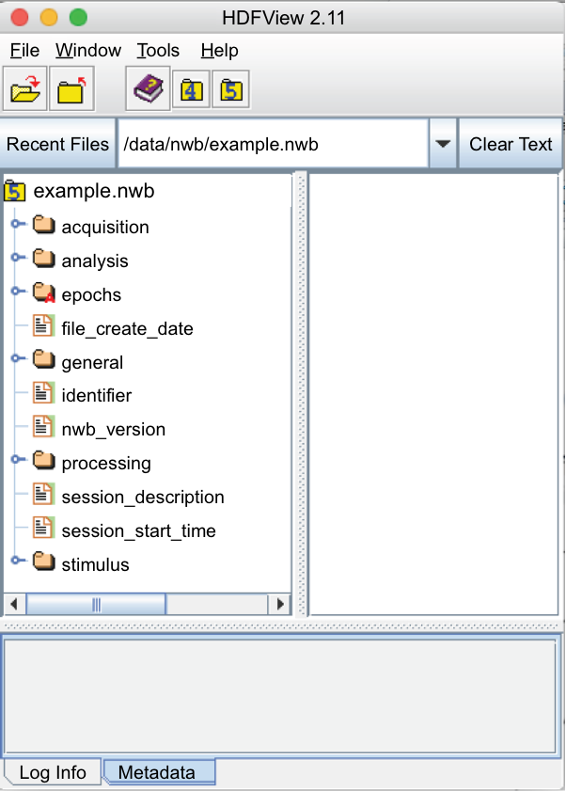
Overview of NWB format
Acquired experimental data and graphical documentation
Logical intervals that provide windows into data occurring during the interval
Metadata, including originating lab, devices, methods, etc
Intermediate processing of data, such as spike sorting
Stimuli that were presented during an experiment
HDFView is a free application for browsing HDF5 files.
Notes:
<number>

